Slide 1
2020 Intermediate Hydraulics Part 1: Open Channel Hydraulics
Course objectives and layouts
Sept.07-Nov.9
Instructor: Prof. Chan Ji Lai (賴泉基)

Slide 2
Course objectives
Understanding theory of open channel flows of various spatial and time scales.
Creating abilities of using the theory for designing practical projects related to open channel hydraulics.

Slide 3
Course layouts
1st week(09/07/2020)
Course introduction
Reviewing fundamentals of open channel hydraulics; model and governing equations
Geometry and coordinates
Classification of open channel flows, and scales,
Some discussions on 1d, 2d, and 3d modelling and the governing equations,
Uniform flow calculation

Slide 4
Course layouts
2-3th week: 9/14;9/21
Uniform flow, Gradually Varied flow(GVF) computation, and channel design.
Steady uniform flow.
Specific energy, specific momentum and control sections.
Governing equation and GVF profile classification.
GVF sketching.
Computation of GVF: directed and standard step methods.
GVF flow by numerical methods.

Slide 5
Course layouts
4th – 7th week: 9/28;10/05;10/12;10/19
Unsteady flow : Basics and Method of characteristics MOC with computations.
Propagation of disturbances and the moving control.
From governing equation to equation of characteristics.
Properties, examples of MOC.
MOC examples; Dam break problems using MOC.
Numerical MOC.;MOC tutorial

Slide 6
Course layout
8th week: 10/26
SVF Spatially varied flow and special topics
1. Governing equation and water surface profile sketching
2. Calculation of SVF.
3. Some discussion on special topics – the non-hydrostatic pressure flows
Final Exam: 11/02(or 10/29)

Slide 7
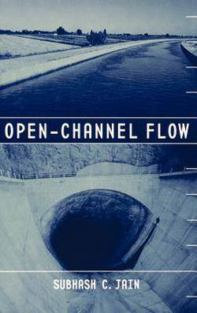
Course note and Referencing books
Text book
Subhash C. Jain, Open-Channel Flow, Wiley&Son, 2001
(see sample pdf file, not to be distributed)
Reference books:
Sturm, Terry W. Open channel hydraulics, McGraw-Hill,2001
Chaudhry, M.H., Open channel flow Springer Science,2ed,2008

Slide 8
Learning Evaluation
One assigned project 25% ; -cooperative projects
Course participation: 15%
Term examination 60%
Open channel flow is the first part of the intermediate hydraulics course, and is accounted for 50% of the total learning score.

