Slide 1
Homework_0611
PhD 2nd Year Student
T88121502 Hung-Jui Chen
2025/06/11

Slide 2
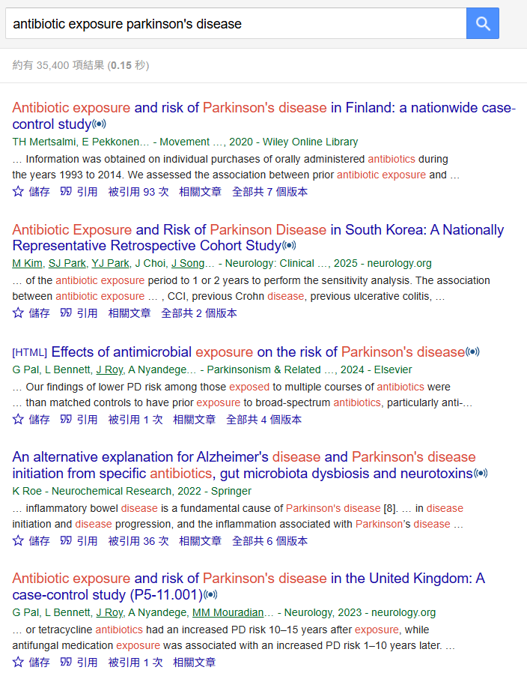
General search

Slide 3
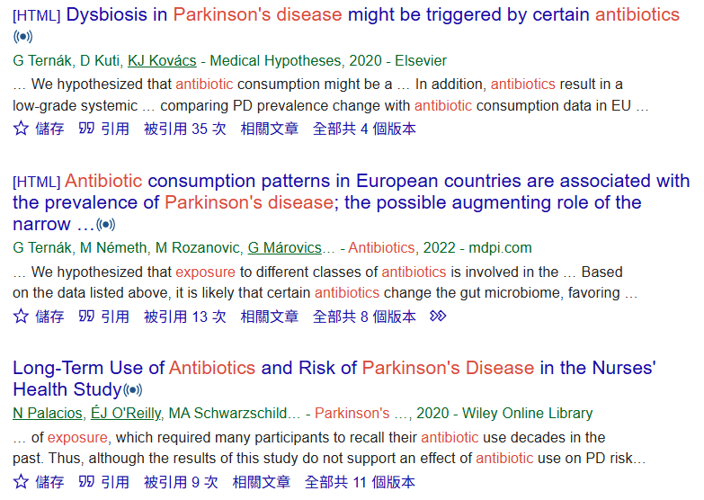
Notifying the author

Slide 4
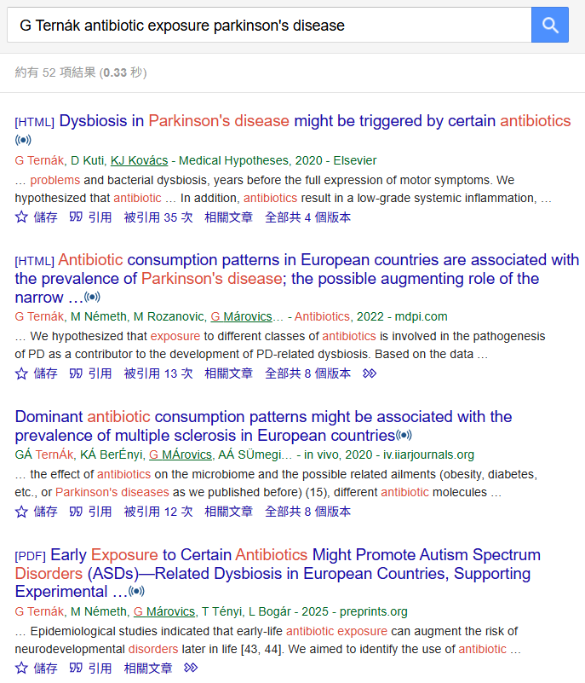
Chasing the author
with series of papers

Slide 5
Target Journals
Neurology(IF: 8.4, Q1)
Movement Disorders(IF: 7.4, Q1)
NPJ Parkinsons Disease(IF: 6.7, Q1)
Gut Microbes(IF: 12.2, Q1)
Antibiotics-Basel (IF: 4.3, Q1)

