Slide 1
Homework for Seminar Medication adherence among elderly
Nicole (2nd Master student)

Slide 2
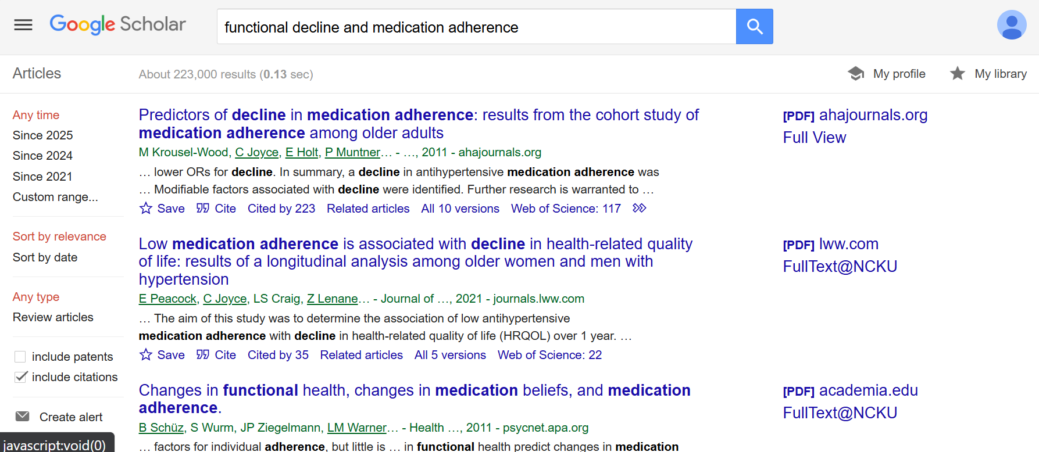
Step 1: Search for article

Slide 3
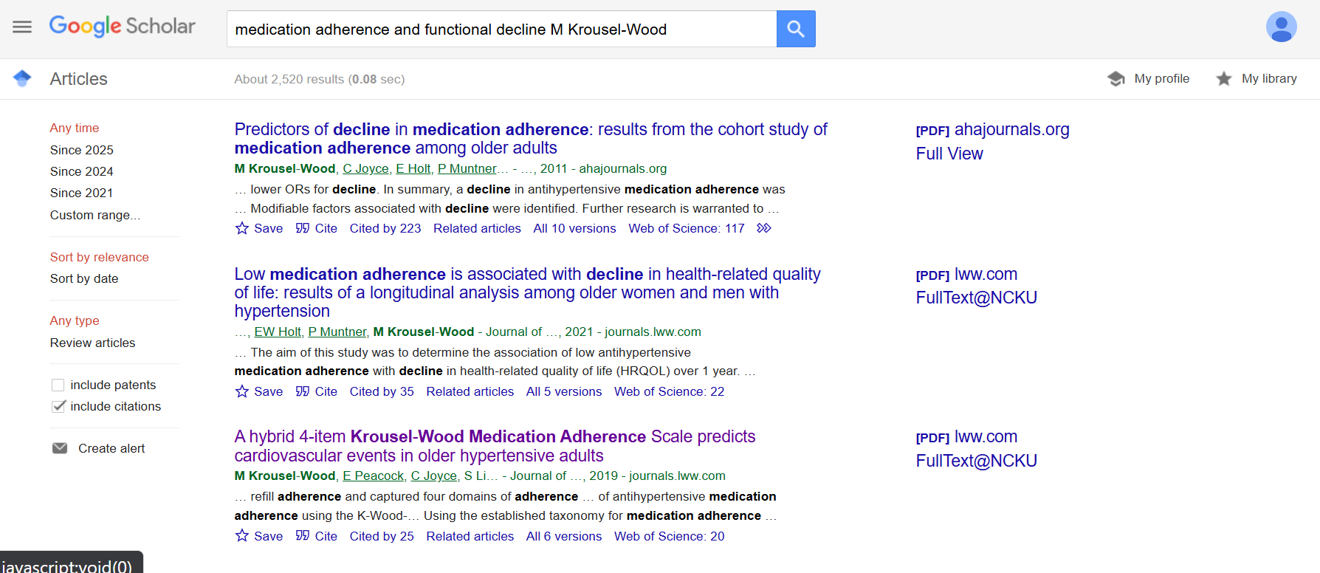
Step 2: Look up for similar articles from the same author

Slide 4
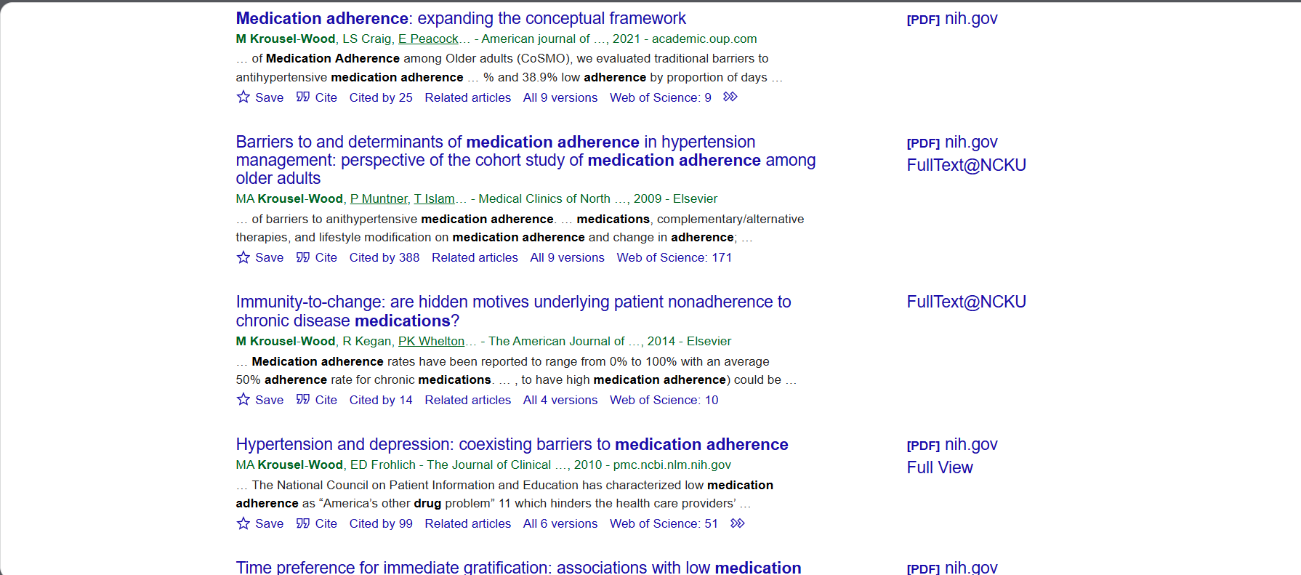
Step 2: Look up for similar articles from the same author

Slide 5
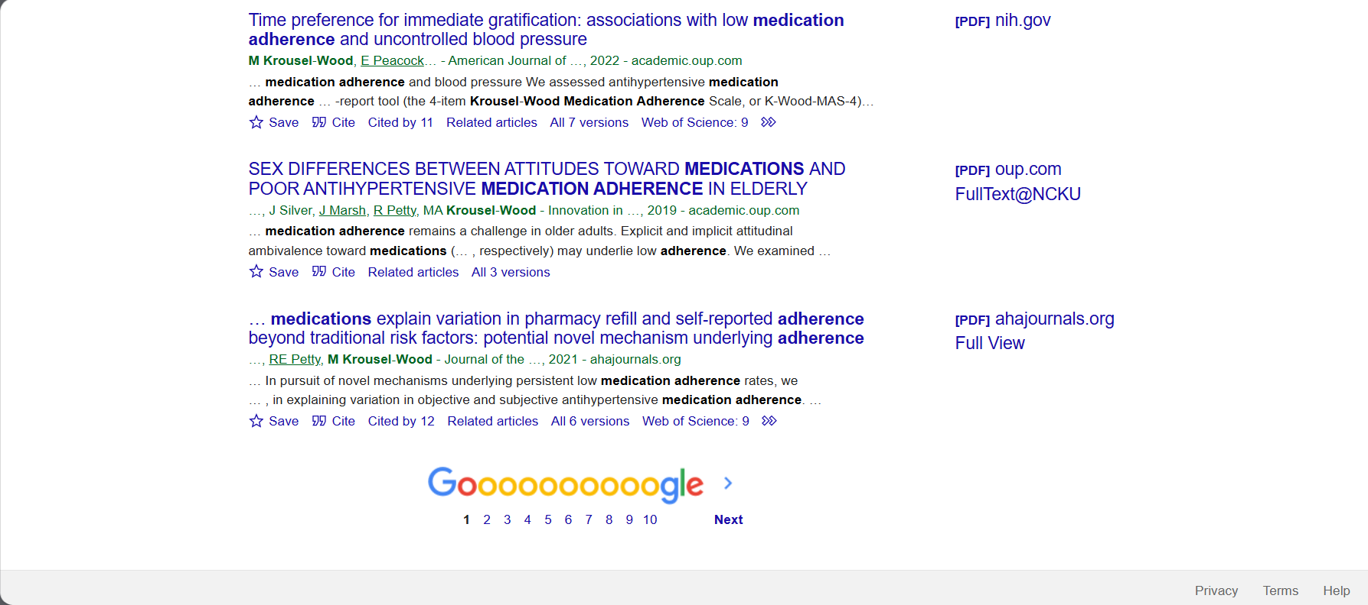
Step 2: Look up for similar articles from the same author

Slide 6
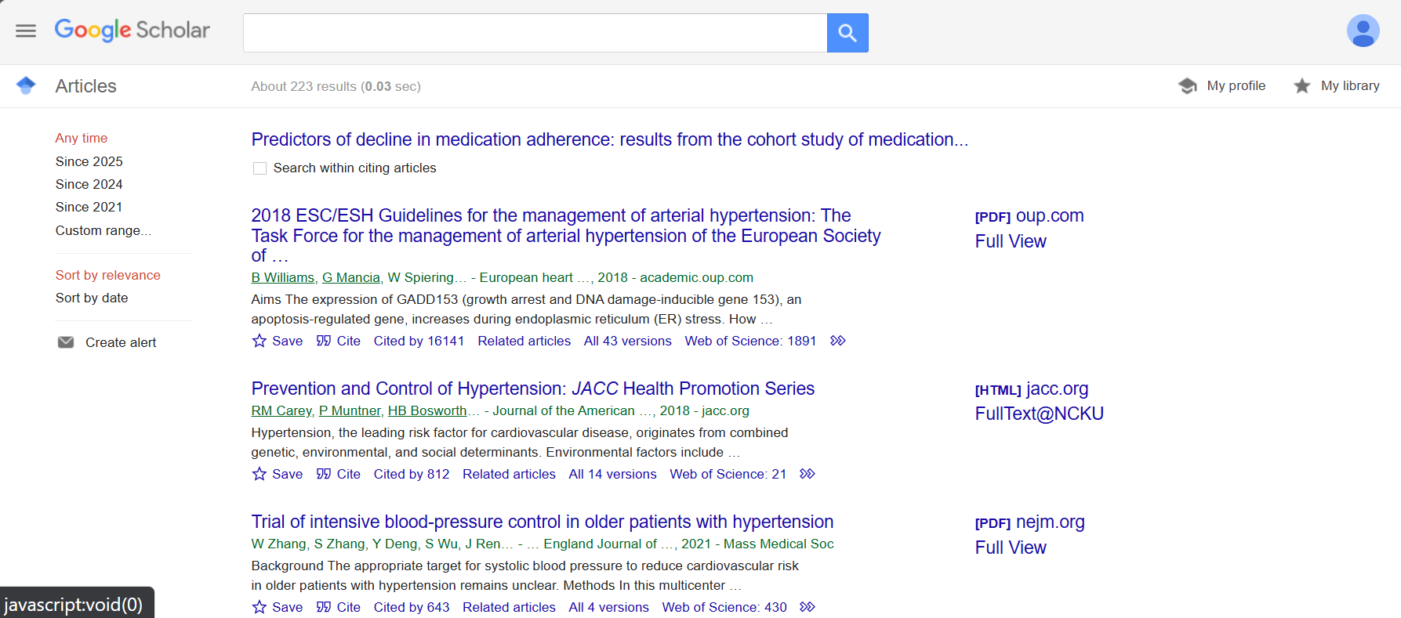
Step 3: Look up for similar articles with same interest

