Slide 1
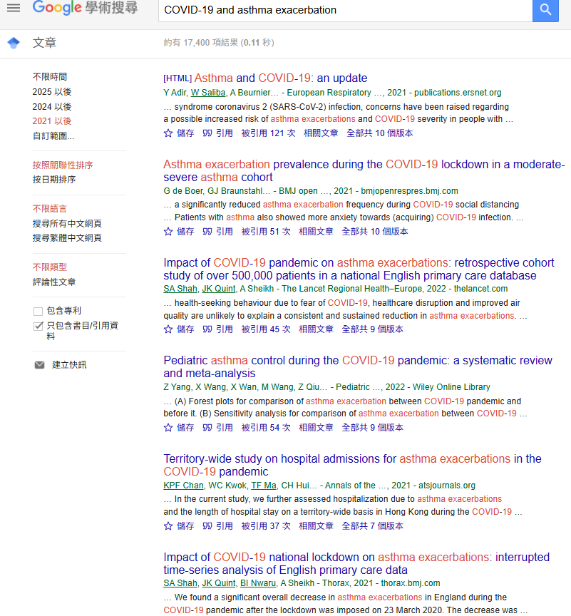
General search
Notifying the author

Slide 2
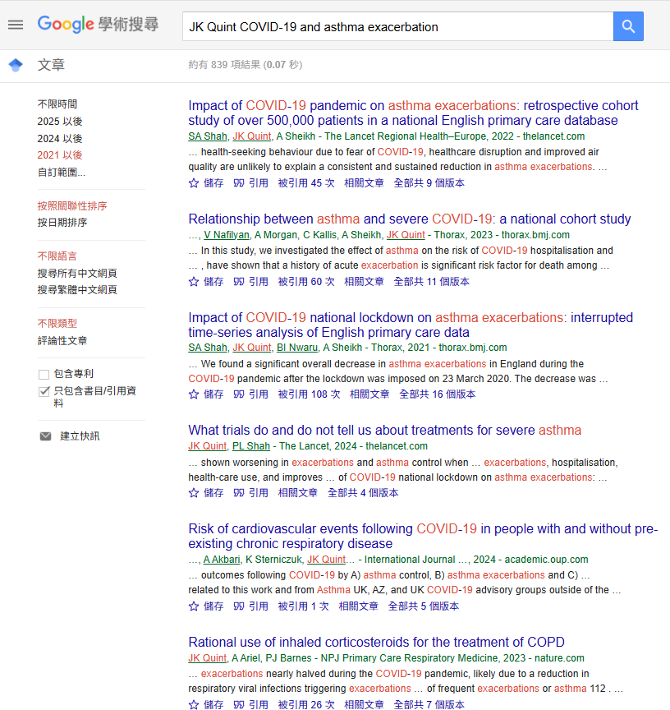
Chasing the author with series of paper

Slide 3
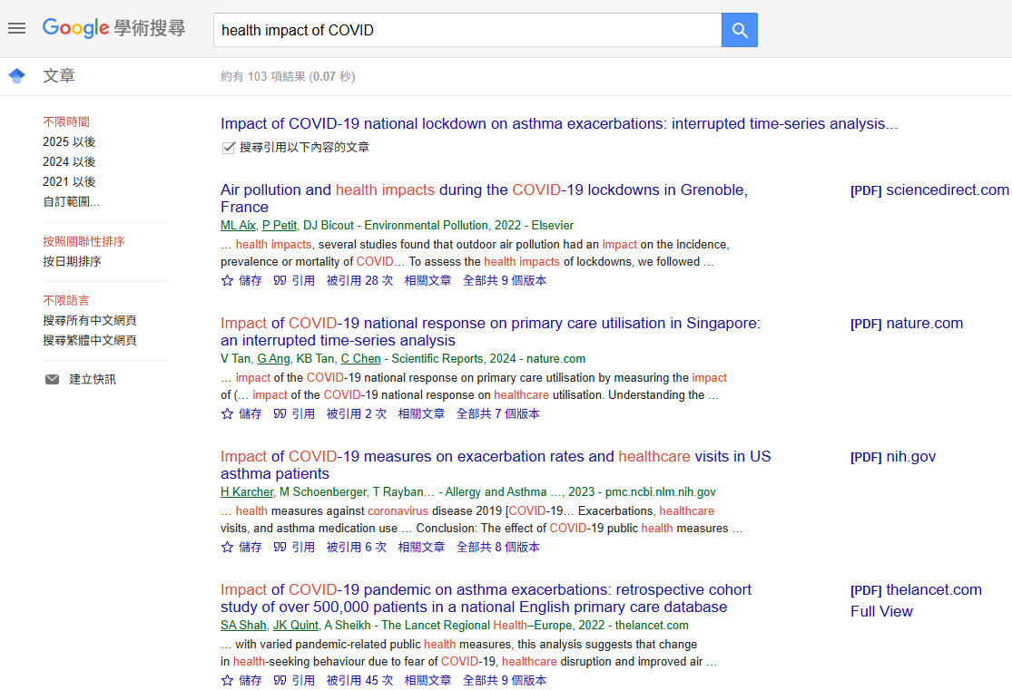
Try to find out updated relevant papers and authors

Slide 4
Target journal
Thorax (IF:10.8, Q1)
Annals of the American Thoracic Society (IF: 6.8, Q1)
International Journal of Epidemiology (IF:6.4, Q1)
BMJ open (IF: 2.4, Q1 )

