Slide 1
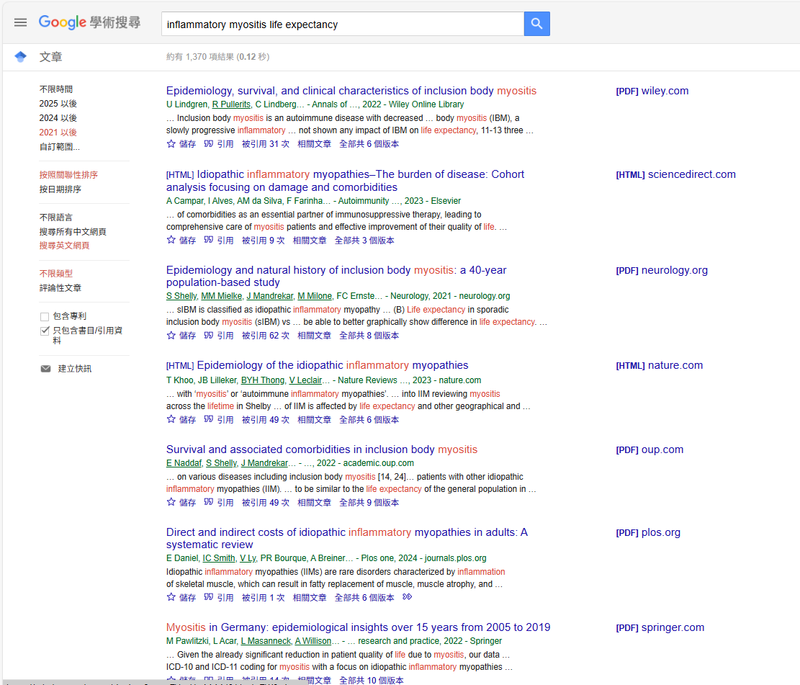
General search

Slide 2
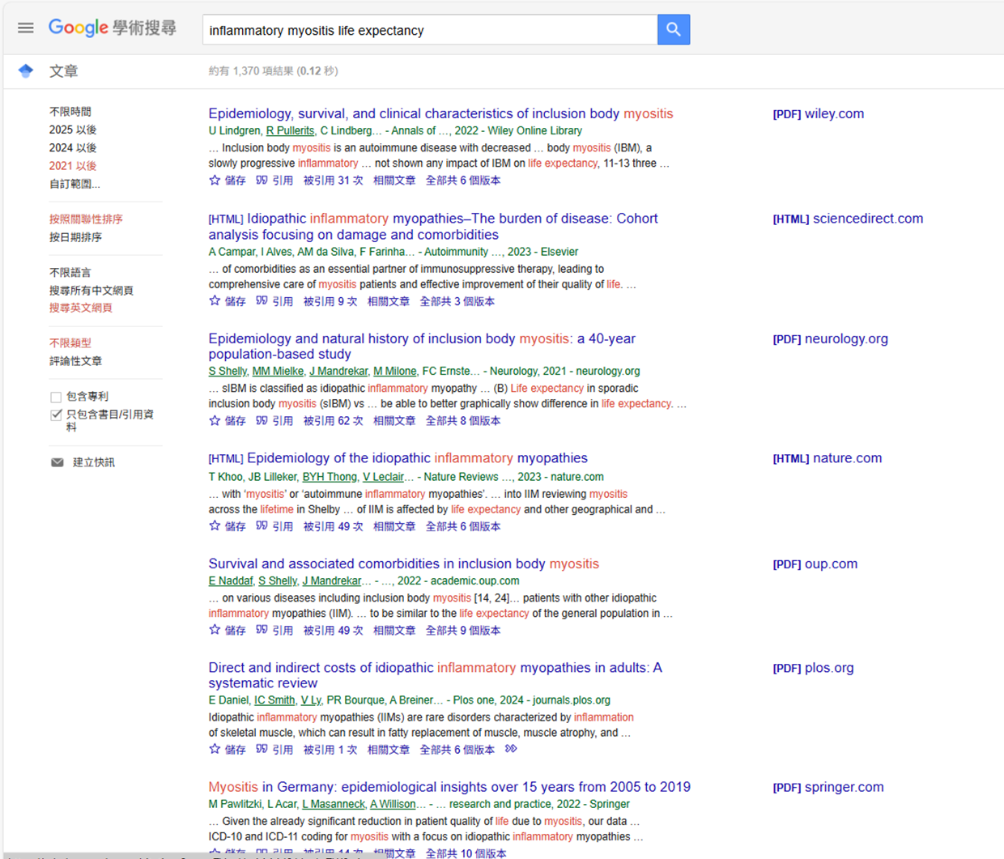
Notifying the author

Slide 3
Chasing the author
with series of papers

Slide 4
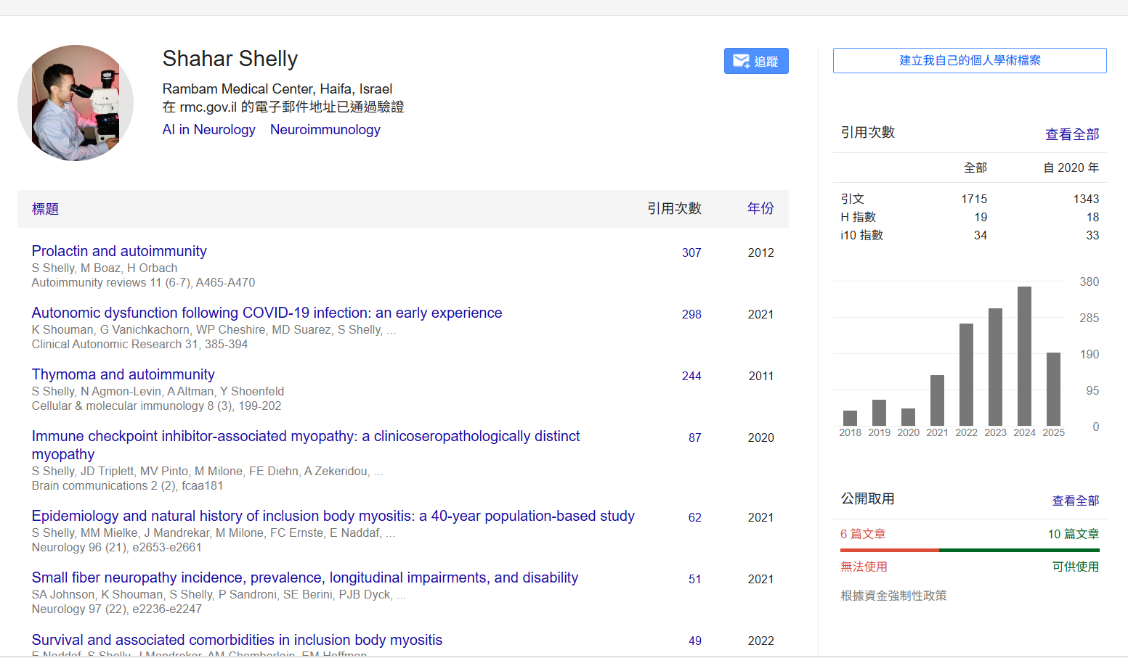

Slide 5
Lists of target journals
Neurology
Rheumatology
Muscle& Nerve
Lancet Rheumatology
Annals of Neurology

