Slide 1
Homework
Bikram Bajgain

Slide 2
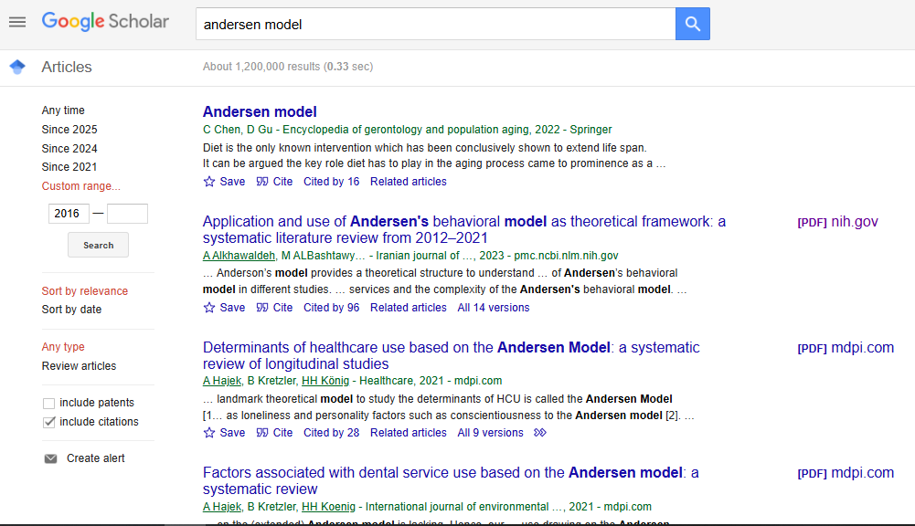

Slide 3
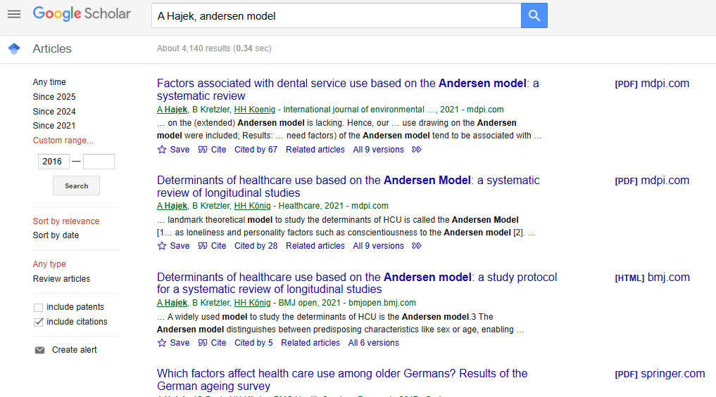

Slide 4
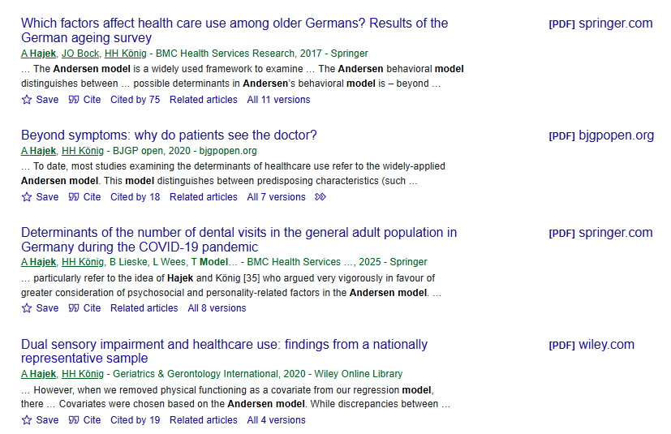

Slide 5
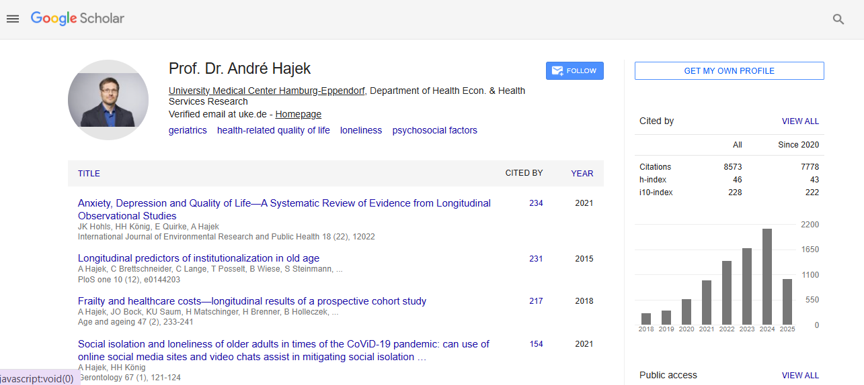

Slide 6
Target Journels
International Journal of Environmental and Public Health
Journal- Healthcare
BMJ Journal
BMC Health Services

