Slide 1
Jheng-Yan Wu
2025.06.11

Slide 2
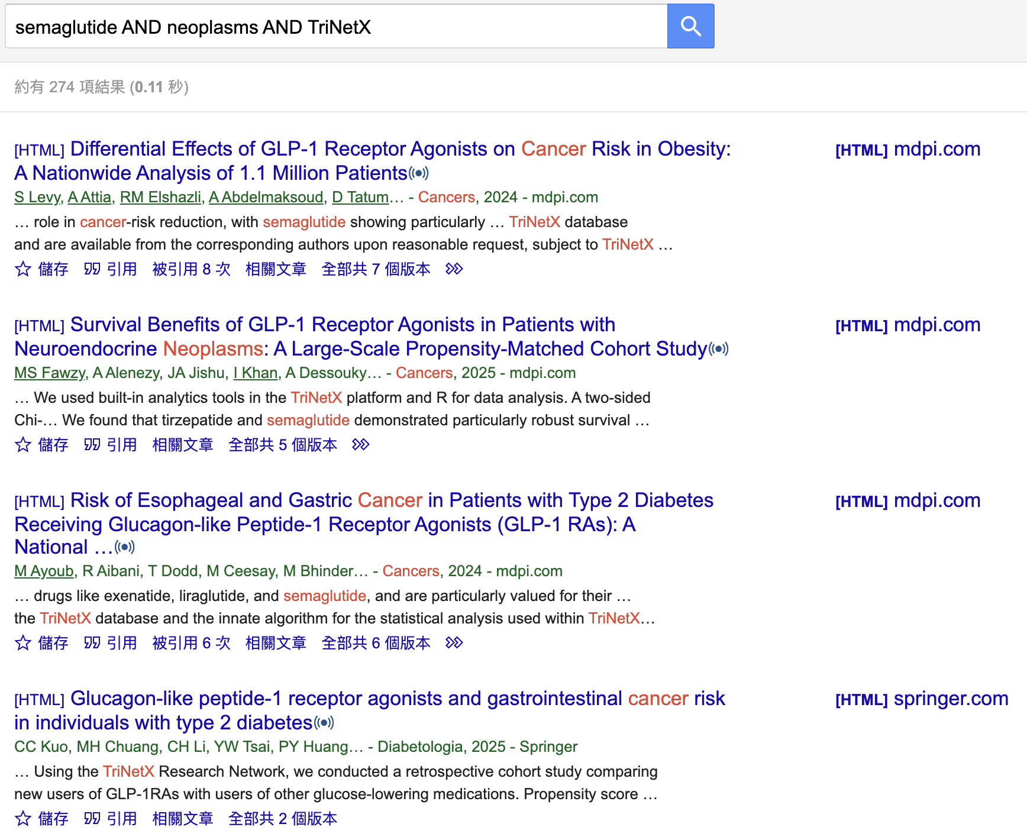
1. General search

Slide 3
2. Notifying the author

Slide 4
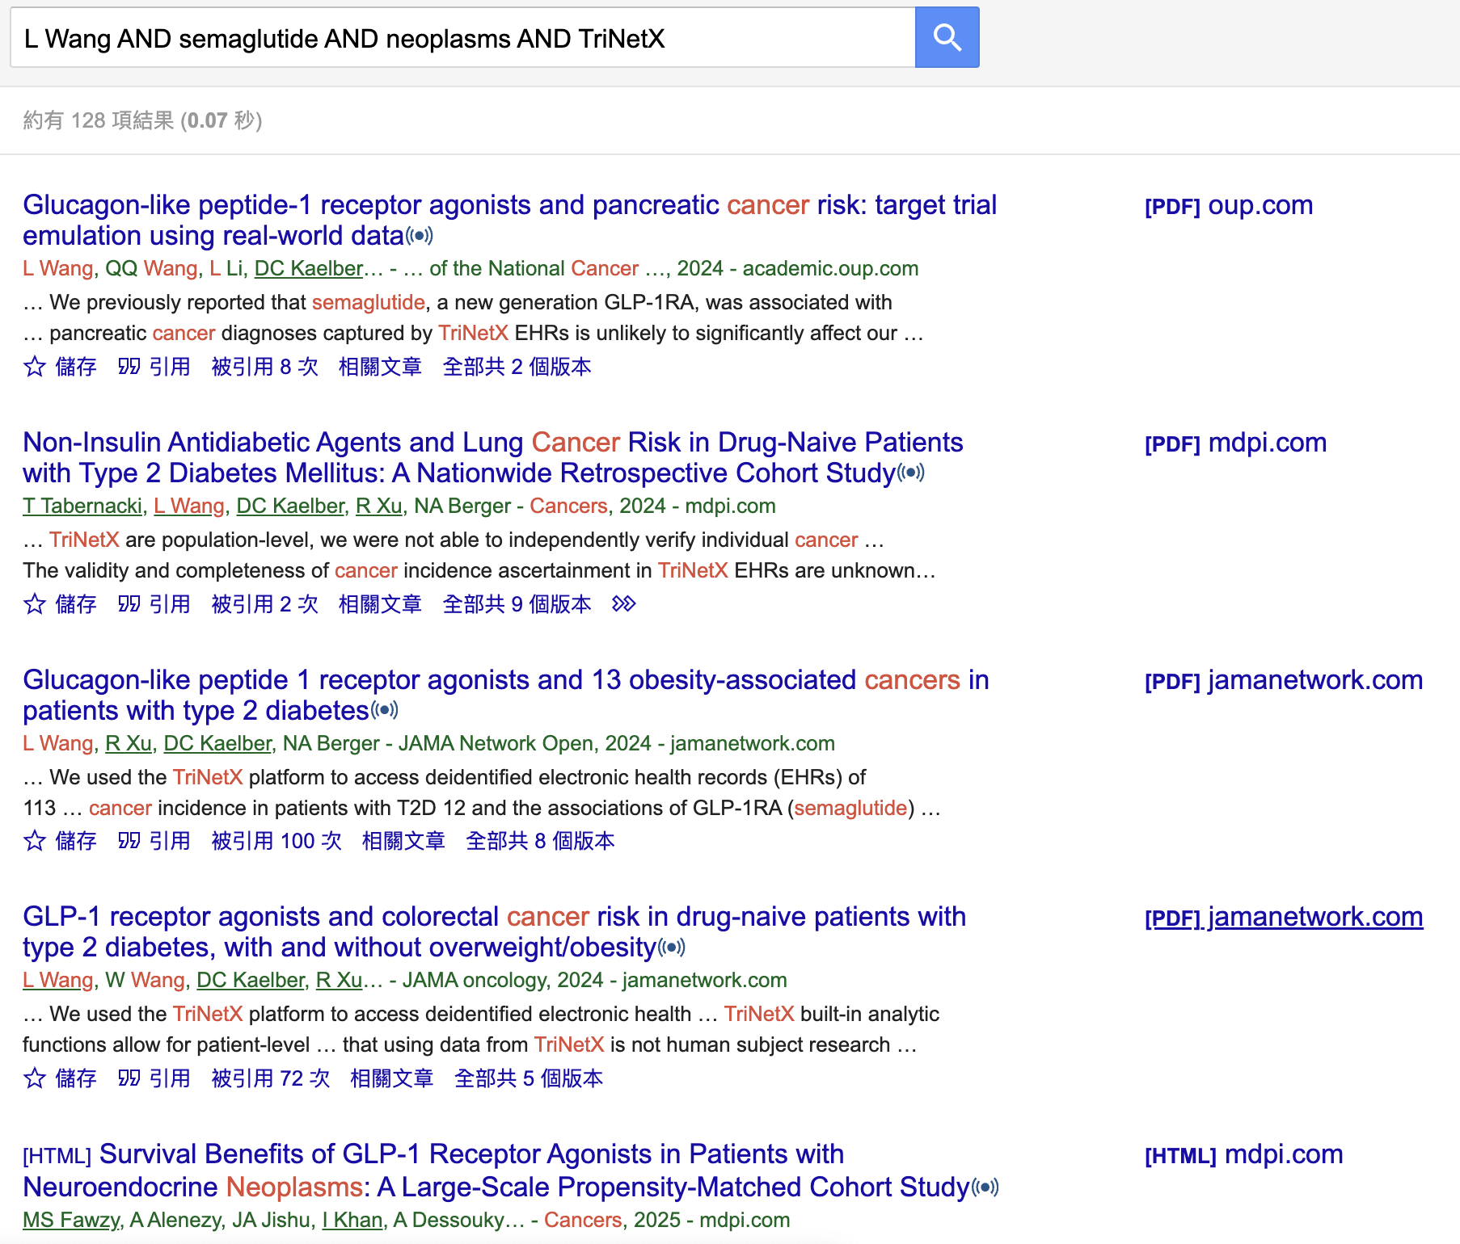
3. Chasing the author with series of papers

Slide 5
Target Journals
JAMA Oncology (IF 22.3, Q1)
JAMA Network Open (IF 10.5, Q1)
Journal of the National Cancer Institute (IF 10.0, Q1)
Diabetologia (IF 8.4, Q1)
European Journal of Cancer (IF 7.6, Q1)
Cancers (IF 4.5, Q1)

