Slide 1
Comment for Mita’s Paper 1
Commentor:
2nd Year PhD student
Chiu- Wen Chang (T88121015)
2025.03.19

Slide 2
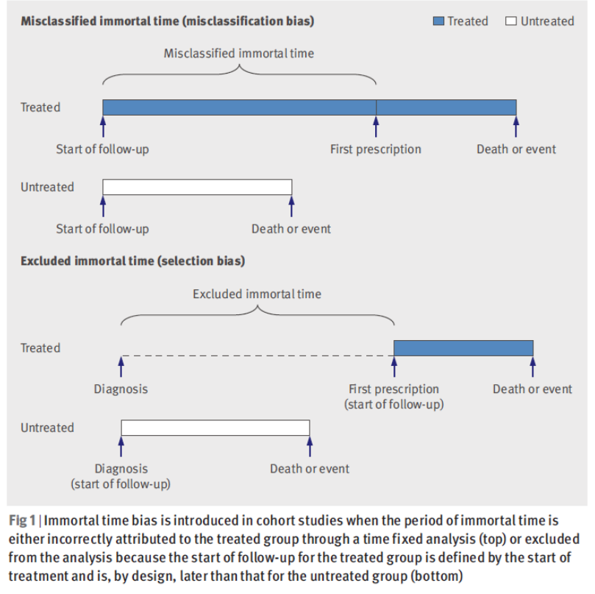
Comment 1
In pharmaco-epidemiology studies, immortal time typically arises when the determination of an individual’s treatment status involves a delay or wait period during which follow up time is accrued.
The immortal time bias in the rate ratio resulting from misclassified or excluded immortal time increases proportionately to the duration of immortal time.
Q. In this study, it estimated a small decrease in the probability of successful treatment for 7–11 months compared with 6 months of BDQ. Do you think there is misclassification of treatment? How do you explain the impact?

Slide 3
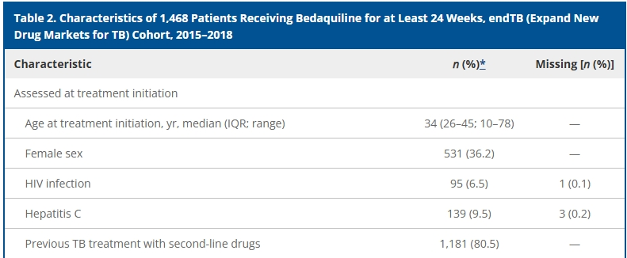
Comment 2
Q2. The characteristics of participants, there are 80%(n=1,181) of previous TB treatment with second-line drugs. Could it influence the results?
Q3.There are 10%(n=149) of missing with extensive disease. Could it influence the results?

