Slide 1
Healthcare Services Utilization Among International Students in Turkey
Insights from Massal et al. (2021)
BMC Health Services Research
Presenter- Bikram Bajgain
Advisor- Prof. Mayeesha

Slide 2
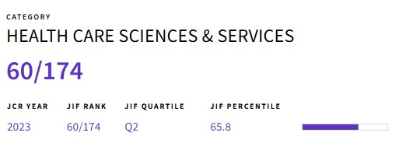
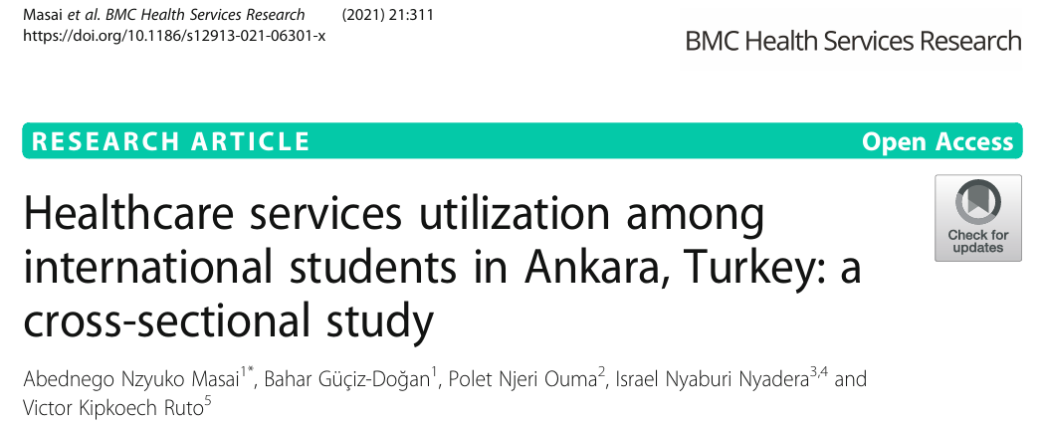

Slide 3
Introduction
International students face challenges while adapting to a new country, which affect their physical and psychological health and wellbeing. (Mesidor et.al 2016)
International students in Turkey, a growing population of over 185,000 in 2020, face unique challenges in accessing healthcare.

Slide 4
Challenges
Starting to live in a new country brings numerous challenges to international students because of culture and language differences.
They have to deal with the people, society, school, psychological status, and behavioral changes in order to adapt to the new environment. (Wu et.al 2015)
International students face barriers in accessing health-care services in many countries, often do not sufficiently benefit from available healthcare, and delay seeking healthcare services when they are ill. (Martin et.al 2017)

Slide 5
Aim Of the Study
To investigate healthcare access among a group of international students studying in Ankara city (Turkey) and identify potential barriers that affect full healthcare utilization.

Slide 6
Methods
Independent variables
Factors affecting healthcare access
Dependent Variables
Utilization of healthcare services
Study Design: Cross-sectional, online survey (Sep–Oct 2020)
Population: 535 international students from 83 countries at 7 public universities in Ankara
Gender
Age
Country
Chronic Disease
Duration of Stay
Ease of Communication
general practitioner
student health centres (SHC)
hospital admissions
dental,
Emergency
mental health services

Slide 7
Methods
Sampling: Non-probabilistic, convenience sampling
The Computer and Information Department of the Presidency of Turks Abroad and Related Communities received the electronic questionnaire and uploaded it to the Student Information System (TBBS).
Survey Instrument: Validated semi-structured questionnaire
Sociodemographic, health status, and healthcare utilization data

Slide 8
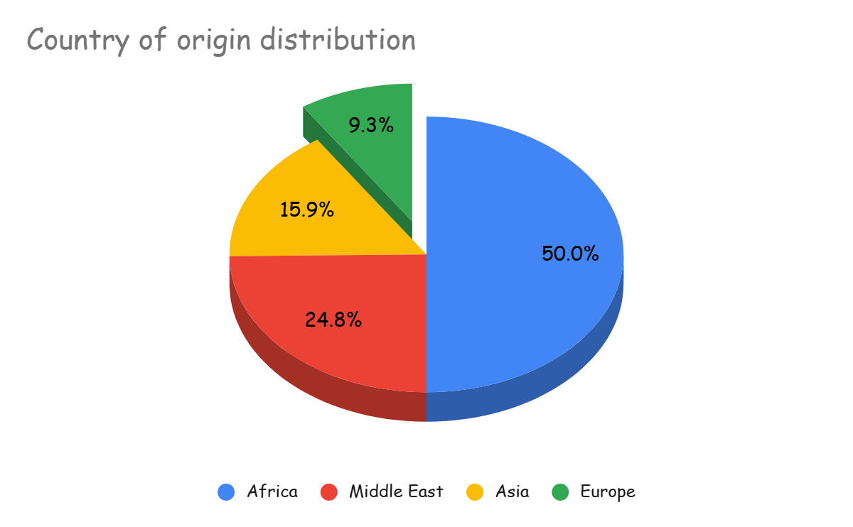
Result Key Demographics
Participants: 535 students (54% male, 46% female)
Age: Mean 25 years (range: 18–39)
Regions of Origin:
Africa (49.2%), Middle East (24.4%), Asia (15.6%), Europe (9.2%)
Health Insurance: 100% covered; 48.8% had no prior insurance

Slide 9
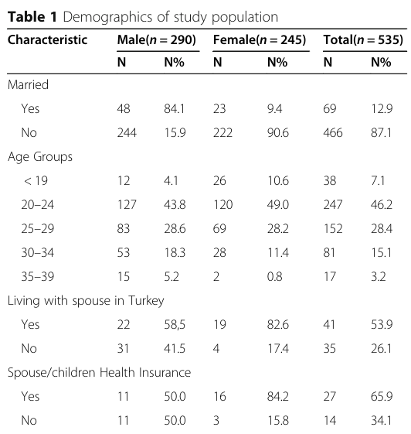
Demographics
Married: 69 (12.9%)
Unmarried: 466 (87.1%)
Age group <19
Females > Male
Age Group 30-34
Males proportion > female
Health Insurance
Female: 16 (84.2%) > Male: 11 (50%)

Slide 10
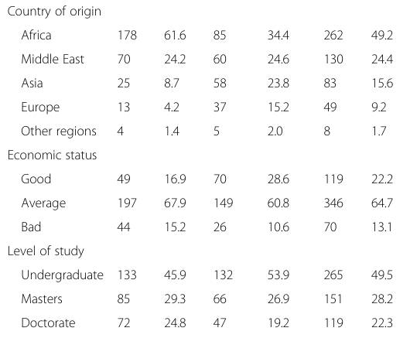
Economic Status
Economic status (Overall)
Good: 119 (22.2%)
Average: 346 (64.7%)
Bad: 70 (13.1%)
Good Economic Status
Females (28.6%) > Males 16.9%
Males (15.2%) > Female (10.6%)

Slide 11
Results Life style and Habits
Males are significantly more physically active than females
Notes:
Males are significantly more physically active than females, which may reflect cultural or social differences in exercise habits. Higher physical activity could correlate with better overall health, potentially reducing healthcare needs.

Slide 12
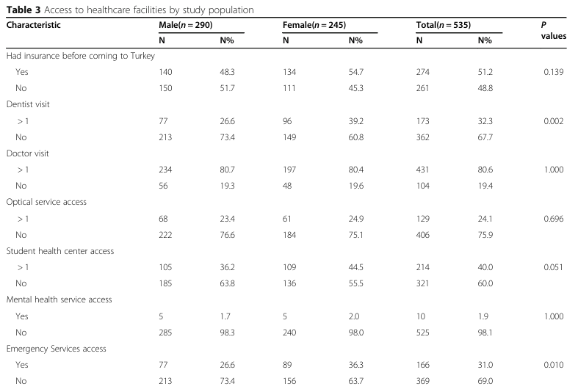
Access to Healthcare Facilities
Dental Visit
Total: ≥1 visit: 173 (32.3%)
No visits: 362 (67.7%)
Extremely low mental health service use (1.9%)
Notes:
Females accessed dental services significantly more than males, consistent with the article’s findings that females have higher health-seeking behaviors.

Slide 13
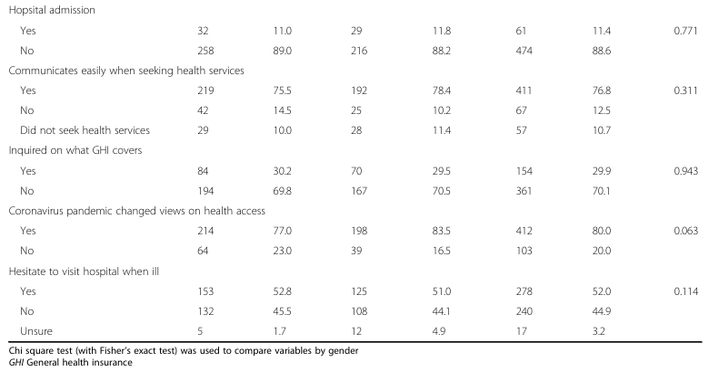
Access to Healthcare Facilities
Low Hospital Admission: Total:
Yes: 61 (11.4%)
No: 474 (88.6%)
.
Notes:
Low hospital admission rates reflect the young, relatively healthy population, with no gender difference. The article notes higher admissions among those with chronic diseases, indicating targeted healthcare needs

Slide 14
Model 1 Hospital Admission
Hospital admissions are strongly associated with chronic disease (8.28 times higher odds)
Hospital admissions are associated with longer stays.
Notes:
Hospital admissions are strongly associated with chronic disease (8.28 times higher odds) and increase with age and longer stays (e.g., 2 years), though only age and chronic disease are statistically significant. This suggests that health needs, rather than gender or communication ease, drive hospital use.

Slide 15
Model 2 Access to Dentist
Females are twice as likely to access dental services.
Europe and the Middle East have higher odds compared to Africa
Longer the stay higher the Dental service Use
Notes:
Hospital admissions are strongly associated with chronic disease (8.28 times higher odds) and increase with age and longer stays (e.g., 2 years), though only age and chronic disease are statistically significant. This suggests that health needs, rather than gender or communication ease, drive hospital use.

Slide 16
Model 3 Access to SHC
Access to SHC is least associated with 5th year of stay.
Access to SHC is associated with ease of communication
Notes:
Hospital admissions are strongly associated with chronic disease (8.28 times higher odds) and increase with age and longer stays (e.g., 2 years), though only age and chronic disease are statistically significant. This suggests that health needs, rather than gender or communication ease, drive hospital use.

Slide 17
Model 4 Access to ED
Access to Emergency Departments are associated with chronic disease (2.56 times higher odds)
Notes:
Hospital admissions are strongly associated with chronic disease (8.28 times higher odds) and increase with age and longer stays (e.g., 2 years), though only age and chronic disease are statistically significant. This suggests that health needs, rather than gender or communication ease, drive hospital use.

Slide 18
Model 5 Access to GP
Access to GP is highly associated with 4th year of stay
Notes:
Hospital admissions are strongly associated with chronic disease (8.28 times higher odds) and increase with age and longer stays (e.g., 2 years), though only age and chronic disease are statistically significant. This suggests that health needs, rather than gender or communication ease, drive hospital use.

Slide 19
Discussion
Findings from the study showed that 52.0% (n=278) of participants hesitated to visit the hospital when they were sick.
The findings are consistent with a study by Skromanis and colleagues (2017), which demonstrated that international students regarded their health problems as minor and felt that they could manage their health challenges on their own.
The study showed that students who had lived in Turkey for more than 5 years accessed ED, GP, and dental services more.
They have social support networks and understand the organization of the local health system. Therefore, these students access and utilize health services more compared to students who have a shorter stay.

Slide 20
Discussion
Students with a longer stay adapt to the social, culture, and language of the host countries.
Extremely low mental health service use (1.9%) reflects significant barriers, particularly perceived stigma (22.6% feared seeking help due to being foreigners). The lack of gender difference suggests stigma affects both groups.

Slide 21
Strength
Diversity of the study population: Participants from 83 countries were enrolled in the study.
The study also managed to recruit a relatively large sample of both male and female participants.
Limitations
Students paying for their education expenses were not included in the study.
The findings of this study provide information on healthcare access and utilization among international students in Turkey on scholarship who receive healthcare insurance.

Slide 22
Study Appraisal
Strengths:
Diverse sample: 535 students from 83 countries, representative of international students in Turkey.
Validated questionnaire, statistical analysis (ANOVA, Chi-square, logistic regression) using SPSS v25.
Limitations:
Excludes self-funded students, limiting generalizability.
Cross-sectional design: Cannot establish causality.
Limited "why" exploration: Focuses on barriers (e.g., language, stigma) but not underlying reasons.
Paper indicated lack of awareness of healthcare support systems, perceived stigma associated with mental health services, and language barriers were the main barriers affecting healthcare access by international students however, failed to provide enough evidence to support this conclusion.

Slide 23
Comment
20250528 Pi-Ling Wang

Slide 24
Main Point
The paper says it aims to explore potential barriers affecting international students’ use of healthcare services
My Concern
But when I looked at the questionnaire and analysis, it seems like the study mostly focuses on descriptive data and yes/no usage patterns — not really on the “why” behind the behavior.
1.Does this kind of design really answer the research question?
My Question to Discuss
2.If we want to go deeper into the “underlying reasons,” what other methods or theoretical models could we use?

Slide 25
Comment 1
I agree that the study is descriptive and doesn’t try to answer “Why” question but focuses on “What” because the aim of the study is to investigate healthcare utilization among a group of international students studying in Ankara, Turkey, and to identify potential barriers that affect their full utilization of healthcare services.

Slide 26
Comment 1
Addressing Patterns of Utilization
Yes: The cross-sectional design captures a snapshot of healthcare utilization (e.g., 80.6% accessed GPs, 40% used SHCs, 1.9% accessed mental health services, Table 3). Descriptive statistics and regression analyses (Table 4) identify patterns by gender, duration of stay, and chronic disease status, effectively answering the "what" of utilization.
Identifying Barriers
Yes: The design identifies key barriers—lack of awareness (29.9% inquired about insurance), language barriers (12.5% communication issues), and stigma (22.6% feared mental health help, Tables 3 and 4). Logistic regression (e.g., OR = 2.37 for ease of communication with SHC access) quantifies their impact.

Slide 27
Comment 2
Qualitative Methods (e.g., Interviews and Focus Groups)
Qualitative methods allow for in-depth exploration of personal experiences, beliefs, and cultural factors driving behaviours. For instance, semi-structured interviews with international students could reveal why they hesitate to seek care (52% hesitated, Table 3) or fear mental health stigma (22.6% reported fear).
Andersen’s Behavioural Model of Health Services Use:
This model categorizes factors influencing healthcare use into predisposing (e.g., demographics), enabling (e.g., access to insurance), and need factors (e.g., chronic disease). It can help dissect why students with chronic diseases have higher hospital admissions (OR = 8.28, Table 4) or why females access more services.

Slide 28
Thank you

Slide 29
Alternative method
Qualitative Methods (e.g., Interviews and Focus Groups): Why It Works: Qualitative methods allow for in-depth exploration of personal experiences, beliefs, and cultural factors driving behaviours. For instance, semi-structured interviews with international students could reveal why they hesitate to seek care (52% hesitated, per Table 3) or fear mental health stigma (22.6% reported fear, per the study).
Reference: Creswell, J. W., & Poth, C. N. (2018). Qualitative Inquiry and Research Design: Choosing Among Five Approaches. Sage Publications. This book highlights how qualitative methods like interviews can provide rich, contextual data to complement quantitative findings.

Slide 30
Alternative model
Health Belief Model (HBM):
Why It Works: The HBM explains health behaviors based on perceptions, such as perceived barriers, benefits, and susceptibility. It can help understand why students hesitate to seek care or avoid mental health services due to stigma.
Reference: Rosenstock, I. M. (1974). The Health Belief Model and preventive health behavior. Health Education Monographs, 2(4), 354–386. This foundational paper outlines how HBM can predict health-seeking behaviors based on individual perceptions.

Slide 31
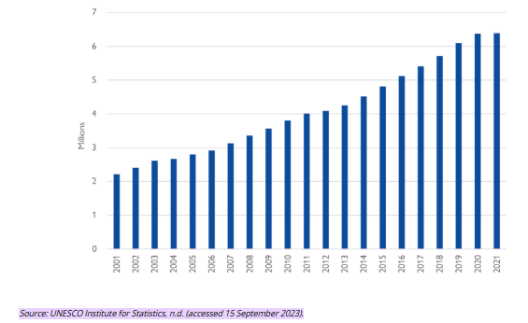
A Global Overview
Background Data
According to World Migration Report, the number of internationally mobile students globally has significantly increased over the last two decades.
In 2001, this number was at just over 2.2 million.
Between 2020 and 2021 – at the height of the pandemic – the number of internationally mobile students increased slightly (from 6.38 million to 6.39 million), defying expectations.

Slide 32
In 2020, the number of international students in Turkey amounted to 185,000, and during the period from 2017 to 2020, the average annual enrollment rate increased up to 15%. (Council of Higher Education, Turkey)

Slide 33
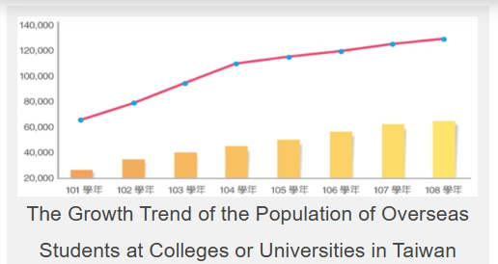
International students trend in Taiwan
As of 2021, over 130,000 foreign students are enrolled in Taiwanese universities, contributing to academic and cultural exchange.
Ministry of Education, Taiwan, 2021).

Slide 34
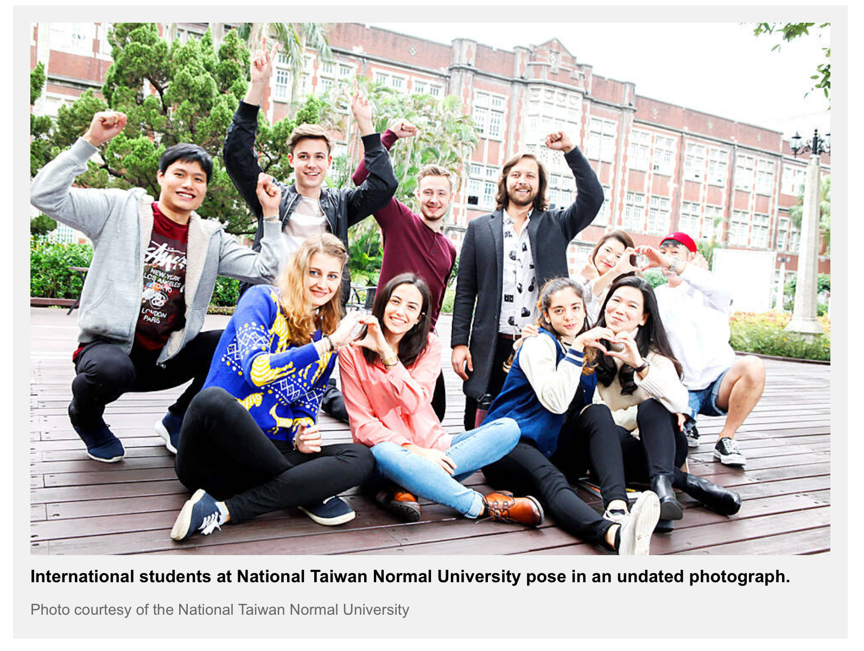

Slide 35
In addition to each university’s own scholarship schemes to attract international students to study in Taiwan, the Ministry of Education also offers the Taiwan Scholarship Program to international students and runs the Taiwan Experience Education Program (TEEP) to encourage more international students. British Council

Slide 36
Statistical Analysis
Statistical analyses were conducted using IBM SPSS statistics version 25.
ANOVA and Chi-square tests (with Fisher’s exact test)were used to compare variables.
Post-hoc used to identify the source when significant differences were identified.
Logistic regression to evaluate the relationships between variables related to access to health services.

