Slide 1
Sexual and Reproductive Health Outcomes Among Adolescent Females During the COVID-19 Pandemic
Presented by: Yen-Chun, Wang
1st Year PhD Student
Supervisor: Prof. Chung-Ying Lin
May 28, 2025

Slide 2
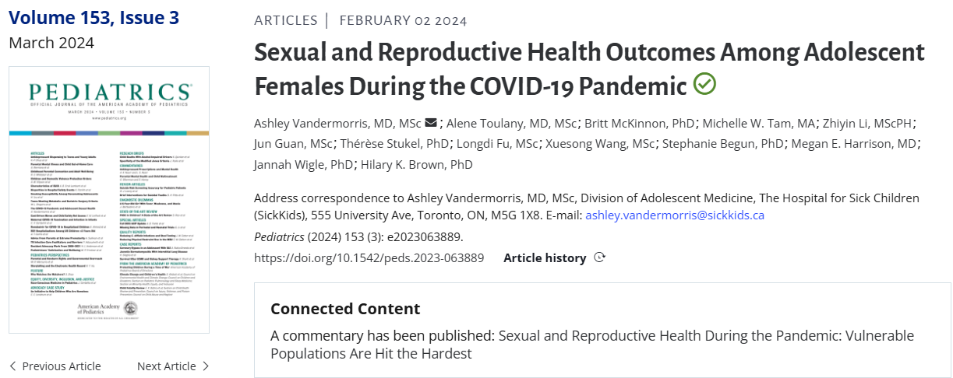
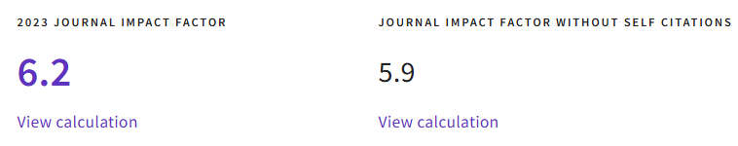
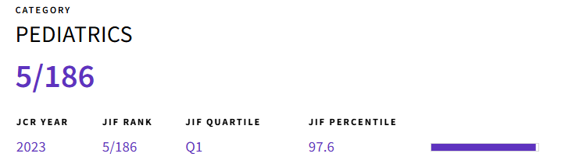

Slide 3

First Author
Introduction
Methods
Results
Discussion
Conclusion
Ashley Vandermorris
Assistant Professor, Department of Pediatrics,
University of Toronto
The Hospital for Sick Children (SickKids), Toronto, Ontario, Canada
Focus on supporting youth navigating the intersections of structural and social determinants of health to achieve healthy developmental trajectories.

Slide 4
Introduction
Introduction
Methods
Results
Discussion
Conclusion
Globally, the COVID-19 pandemic posed a significant threat to adolescent sexual and reproductive health (ASRH).
It disrupted fundamental aspects of normative adolescent developmental trajectories, resulting in alterations in peer and romantic interactions, differences in parental supervision, changes in risk-taking behavior, and increased potential exposure to relationship abuse. The pandemic reduced opportunities for comprehensive school-based sexual education and altered access to confidential health care, medication, and services.

Slide 5
Introduction
Methods
Results
Discussion
Conclusion
An ASRH outcome of particular importance is adolescent pregnancy. Risks for adolescent pregnancy in high-income countries encompass a number of :
  Living in poverty, lower education, and other adverse early life experiences.
Outcomes associated with adolescent pregnancy can further compound these inequities and include elevated risk of :
  Substance use, poor educational attainment, exposure to violence, and poverty for both the adolescent parent and their offspring.

Slide 6
Research gap
Introduction
Methods
Results
Discussion
Conclusion
The relationship of population-based rates of pregnancy and sexual health-related care utilization among female adolescents with key sociodemographic characteristics, including rurality, neighborhood income quintile, immigration status, and geographic region and changes during the COVID-19 pandemic were unknown.

Slide 7
Research question and objective
Introduction
Methods
Results
Discussion
Conclusion
Determining trends in pregnancy and sexual health-related care utilization among female adolescents during the pandemic and identifying potential disparities by key sociodemographic characteristics in a high-income country during the COVID-19 pandemic.

Slide 8
Study design
Introduction
Methods
Results
Discussion
Conclusion
Population-based, repeated cross-sectional study from January 1, 2018–December 31, 2022
Health administrative data on all female adolescents
  included eligible for provincial health insurance, 12–19 years old
  excluded non-Ontario residents, those ineligible for the Ontario Health Insurance Plan (OHIP), individuals with invalid birth or death dates (eg, death before the index date) within the study period, and those with missing data on sex.

Slide 9
Data source
Introduction
Methods
Results
Discussion
Conclusion
Health Insurance Registered Persons Database: Demographic information
Resident Database: Immigration status
Ontario Health Insurance Plan physician billings database: Outpatient visits
National Ambulatory Care Reporting System: Emergency department visits
Health Information Discharge Abstract Database: Hospitalizations
MOMBABY dataset: Hospitalizations for obstetrical deliveries
Ontario Drug Benefits database: Contraceptive-related prescriptions

Slide 10
Primary Outcome
Introduction
Methods
Results
Discussion
Conclusion
Adolescent pregnancy, including abortion, miscarriage, stillbirth, or livebirth
International Classification of Diseases, procedural, or OHIP diagnostic or fee codes were used, supplemented by data on health care encounters indicative of pregnancy (ie, prenatal ultrasounds, pregnancy-related outpatient care, pregnancy-related hospitalizations, or emergency department visits)
Notes:
identify pregnancies without a recorded delivery in health administrative data (eg, miscarriages, abortions at private clinics)

Slide 11
Secondary Outcomes
Introduction
Methods
Results
Discussion
Conclusion
Health care visits (virtual and in-person) for contraceptive management
Uptake of prescription contraception
Health care visits (virtual and in-person) for sexually transmitted infection (STI) management

Slide 12
Exposure
Introduction
Methods
Results
Discussion
Conclusion
Conception dates were estimated by using recorded gestational age (based primarily on first-trimester ultrasound) when available or the median of non-missing values by pregnancy type.
Pregnancies were classified as pandemic-unexposed or -exposed on the basis of whether conception occurred.
  before the COVID-19 pandemic (January 1, 2018 - February 29, 2020)
  phase 1 COVID-19 pandemic (March 1, 2020 - September 30, 2021)
  phase 2 COVID-19 pandemic (October 1, 2021 - December 31, 2022)

Slide 13
Covariates
Introduction
Methods
Results
Discussion
Conclusion
Sociodemographic characteristics
  Urbanicity of residence
  Neighborhood income quintile (low-income: quintiles 1 and 2, vs moderate-/high-income: quintiles 3–5)
  Immigration status (immigrant or refugee vs non-immigrant/non-refugee)
  Geographic region of residence

Slide 14
Statistical Analysis
Introduction
Methods
Results
Discussion
Conclusion
quantified the monthly rates of primary and all secondary outcomes per 1000 adolescent females
Poisson models with generalized estimating equations for clustered count data with correlation structure was AR(1) autocorrelation with a lag of 1.
used the fitted models of pre-COVID-19 time trends to predict the expected outcome rates for each month from March 2020 to December 2022

Slide 15
Primary analysis
Introduction
Methods
Results
Discussion
Conclusion
Absolute rate differences and 95% confidence intervals (CIs) between observed and expected outcome rates for each pandemic month (observed rates-expected rates)
Overall and monthly incidence rate ratios were quantified with 95% CIs

Slide 16
Secondary analysis
Introduction
Methods
Results
Discussion
Conclusion
examined primary and secondary outcomes by 4 key sociodemographic characteristics
χ2 test for statistical comparison of heterogeneity of the estimated incidence rate ratios

Slide 17
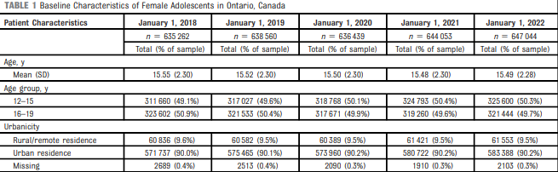
Results
Introduction
Methods
Results
Discussion
Conclusion

Slide 18
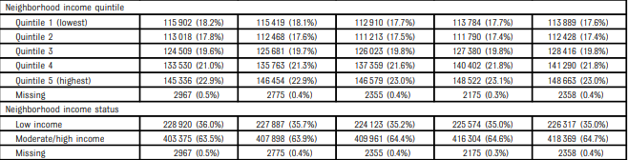
Results
Introduction
Methods
Results
Discussion
Conclusion

Slide 19
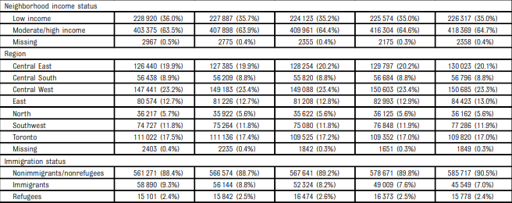
Results
Introduction
Methods
Results
Discussion
Conclusion

Slide 20
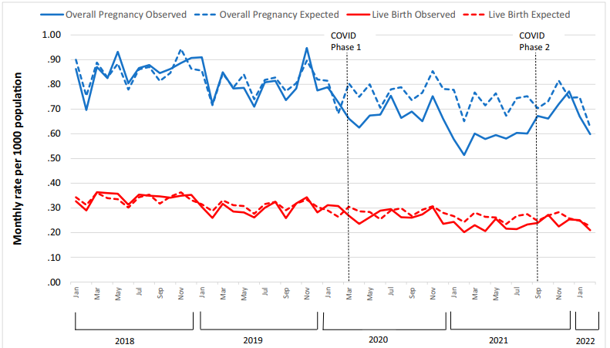
Introduction
Methods
Results
Discussion
Conclusion
Observed and expected rates, rate ratios, and absolute rate differences of overall pregnancies and live births

Slide 21
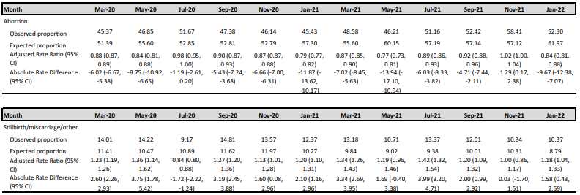
Introduction
Methods
Results
Discussion
Conclusion
Observed and expected rates, rate ratios, and absolute rate differences of overall pregnancies and live births

Slide 22
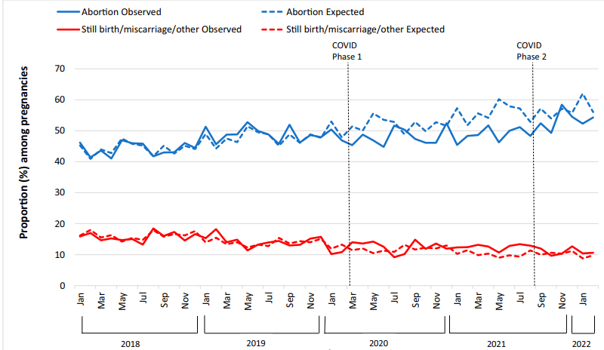
Introduction
Methods
Results
Discussion
Conclusion
Observed and expected rates, rate ratios, and absolute rate differences of abortions and still births/miscarriages/other

Slide 23
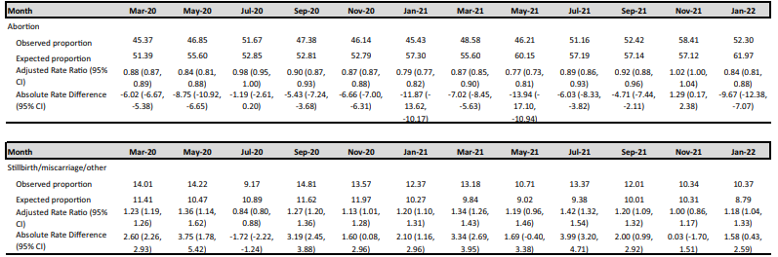
Introduction
Methods
Results
Discussion
Conclusion
Observed and expected rates, rate ratios, and absolute rate differences of abortions and still births/miscarriages/other

Slide 24
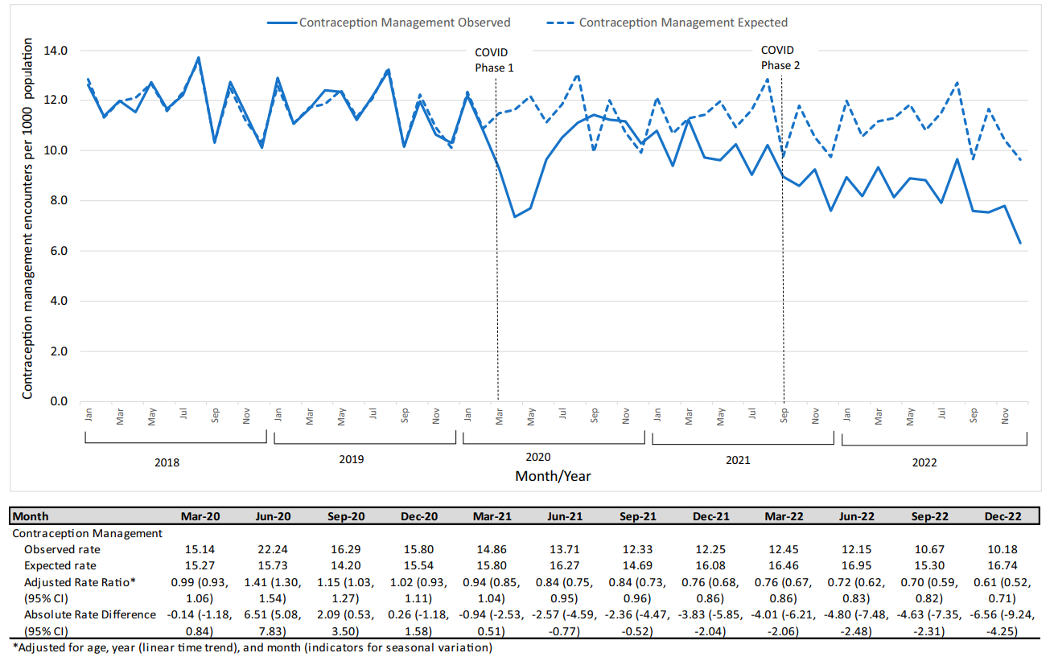
Introduction
Methods
Results
Discussion
Conclusion
Observed and expected rates, rate ratios, and absolute rate differences of contraception management encounters

Slide 25
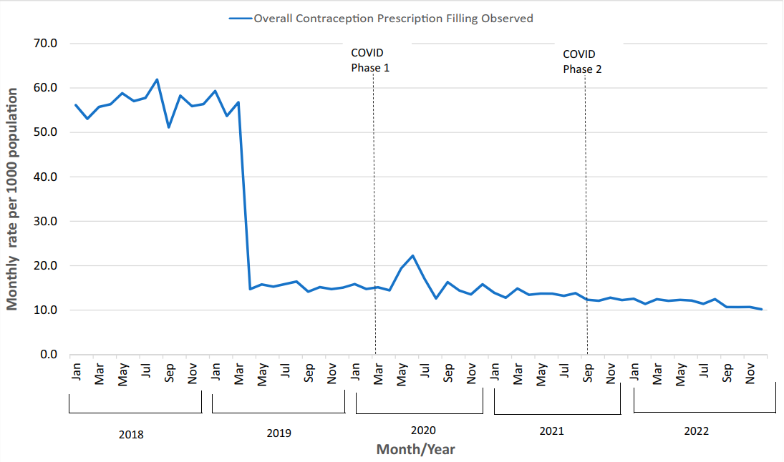
Introduction
Methods
Results
Discussion
Conclusion
Observed rates of contraceptive prescriptions

Slide 26
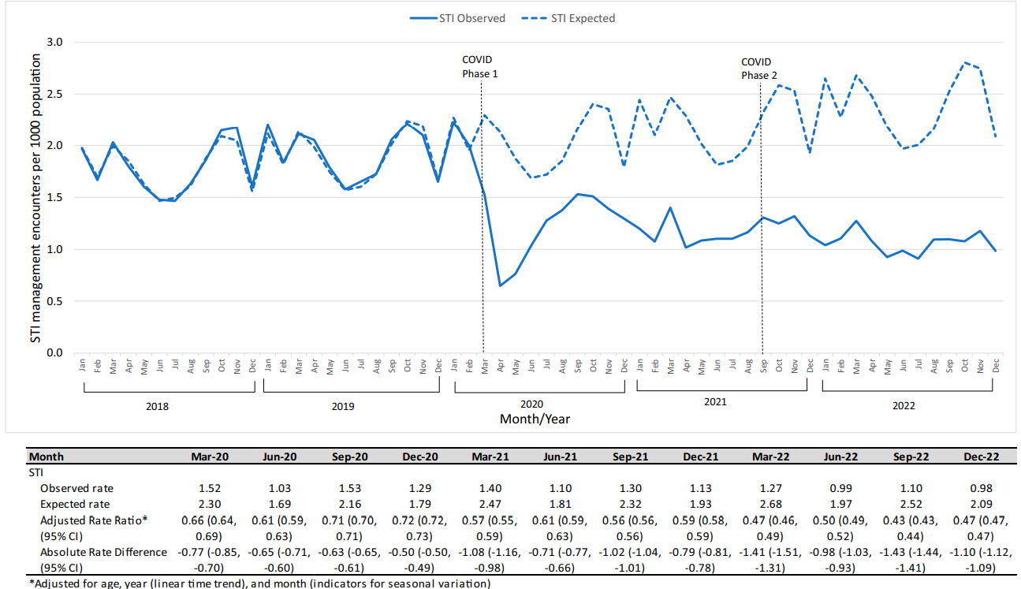
Introduction
Methods
Results
Discussion
Conclusion
Observed and expected rates, rate ratios, and absolute rate differences of STI management encounters

Slide 27
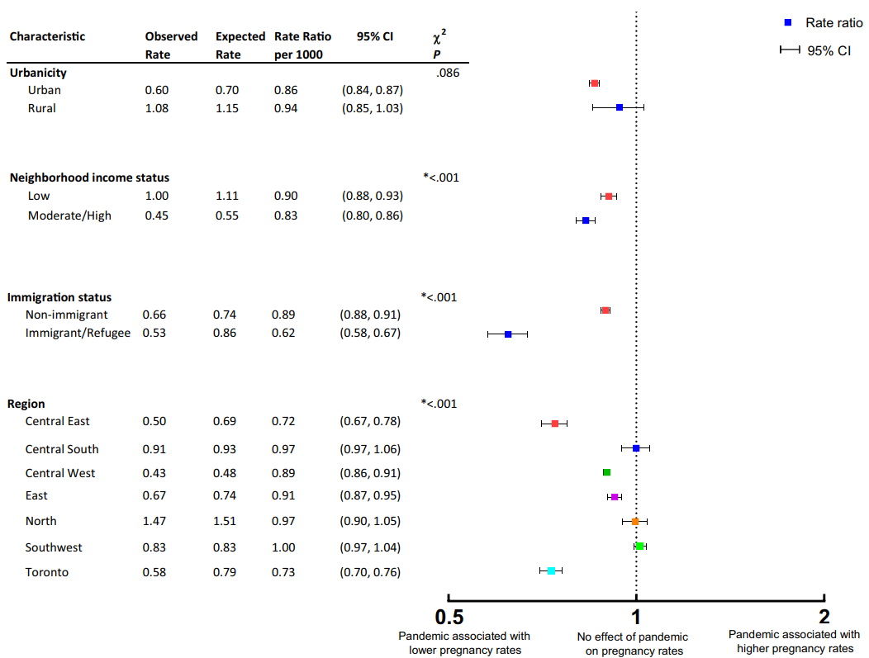
Introduction
Methods
Results
Discussion
Conclusion
Adjusted overall rate ratio of ASRH outcomes for pregnancy

Slide 28
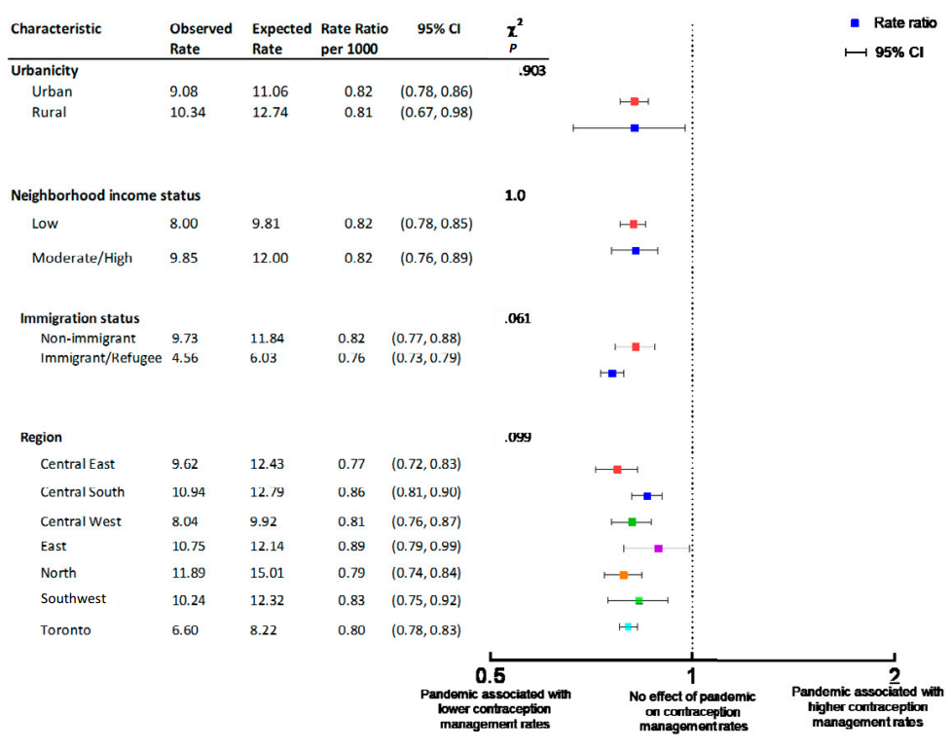
Introduction
Methods
Results
Discussion
Conclusion
Adjusted overall rate ratio of ASRH outcomes for contraception management encounters

Slide 29
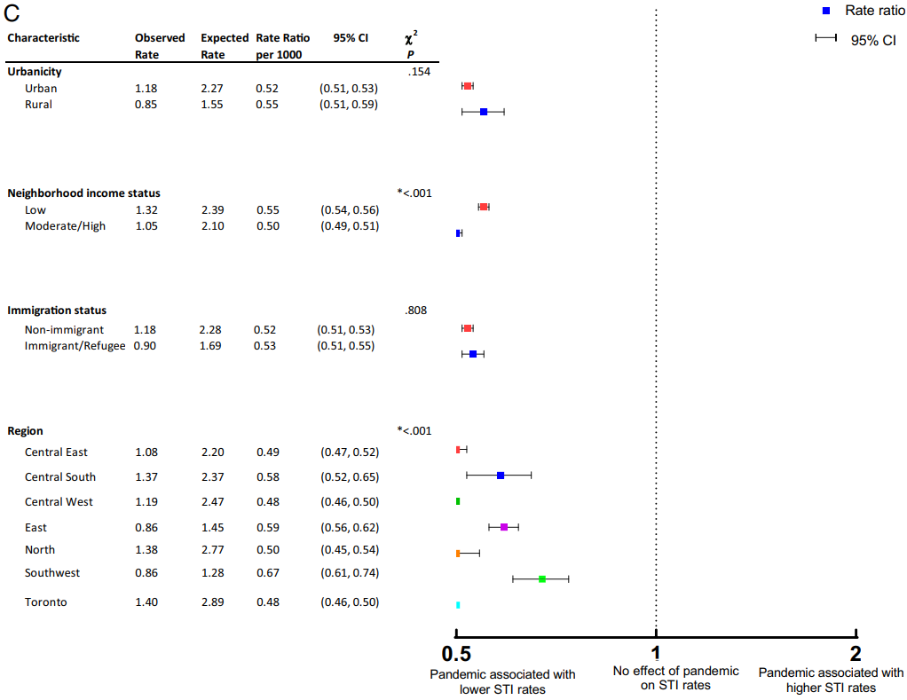
Introduction
Methods
Results
Discussion
Conclusion
Adjusted overall rate ratio of ASRH outcomes for STI management encounters

Slide 30
Introduction
Methods
Results
Discussion
Conclusion
Lower-than-expected rates of adolescent pregnancy and health care encounters for contraceptive and STI management during the COVID-19 pandemic.
The rates of pregnancy for adolescents living in contexts associated with higher pre-pandemic pregnancy rates revealed less of a decline, suggesting a further exacerbation of preexisting inequities.
A key study finding is that visits for contraception management had not returned to pre-pandemic levels at the end of the study period. This exposes a potentially concerning gap in coverage, particularly as public health restrictions eased, and sexual behaviors may have shifted back toward pre-pandemic patterns.

Slide 31
Introduction
Methods
Results
Discussion
Conclusion
In this paper, data cannot offer insight into whether this pattern results from decreased desire or need for contraception or decreased access to services.
It is unclear whether this trend represents a decreased need for services, decreased access to services, an increase in care-seeking through alternate access points (eg, clinics that do not bill OHIP), or deferred care-seeking (either for routine asymptomatic screening or for the assessment or treatment of symptoms) with an associated increase in unidentified or untreated STIs.

Slide 32
Limitation
Introduction
Methods
Results
Discussion
Conclusion
Study design (generalizability): Implications of the pandemic may differ among high-income countries with different health care landscapes (eg, private vs publicly financed) or differing pandemic-associated restrictions and in low-and-middle-income countries with different ASRH considerations.
Unaccounted Confounders: Racial or ethnic identities, gender identities, or others.

Slide 33
Conclusion
Introduction
Methods
Results
Discussion
Conclusion
The rates of adolescent pregnancy and visits for contraceptive and STI management decreased in Ontario, Canada during the pandemic, compared with pre-pandemic trends, and preexisting inequities were amplified. Adolescents are early in their reproductive life course, and the pandemic may have SRH implications that have not yet become evident; such impacts must be identified and attended to in a responsive, adolescent-centered, and rights-based manner that promotes optimal outcomes for all.

Slide 34
Limitation
Comment
Population-based, repeated cross-sectional study | Advantage/Disadvantage
General cross-sectional study | This study can explore the trend of outcomes.
Longitudinal study | There is no temporality.
Bias | Comment
Information bias (misclassification) | Potential bias, missing was imputed by median of non-missing values by pregnancy type.
Selection Bias | No bias, I think the selection bias is minimal because of the low missing rate.
Unmeasured Confounders | No bias, I think that there were no unmeasured confounders in this paper for the research objective.

Slide 35
Limitation
Comment
Generalizability
  This is the repeated survey in one region and it only collects a few sociodemographic characteristics. There is low generalizability.
Despite the limited results, this study still provides an insight to explore the health issue. It is important to the further study and policy making.

Slide 36
Comments on Paper of Yen-Chun
T88121057 Jheng-Yan, Wu
PhD 2nd Year Student

Slide 37
Comment 1
In the discussion section, the authors mention that about 70% of adolescent pregnancies are unintended, and that the pandemic was associated with a significant decline in pregnancy rates
However, since pregnancy typically involves mutual consent, I’m curious about did the study specifically analyze whether pregnancies were unintended or intended? Such an analysis could help clarify whether the pandemic primarily impacted unintended pregnancies
Alternatively, could abortion be used as a surrogate outcome for unintended pregnancy? If so, might the observed decline in pregnancies and abortions suggest that the pandemic mainly reduced unintended conceptions?

Slide 38
Response to Comment 1
The study did not measure whether the pregnancies were unintended or intended, so it cannot be further analyzed.
The authors note that approximately 70% of adolescent pregnancies are unintended. In addition, based on 2019 data from WHO, 55% of unintended pregnancies among adolescent girls aged 15–19 years end in abortions.
From my point of view, abortions can be used as a surrogate outcome for unintended pregnancy. However, this surrogate method will face the issue of information bias, with approximately 30-45% of abortions being the result of misclassification of unintended pregnancies. It must be discussed more carefully and handled (e.g. using quantitative bias analysis).

Slide 39
Comment 2
Regarding the MOMBABY dataset used to capture obstetrical deliveries, does it include all births in Ontario, or only those that occurred in hospital settings?
Are private clinic births, or those not billed through OHIP potentially excluded?
If so, would this small subset of non-hospital births introduce any meaningful bias in estimating overall adolescent pregnancy outcomes?

Slide 40
Response to Comment 2
The MOMBABY dataset does not include births that occur outside of hospital settings. It focuses solely on births that take place within hospital environments. In addition to the MOMBABY dataset, this study is supplemented with data on healthcare encounters indicative of pregnancy without a recorded delivery in health administrative data (e.g., miscarriages and abortions at private clinics). Those pregnancies that are not billed by OHIP are considered as not occurring.
Despite of the high coverage rate of OHIP and the detailed data collection, there may still be information bias (outcome misclassification).
However, I think this bias may be minimal. The author can also use QBA to quantify this bias.

Slide 41


