Slide 1
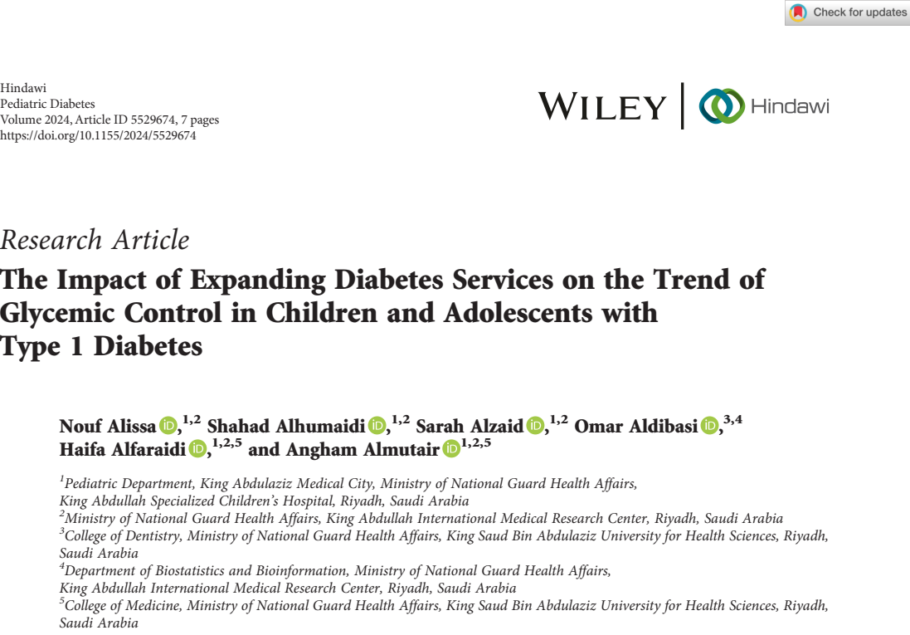
Thembekile Precious Dlamini-T88137024
21/05/2025

Slide 2
Response to comments from Mita and Professors

Slide 3
Comments on Paper 1
T88127011 Mita Restinia
2nd Year PhD Student

Slide 4
Comment 1. The aim of study
The study aims to assess whether the expansion of pediatric diabetes service, including access to technology (like insulin pumps), and more frequent clinic visits—led to improved glycemic control and reduce acute complication.
However, the study does not fully address the aim of study, as it tends to be descriptive study. Although the authors observed an improvement in HbA1c over time, it remains difficult to determine whether this improvement can be attributed solely to the expansion of diabetes services, given the absence of a control group and causal analysis.
Therefore, including data from a comparable centre without service expansion would have helped isolate the effect of the expanded services from glycemic control. What are your thoughts on this matter?

Slide 5
Response to comment 1
I agree with you; the study did not fully achieve its objective.
Although the study provides valuable insight into potential benefits of multidisciplinary care models and more frequent patient engagement, but,
The study's descriptive design limits its ability to prove causation; we cannot confidently say the observed improvement in HbA1c is solely to the service expansion.
Descriptive studies can not explain causation.

Slide 6
Our agreement to comment 1(Myself and Mita)
Study objective:
To evaluate the impact of initiating a specialized children’s hospital and expanding the diabetes service for children with type 1 diabetes (T1DM) on their glycemic control and on acute–diabetes-related complications over a 4-year follow-up period.
Revised objective:
To assess the association between expanding diabetes services for children with T1DM with their glycemic control and diabetes complications over a 4-year follow-up period.

Slide 7
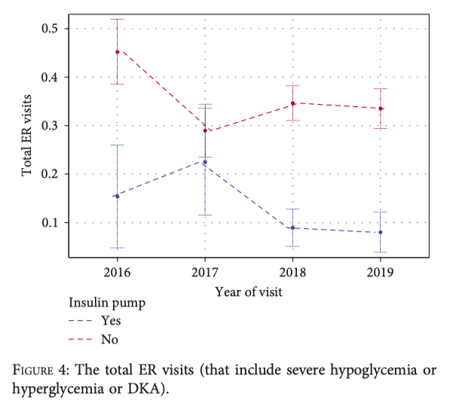
Comment 2. ER Visit Trend Analysis
The authors appropriately stratified emergency room (ER) visits by insulin modality (CSII vs. MDI), as shown in Figure 4
However, the analysis remains limited because ER visits were reported in aggregate, without disaggregation by type of acute complication (e.g., DKA, severe hypoglycaemia, or severe hyperglycaemia),
To enhance the clinical relevance and interpretability of the results, ER visits should be reported separately by type of complication and further stratified by insulin regimen and year. What do you think about it?

Slide 8
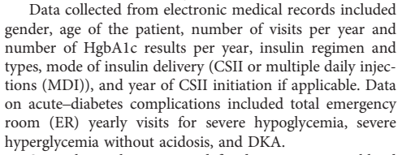
Response to comment 2
I think ER visits were well classified as DKA, severe hypoglycemia, or severe hyperglycemia.
I think the study did classify insulin by regimen.
I think they did stratify by year in the four year-study period.
However, I agree with you since the study did not clearly explain this part, and
I could not get the study materials as the corresponding author has not replied to my email yet.

Slide 9
Comments from Professors
Associate Professor Li-Jung Elizabeth Ku; why did you choose Saudi Arabia?
Response; I choose Saudi Arabia because the World Health Organization has ranked Saudi Arabia as having the second highest rate of diabetes in the Middle East and 7th highest in the world, with an estimated population of 7 million living with diabetes and more than 3 million with pre-diabetes.

Slide 10
Comments from Professors
Professor Chung-Yi Li; commented that it is not clear how the study recruited participants, the numbers doesn’t add up. Maybe they used repeated measures.
Everyone agreed with this comment.

Slide 11
THANK YOU!

