Slide 1
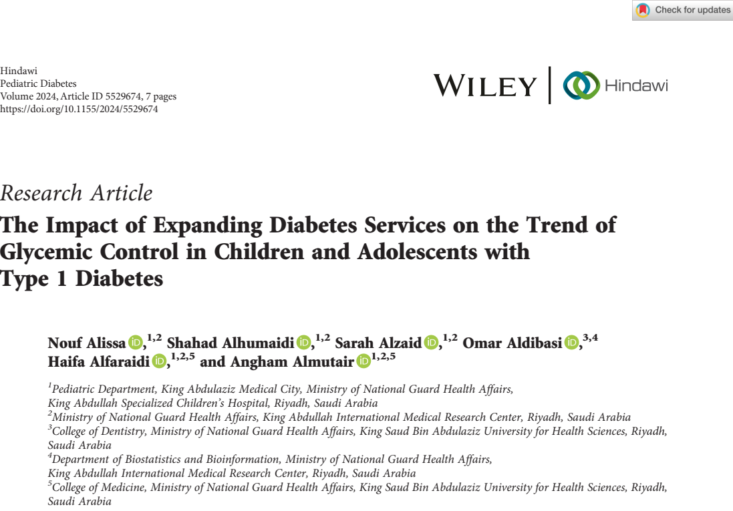
Thembekile Precious Dlamini-T88137024
21/05/2025

Slide 2
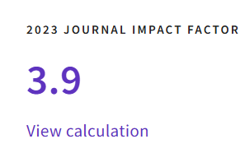

Slide 4
Outline
Background
Knowledge gap
Study objective
Methods
Results
Discussions
Strengths
Limitations
Conclusion
Critical appraisal

Slide 5
Background
When is world AIDS day?
When is world Obesity day?
When is world Diabetes day?

Slide 6
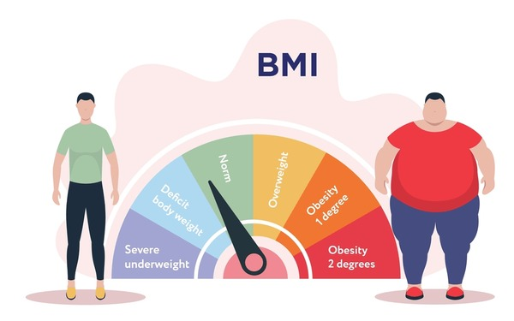
Background

Slide 7
Let’s commemorate world diabetes day to increase awareness
Background

Slide 8
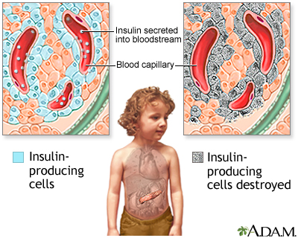
TYPE 1 Diabetes Mellitus (T1DM)

Slide 9
Background
Type 1 diabetes (T1DM) is the most common cause of diabetes mellitus in the pediatric age group (Pasi & Ravi, 2022).
T1DM affects more than 1.2 million children and adolescents globally, about 29,000 affected youth in Saudi Arabia.
Saudi Arabia is among the top 10 countries with the highest prevalence of T1DM in youth under 19 years.
Thus, T1DM, is a critical healthcare concern in Saudi Arabia.

Slide 10
Deaths attributed to obesity in Saudi Arabia 2021

Slide 11
Knowledge gap
Known
There is a high prevalence of T1DM burden and need for care in children and adolescents.
Education and more frequent visit improve glycemic control.
Unknown
The impact of expanding diabetes services in children with T1DM
Effectiveness of CSII and educational programs over time
The effect of increased visit frequency and staffing ratios on patient outcomes
Combined impact of education, clinic expansion, and tech use

Slide 12
Study objective
To evaluate the impact of initiating a specialized children’s hospital and expanding the diabetes service for children with type 1 diabetes (T1DM) on their glycemic control and on acute–diabetes-related complications over a 4-year follow-up period.

Slide 13
Methods

Slide 14
Study design
This was a retrospective cohort study, which was conducted at King Abdullah Specialized Children Hospital (KASCH).
KASCH is a tertiary children’s hospital that offers specialized care to children and adolescents with chronic medical conditions, including DM.
Timeline: January 2016 to December 2019

Slide 15
Study population
Children and adolescents, ages 1–16 years, with T1DM for at least 1 year, followed in KASCH, Riyadh, Saudi Arabia
Sample size was 499 patients.

Slide 16
Eligibility criteria
Inclusion criteria
Children and adolescents, aged 1–16 years, with T1D for at least 1 year, followed in KASCH, Riyadh, Saudi Arabia, from January 2016 to December 2019.
Exclusion criteria
Had other types of diabetes,
Presence of any chronic disease other than diabetes
Signiﬁcant psycho-social concerns necessitating home healthcare intervention.

Slide 17
Data analysis
Data were analyzed and summarized using descriptive statistics (SAS 9.4) to explore and visualize the trend of HgbA1c and total ER visits over 4 years for the two groups (CSII and MDI).
Regression analyses were conducted using a ﬁxed effects model for longitudinal data to examine the main effect of time and mode of therapy on HgbA1c.
The total ER visits were modeled using the negative binomial regression model with time and mode of therapy as the main effects.
The signiﬁcance level was declared α 0.05

Slide 18
RESULTS

Slide 19
The trend of HgbA1c over 4 years, 2016–2019
There was an improvement in HbA1c over the study period

Slide 20
Average number of clinic visits and HgbA1c results per year.
There was an increase in the number of patient–physician visits per year, from 2.6 to 3 visits.
Increase in number of HgbA1c results in 2019 compared to 2016

Slide 21
Distribution of pump users per year
2019- 75
2016- 26

Slide 22
Mean HgbA1c per year for the patient on Multiple Daily Injections (MDI) or Continuous Subcutaneous Insulin Infusion (CSII) (pump)
There was a signiﬁcant decline in the trend of HgbA1c over 4-years in both the MDI and CSII groups,
with a 0.47 HgbA1c decline in the CSII group and,
a 0.67% decrease in the MDI group (p-value = <0.001).

Slide 23
Total ER visits
The total ER visits for severe hypoglycemia, severe hyper- glycemia, or DKA were signiﬁcantly less in the CSII com- pared to the MDI (p-value <0.0001), with a slight decrease in the trend of total ER visits over 4 years in both groups (p-value = 0.46

Slide 24
Results
The expansion of the diabetes service resulted in improved diabetes education, with an increase in educator to patient ratio from 1 : 450 to 1 : 180.

Slide 25
DISCUSSION

Slide 26
Discussion
The average number of visits per patient per year (2.6–2.9 visits per patient per year) is similar to the average number of visits per patient per year reported by Markowitz et al.,(2014) where the average number of visits per patient over 2 years was 5.8 visits
overall attendance for all pediatric endocrinology and diabetes clinics remained steady (71.7% to 72.5%).
This is similar with the attendance rates reported at other diabetes clinics for pediatric and young adult patients, (73% and 75%) (Fisher et al., 2018; Nadeem et al., 2019)

Slide 27
Discussion
Improved diabetes education and increased availability and accessibility of the diabetes care team to patients enhanced glycemic control and extended to acute–diabetes-related complications and ER visits.
This results are consistent to observations from both adult and pediatric data, where the utilization of diabetes education programs resulted in fewer ER visits (Deeb et al., 2016; Gao et al., 2022)

Slide 28
Discussion
Glycemic control in the CSII group was markedly better than in the MDI group.
This is in line with other studies that have observed HgbA1c levels are better in those using CSII than MDI (Karges et al., 2022; Kamrath et al., 2021; Pala et al., 2019; Sherr et al., 2017; Szypowska et al., 2016)

Slide 29
Discussion
The enhanced glycemic control in the CSII group was maintained through- out the observation period, supporting the notion that the beneﬁt of CSII on glycemic control is preserved on the long term (Babiker et al., 2022; Carlsson et al., 2013; Colino et al., 2016; Johnson et al., 2013)

Slide 30
Discussion
HgbA1c was lower in the CSII group, however, the change in HgbA1c was more evident in the MDI group during the 4 years.
This can be explained by the fact that individuals who are planning to initiate CSII typically receive intensive diabetes education prior to starting their pump therapy, compared to those treated with MDI.

Slide 31
Discussion
ER visits for hypoglycemia, hyperglycemia, and DKA were signiﬁcantly lower in the CSII group compared to the MDI group.
These results support the safety of insulin pumps, if patients receive adequate diabetes education and training.
These observations are consistent with more recent studies, including large-scale registry data, that have not identiﬁed a signiﬁcant increase in the risk of DKA with CSII use
(Alshami et al., 2021; Hoshina et al., 2018; Karges et al., 2015)

Slide 32
Strengths
Real-World, Longitudinal Data; the study reflect actual clinical practice as they followed patients over 4 years, providing insight into long-term trends in glycemic control and acute complications.
Large Sample Size (499), high volume of clinical visits analyzed (3,906 visits) adds statistical power and robustness to findings.
Focus on a High-Prevalence Region- Saudi Arabia, is one of the top 10 countries globally in pediatric T1DM prevalence.
Evaluation of a System-Wide Service Expansion makes the study to be more relevant to healthcare planning and policy.
Relevance Clinical Findings- 0.67% drop in HbA1c is clinically significant, as per international guidelines.

Slide 33
Limitations
Retrospective studies cannot clearly establish causation.
The study could not directly quantify the impact of increase in CSII use on the glycemic control.
Could not assess the effect of ﬂash CGM on glycemic control as it only became available during 2019.

Slide 34
Limitations
Un-scheduled walk-in visits
Educator-speciﬁc visits
Time spent with the health care provider during each visit
Phone calls to the diabetes team were not captured, to further quantify the increased education and support provided by the diabetes team.

Slide 35
Conclusion
Increased accessibility of the diabetes care team to children and adolescents with T1DM and their families, with more frequent contact with team members, contributes signiﬁcantly to the improvement of glycemic control.

Slide 36
Critical appraisal
Item | Comment
Objective | Clear
Study population | Sample is based only on 1 hospital, cannot be generalized.
Measurement tools | Clear
Statistical methods | Clear
Uncontrolled variables | Socioeconomic Status (SES), Parental Involvement and Supervision, Adherence to Insulin Therapy and Glucose Monitoring, Diabetes Duration and Baseline Control, Psychosocial Factors (Depression)

Slide 37
Critical appraisal
Item | Comment
Results | Clear
Bias | Selection Bias in CSII Group; Patients started on CSII may already be more engaged, better educated, or selected by providers as more likely to succeed.
Suggestions | Use a controlled cohort (compare with a similar hospital that did not expand services) to improve causal inference. Use Multivariable regression to control for key confounders. Expand to multiple centers to improve generalizability to broader population. Include patient-reported outcomes to add depth to understanding of effectiveness

Slide 38
References
Alshami, A., Purewal, T., Douedi, S., Hossain, M. A., Patel, R., & Dev, A. (2021). Effect of insulin pump use on diabetic ketoacidosis in type 1 diabetes mellitus: A matched cohort study. Journal of Clinical Medicine, 10(5), 898. https://doi.org/10.3390/jcm10050898
Babiker, A., Alammari, N., Aljuraisi, A., Alharbi, A., Alharbi, N., & Alharbi, M. (2022). The effectiveness of insulin pump therapy versus multiple daily injections in children with type 1 diabetes mellitus in a specialized center in Riyadh. Clinical Medicine Insights: Endocrinology and Diabetes, 15, 1–7. https://doi.org/10.1177/11795514221139950
Carlsson, B.-M., Attvall, S., Clements, M., Persson, M., Lindblad, B., & Adamson, U. (2013). Insulin pump—long-term effects on glycemic control: An observational study at 10 diabetes clinics in Sweden. Diabetes Technology & Therapeutics, 15(4), 302–307. https://doi.org/10.1089/dia.2012.0282
Colino, E., Martin-Frias, M., Yelmo, R., Alvarez, M. A., Roldan, B., & Barrio, R. (2016). Impact of insulin pump therapy on long-term glycemic control in a pediatric Spanish cohort. Diabetes Research and Clinical Practice, 113, 69–76. https://doi.org/10.1016/j.diabres.2016.01.004
Deeb, A., Yousef, H., Abdelrahman, L., Al-Mutairi, M., & Elbarbary, N. (2016). Implementation of a diabetes educator care model to reduce paediatric admission for diabetic ketoacidosis. Journal of Diabetes Research, 2016, Article ID 3917806, 5 pages. https://doi.org/10.1155/2016/3917806
Fisher, E., Lazar, L., Shalitin, S., Yackobovitch-Gavan, M., Constantini, S., & Phillip, M. (2018). Association between glycemic control and clinic attendance in emerging adults with type 1 diabetes: A tertiary center experience. Journal of Diabetes Research, 2018, Article ID 9572817, 6 pages. https://doi.org/10.1155/2018/9572817
Gao, Y., Xu, C., Yang, A., Wang, L., Wu, H., & Liu, Y. (2022). How outpatient diabetes education programs can support local hospitals to reduce emergency department visits for adults with diabetes. Canadian Journal of Diabetes, 46(8), 797–803. https://doi.org/10.1016/j.jcjd.2022.05.004
Hoshina, S., Andersen, G. S., Jørgensen, M. E., Ridderstråle, M., Vistisen, D., & Andersen, H. U. (2018). Treatment modality-dependent risk of diabetic ketoacidosis in patients with type 1 diabetes: Danish adult diabetes database study. Diabetes Technology & Therapeutics, 20(3), 229–234. https://doi.org/10.1089/dia.2017.0374
Johnson, S. R., Cooper, M. N., Jones, T. W., & Davis, E. A. (2013). Long-term outcome of insulin pump therapy in children with type 1 diabetes assessed in a large population-based case-control study. Diabetologia, 56(11), 2392–2400. https://doi.org/10.1007/s00125-013-3030-0

Slide 39
References
Kamrath, C., Tittel, S. R., Kapellen, T. M., Reschke, F., Rohrer, T. R., Schwarz, H. P., ... & Holl, R. W. (2021). Early versus delayed insulin pump therapy in children with newly diagnosed type 1 diabetes: Results from the multicenter, prospective diabetes follow-up DPV registry. The Lancet Child & Adolescent Health, 5(1), 17–25. https://doi.org/10.1016/S2352-4642(20)30350-9
Karges, B., Rosenbauer, J., Holterhus, P. M., Beyer, P., Thon, A., Schierloh, U., ... & Holl, R. W. (2015). Hospital admission for diabetic ketoacidosis or severe hypoglycemia in 31,330 young patients with type 1 diabetes. European Journal of Endocrinology, 173(3), 341–350. https://doi.org/10.1530/EJE-15-0173
Karges, B., Schwandt, A., Heidtmann, B., Kordonouri, O., Binder, E., Schierloh, U., ... & Holl, R. W. (2017). Association of insulin pump therapy vs insulin injection therapy with severe hypoglycemia, ketoacidosis, and glycemic control among children, adolescents, and young adults with type 1 diabetes. Journal of the American Medical Association, 318(14), 1358–1366. https://doi.org/10.1001/jama.2017.13994
Markowitz, J. T., Volkening, L. K., & Laffel, L. M. B. (2014). Care utilization in a pediatric diabetes clinic: Cancellations, parental attendance, and mental health appointments. The Journal of Pediatrics, 164(6), 1384–1389. https://doi.org/10.1016/j.jpeds.2013.12.025
Nadeem, F., Urwin, A., Marshall, M., Rayman, G., & Bain, S. C. (2019). Risk factor control and outpatient attendance in young adults with diabetes. Acta Diabetologica, 56(5), 597–600. https://doi.org/10.1007/s00592-019-01306-8
Pala, L., Dicembrini, I., & Mannucci, E. (2019). Continuous subcutaneous insulin infusion vs modern multiple injection regimens in type 1 diabetes: An updated meta-analysis of randomized clinical trials. Acta Diabetologica, 56(9), 973–980. https://doi.org/10.1007/s00592-019-01364-y
Pasi, R., & Ravi, K. S. (2022). Type 1 diabetes mellitus in pediatric age group: A rising endemic. Journal of family medicine and primary care, 11(1), 27–31. https://doi.org/10.4103/jfmpc.jfmpc_975_21
Sherr, J. L., Hermann, J. M., Campbell, F., Foster, N. C., Hofer, S. E., Allgrove, J., ... & Holl, R. W. (2016). Use of insulin pump therapy in children and adolescents with type 1 diabetes and its impact on metabolic control: Comparison of results from three large, transatlantic paediatric registries. Diabetologia, 59(1), 87–91. https://doi.org/10.1007/s00125-015-3790-6
Szypowska, A., Schwandt, A., Svensson, J., Shalitin, S., Cardona-Hernandez, R., Forsander, G., ... & Holl, R. W. (2016). Insulin pump therapy in children with type 1 diabetes: Analysis of data from the SWEET registry. Pediatric Diabetes, 17(Suppl 23), 38–45. https://doi.org/10.1111/pedi.12370

Slide 40
THANK YOU!

Slide 41
Comments on Paper 1
T88127011 Mita Restinia
2nd Year PhD Student

Slide 42
Comment 1. The aim of study
The study aims to assess whether the expansion of pediatric diabetes service, including access to technology (like insulin pumps), and more frequent clinic visits—led to improved glycemic control and reduce acute complication.
However, the study does not fully address the aim of study, as it tends to be descriptive study. Although the authors observed an improvement in HbA1c over time, it remains difficult to determine whether this improvement can be attributed solely to the expansion of diabetes services, given the absence of a control group and causal analysis.
Therefore, including data from a comparable centre without service expansion would have helped isolate the effect of the expanded services from glycemic control. What are your thoughts on this matter?

Slide 43
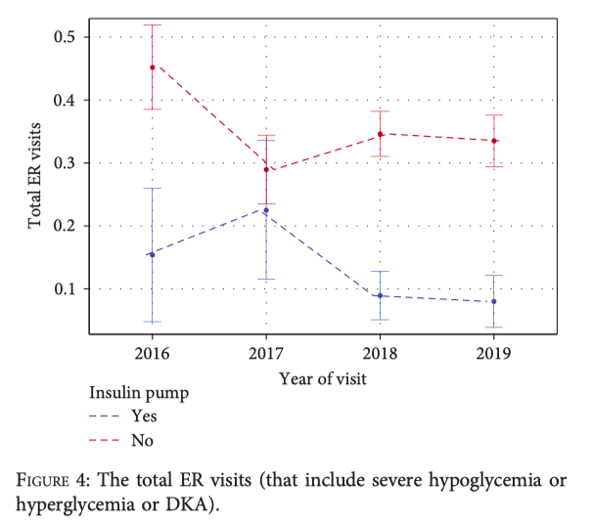
Comment 2. ER Visit Trend Analysis
The authors appropriately stratified emergency room (ER) visits by insulin modality (CSII vs. MDI), as shown in Figure 4
However, the analysis remains limited because ER visits were reported in aggregate, without disaggregation by type of acute complication (e.g., DKA, severe hypoglycaemia, or severe hyperglycaemia),
To enhance the clinical relevance and interpretability of the results, ER visits should be reported separately by type of complication and further stratified by insulin regimen and year. What do you think about it?

Slide 44
Response to comment 1
I agree with you; the study did not fully achieve its objective.
Although the study provides valuable insight into potential benefits of multidisciplinary care models and more frequent patient engagement, but,
The study's descriptive design limits its ability to prove causation; we cannot confidently say the observed improvement in HbA1c is solely to the service expansion.
Descriptive studies can not explain causation.

Slide 45
Our agreement to comment 1
Study objective:
To evaluate the impact of initiating a specialized children’s hospital and expanding the diabetes service for children with type 1 diabetes (T1DM) on their glycemic control and on acute–diabetes-related complications over a 4-year follow-up period.
Revised objective:
To assess the association between expanding diabetes services for children with T1DM with their glycemic control and diabetes complications over a 4-year follow-up period.

Slide 46
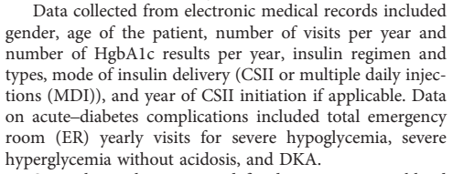
Response to comment 2
I think ER visits were well classified as DKA, severe hypoglycemia, or severe hyperglycemia.
I think the study did classify insulin by regimen.
I think they did stratify by year in the four year-study period.
However, I could not get the study materials as the corresponding author has not replied to my email yet.

