Slide 1
Relationship between asthma and severe COVID-19
林泱瀚 Yang-Han, Lin 1st year PhD student
Supervisor: Yu-Wen Chien, PhD

Slide 3
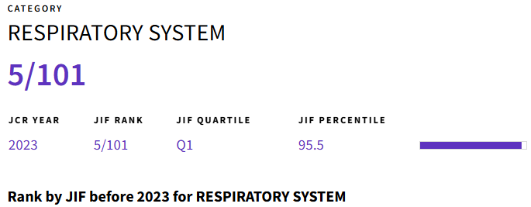
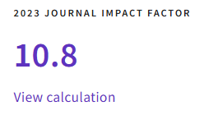

Slide 4
Jennifer Quint
Professor, Imperial college of London, National Heart and Lung Institute.
Physician of Respiratory Medicine, Royal Brompton Hospital.
Clinical epidemiology and respiratory diseases.

Slide 5
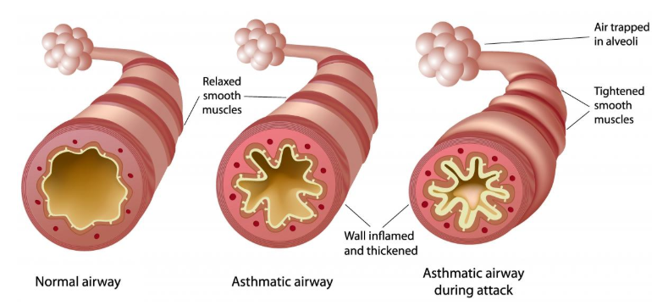
Introduction
Asthma is an airway disease which associated with airway hyperresponsiveness and inflammation.

Slide 6
Introduction
Asthma is characterized by variable symptoms of wheeze, shortness of breath, chest tightness and cough.
Symptoms of asthma vary over time and in intensity.
These variations are often triggered by factors such as exercise, allergen or irritant exposure, change in weather, or respiratory infection.

Slide 7
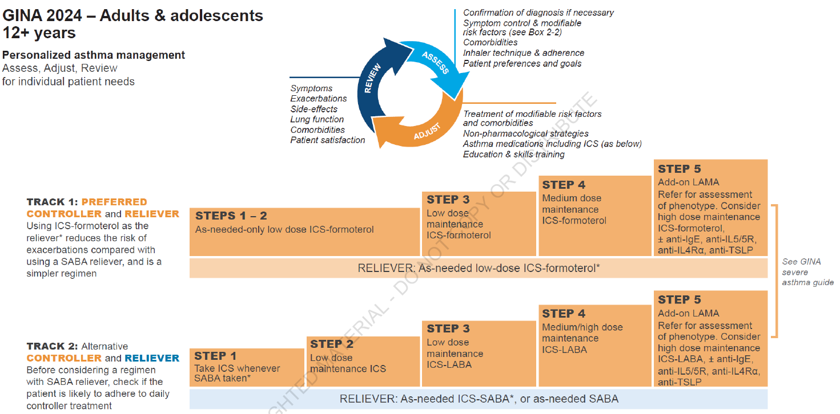

Slide 8
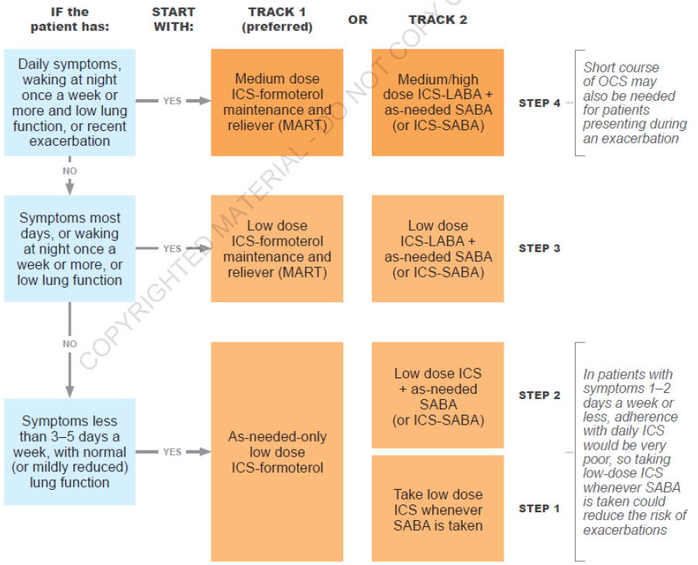

Slide 9
Introduction
Asthma has been identified as one of diseases associated with an increased risk of poorer COVID-19 outcomes.
People with asthma are prioritized for vaccination and antiviral medication.
Guideline of SARS-CoV-2 by Taiwan CDC

Slide 10
Knowledge gaps
However, the evidence is not entirely clear.
Asthma may increase the risk of developing more serious disease and hospitalization for COVID-19.
Asthma are not at increased risk for acquiring COVID-19.
Protective effect of inhaled corticosteroids.

Slide 11
Knowledge gaps
Limitation of previous studies:
Most studies was conducted in populations hospitalized for COVID-19 rather than people who contact COVID-19 in the community
Most studies was conducted during the first wave of the pandemic.
Most studies was conducted in adults rather than in children and with relatively short follow-up times.
Most studies do not differentiate mild asthma from more severe asthma or between poorly and well-controlled asthma.

Slide 12
Introduction
This study used a large linked dataset of individuals aged 12+ in England to assess whether poorly controlled asthma increases the risk of COVID-19 hospitalization or death, and whether these individuals should be prioritized for vaccination or other interventions.

Slide 13
Methods: Study design
Retrospective cohort study
Data sources:
Office for National Statistics Public Health Data Asset (2011 census in England) linked to 2011-2013 NHS patient registers.
General Practice Extraction Service data (death registration records)
Hospital Episode Statistics
(hospital admission data)

Slide 14
Methods: Data sources
Data were firstly linked deterministically using 24 different matching keys, based on a combination of forename, surname, date of birth, sex and geography.
Probabilistic matching was then used to attempt to match records that were not linked deterministically, using 13 different combinations of personal identifiers.

Slide 15
Methods: Data sources
Total 53,483,502 census records
50,019,451 were linked deterministically
555,291 were obtained using probabilistic matching
Overall linkage rate: 94.6%

Slide 16
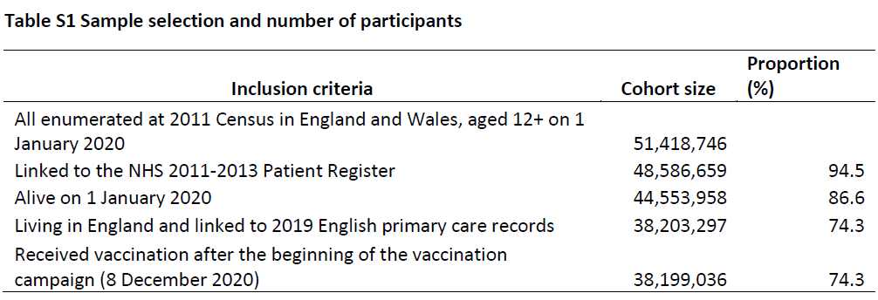
Methods: Data sources
35,202,533 (Age 18+) and 2,996,503 (Age 12-17)

Slide 17
Methods: Exposure
Control group: individuals without an asthma diagnosis in the two years prior to the pandemic. (1 January 2018 to 31 December 2019)
Exposure groups were: with an asthma diagnosis in the two years prior to the pandemic.
No ICS prescriptions in the year prior to the pandemic. (1 January 2019 to 31 December 2019)
Low dosage ICS prescribed in the year prior to the pandemic.
Medium dosage ICS prescribed in the year prior to the pandemic.
High-dosage ICS prescribed in the year prior to the pandemic.

Slide 18
Methods: Exposure
This study also used oral corticosteroids (OCS) prescriptions as an exposure variable (as a measure of exacerbation frequency and thus poor control).
Exposure categories:
No OCS prescription in the year prior to the pandemic.
One OCS prescription in the year prior to the pandemic.
Two or more OCS prescriptions in the year prior to the pandemic.

Slide 19
Methods: Outcomes
Follow-up: 1 January 2020 to 30 September 2021.
Primary outcome: COVID-19 death.
(death certificate and ICD-10 codes)
Secondary outcome: hospitalization with COVID-19 . (ICD-10 codes)
For children, this study only included hospitalizations, as the number of deaths was too low to conduct a meaningful statistical analysis.

Slide 20
Methods: Statistical analyses
Absolute risk of COVID-19 hospitalization and death:
Age standardized rates separately for men and women for adults (18 or over).
Crude rates for children (12–17).

Slide 21
Methods: Statistical analyses
Relative risk of COVID-19 mortality:
Cox proportional hazard models, adjusted for a range of potential confounding factors.
This study used different model specifications for children and for adults.

Slide 22
Methods: Statistical analysis
For adults:
1st model was just adjusted for age and sex.
2nd model: 1st model + socio-demographic factors, including region, ethnicity, and quintile of the Index of Multiple Deprivation.
3rd model: 2nd model + comorbidities, hospitalization in the previous year for any other reason than asthma, and OCS use (except when OCS was the exposure variable).
4th model: 3rd model + vaccination status.

Slide 23
Methods: Statistical analysis
For children:
The first two models were the same as for adults.
3rd model we adjusted for hospitalization in the previous year for any other reason than asthma.

Slide 24
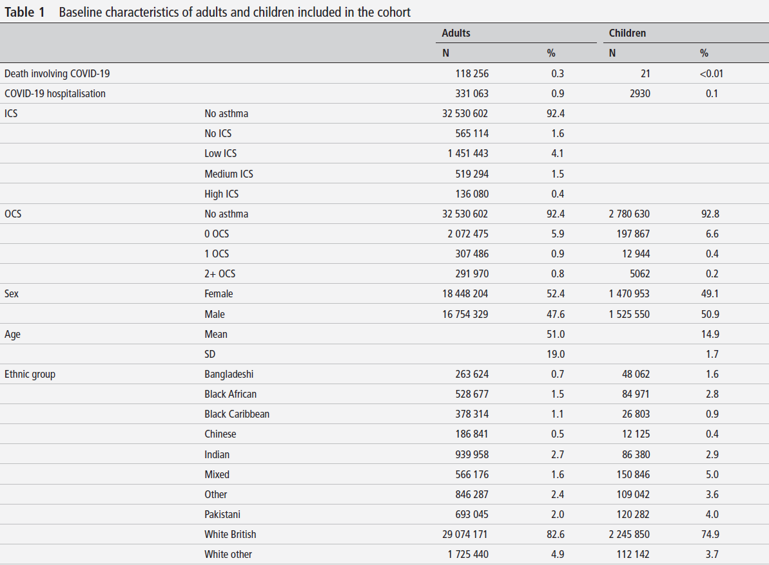

Slide 25
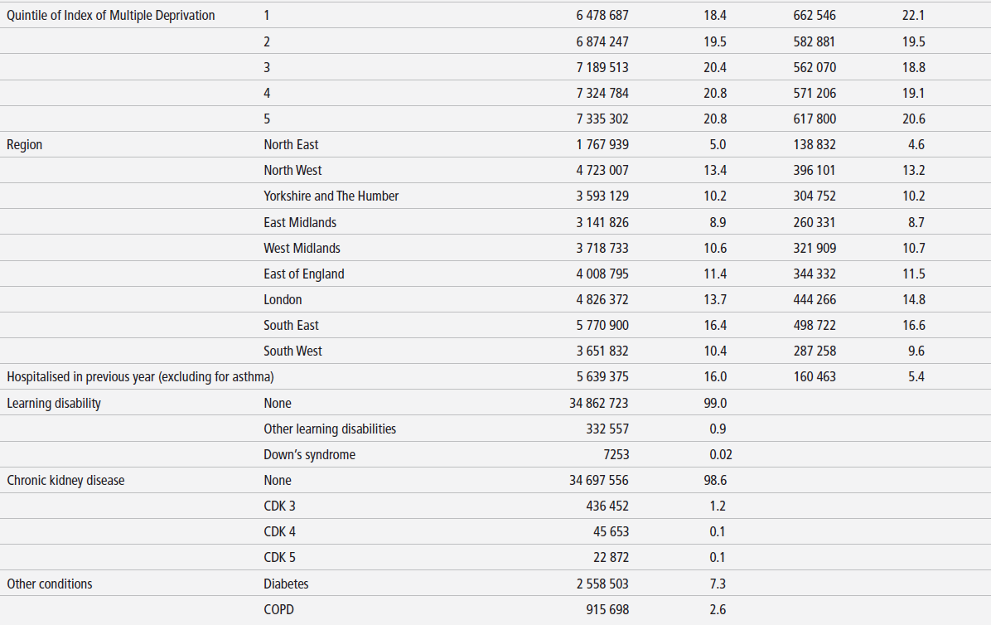

Slide 26
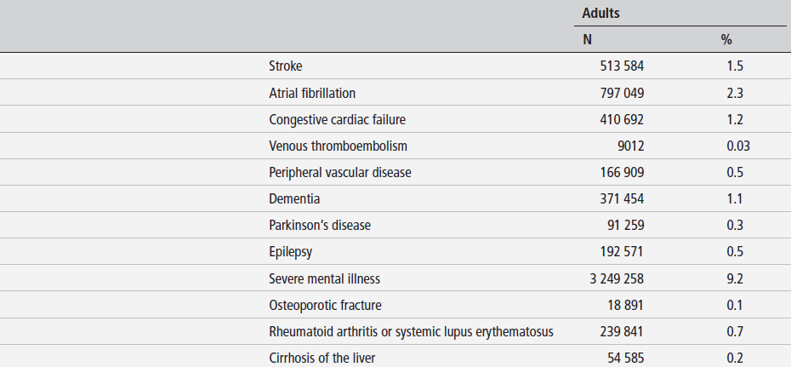

Slide 27
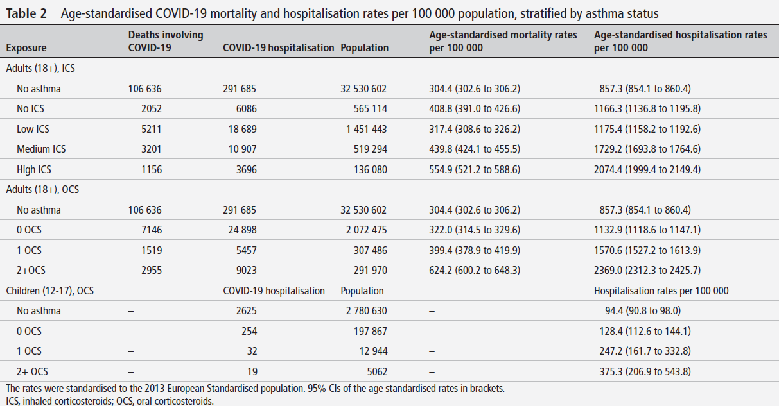

Slide 28
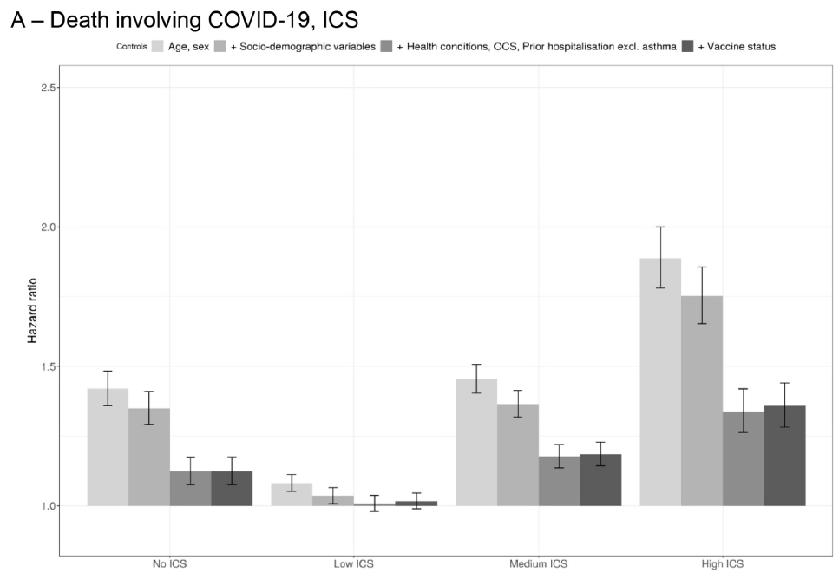
1.36
1.18
1.12
1 2 3 4
1 2 3 4
1 2 3 4
1 2 3 4

Slide 30
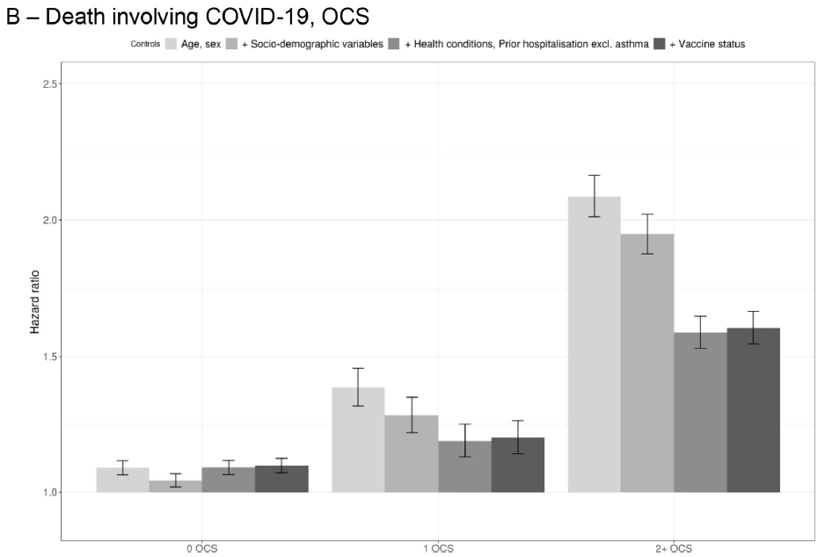
1.60
1.20
1.10
1 2 3 4
1 2 3 4
1 2 3 4

Slide 31
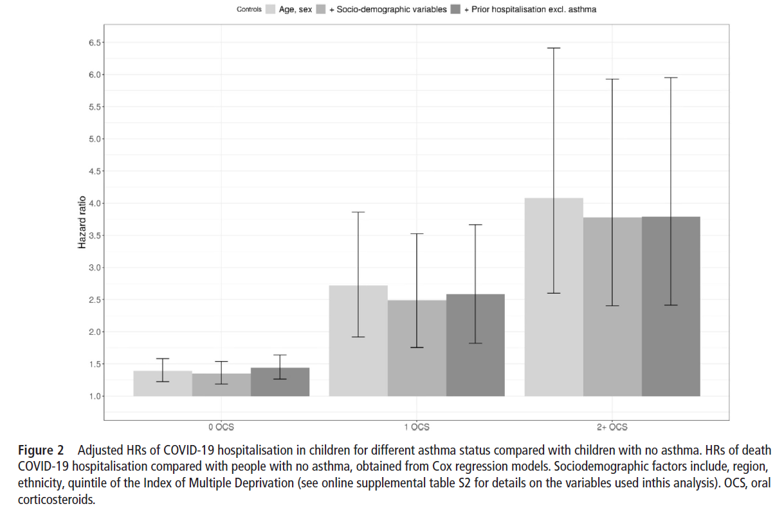
3.79
2.58
1.44
1 2 3
1 2 3
1 2 3

Slide 32
Discussion
Adults with mild or well-controlled asthma are neither at significantly increased risk of being hospitalized with COVID-19 nor die from COVID-19 than adults without asthma.
Adults who required higher ICS or experience one or more exacerbations per year as measured by OCS prescriptions, are potentially at increased risk of both hospitalization and death.

Slide 33
Discussion
Two or more courses of OCS in the preceding year was associated with an increase in hospitalization in both children and adults and associated with death in adults.
There was no difference in COVID-19 hospitalization and death between adults with asthma prescribed low-dose ICS and those with no history of asthma.
There was a slightly increased risk of death in those with a diagnosis of asthma but not prescribed ICS.

Slide 34
Discussion: Strengths
Large and nationwide population-level dataset.
The data cover 80% population of England.

Slide 35
Discussion: Limitations
Not data in children under the age of 12.
This study did not include people who have immigrated between 2011 and 2020.
Misclassification of electronic healthcare records.

Slide 36
Discussion
Compared to previous studies, this research helps clarify inconsistencies in previous findings on asthma and COVID-19, which were influenced by the rapid progression of the pandemic and limitations such as small sample sizes, inconsistent definitions, and a focus on hospitalized cases.

Slide 37
Discussion
The risks are not equal in different severity of asthma.
Only those with poorly controlled or severe disease that are at increased risk of serious COVID-19 and may need prioritization for vaccination or other treatment.

Slide 38
Discussion
When planning public health intervention, not to focus on individual diseases, but to consider the interaction between asthma risk and other diseases.

Slide 39
Conclusion
Good disease management including treatment adherence leading to better disease control helps to limit the risk of poor outcomes.
Even during the pandemic, basics of routine healthcare should not be overlooked.

Slide 40
Comments from Ya-Ling

Slide 41
Comment 1
In this study, the control group was defined using data from 2018–2019, while the exposure groups were based only on 2019 prescriptions. This inconsistency in time windows could lead to bias or affect comparability.
Why were different time frames used for the control and exposure groups?

Slide 42
Reply of comment 1
Asthma diagnosis was defined by the presence of at least one relevant SNOMED code in the primary care record in the 2 years prior to the pandemic(1 January 2018 to 1 January 2020).
Prescriptions for ICS and OCS in the 1 year prior to the pandemic (1 January 2019 to 31 December 2019) were used to define the exposure categories.

Slide 43
Reply of comment 1
Asthma is difficult to diagnose, using a 2-year period to determine whether a diagnosis was made can improve the accuracy of classification.
Medication use was assessed based on the past 1 year, which better reflects recent asthma control.

Slide 44
Comment 2
Although this study included vaccination status as a time-varying covariate in the adult risk models, it did not mention whether vaccination was accounted for in the models for children aged 12–17, either in the methods or in the reported results. Given that the UK had already implemented a vaccination program for adolescents during the study period, could the omission of vaccination status in the children's model have led to an underestimation of the protective effect of vaccination in high-risk pediatric populations?

Slide 45
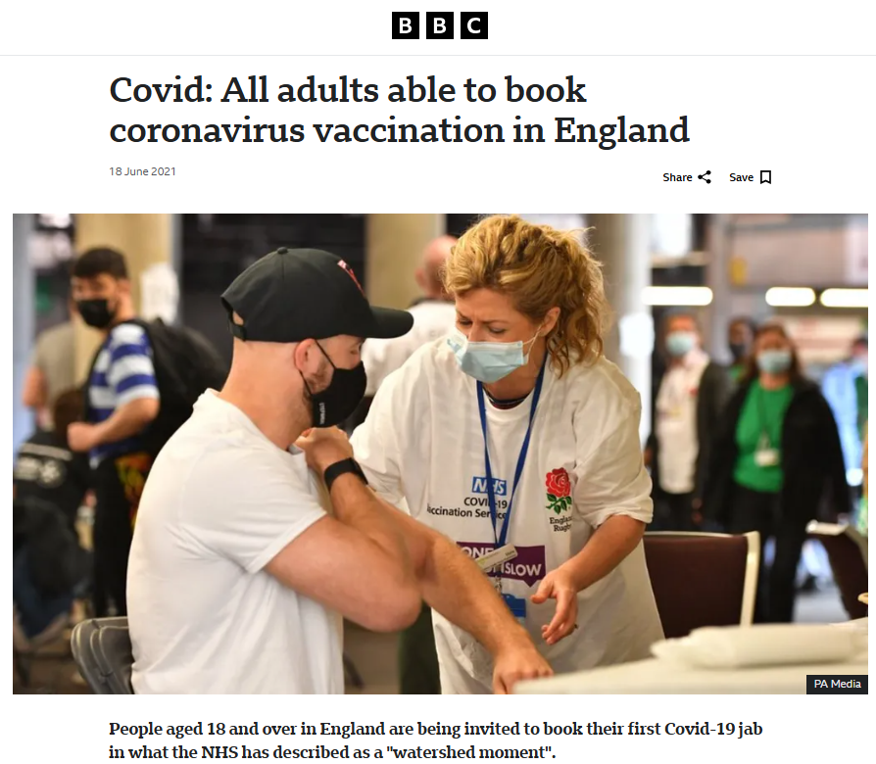

Slide 46
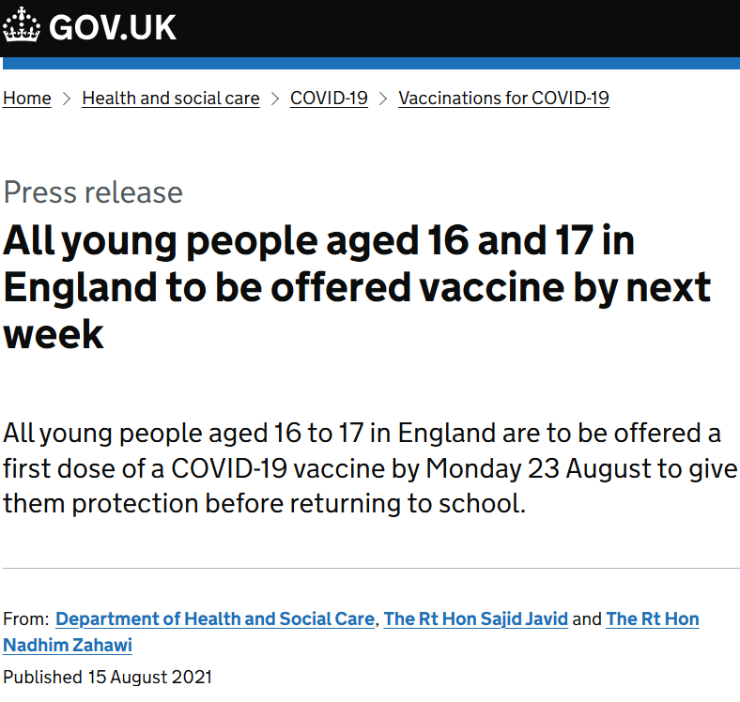

Slide 47
Reply of comment 2
It takes about two weeks after receiving the COVID-19 vaccine for protection to begin.
The follow-up period was 1 January 2020 to 30 September 2021.
Vaccination status had little impact on Age 12-17 in the UK. Therefore, the study did not consider it as a confounding factor.

