Slide 1
Literature Reports
PhD 2nd Year Student
T88121502 Hung-Jui Chen
Advisor: Professor Pei-Chen Lee
2025/04/16

Slide 2
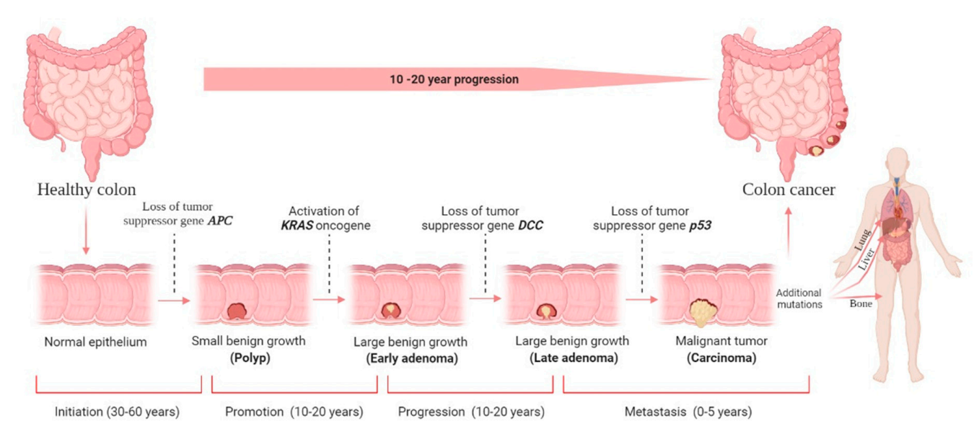
Colorectal cancer(CRC)
Cancers. 2022 Mar 29;14(7):1732

Slide 3
Global incidence and mortality of colorectal cancer
CA Cancer J Clin. 2024 May-Jun;74(3):229-263.

Slide 5
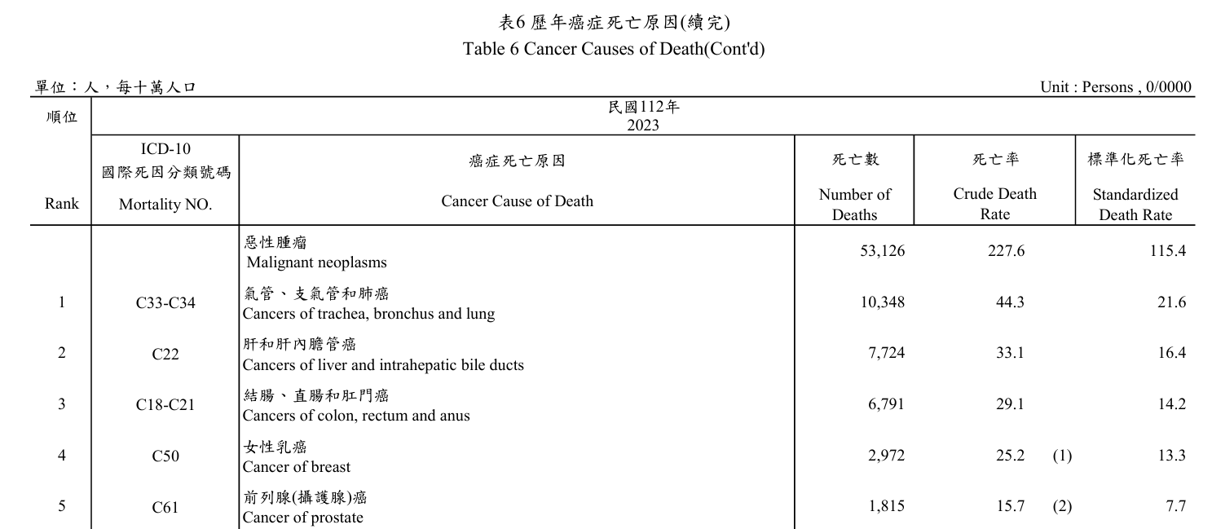
Cancer cause of death in Taiwan
Ministry of Health and Welfare, Taiwan

Slide 6
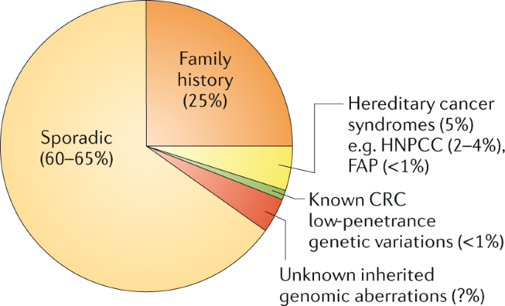
Cause of colorectal cancer
Nat Rev Gastroenterol Hepatol. 2019 Dec;16(12):713-732.

Slide 7
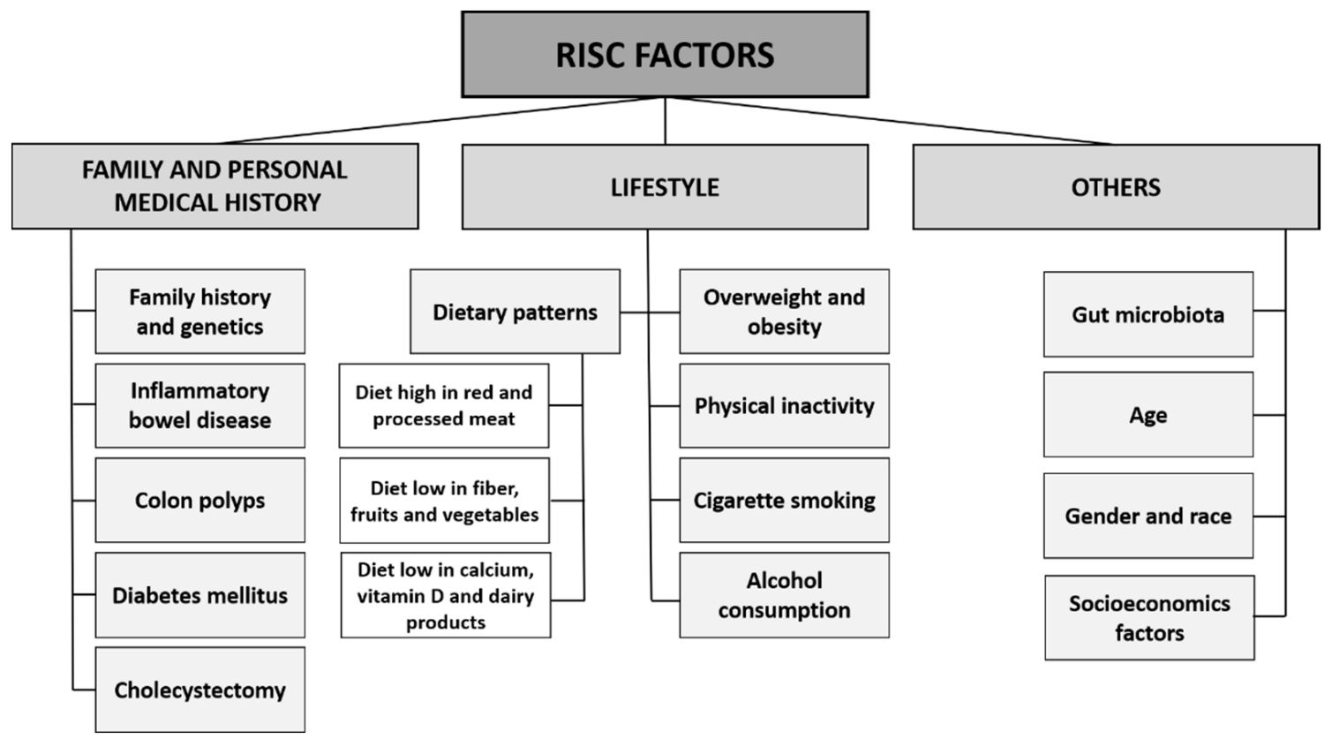
Risk factor of colorectal cancer
Cancers (Basel). 2021 Apr 22;13(9):2025

Slide 8
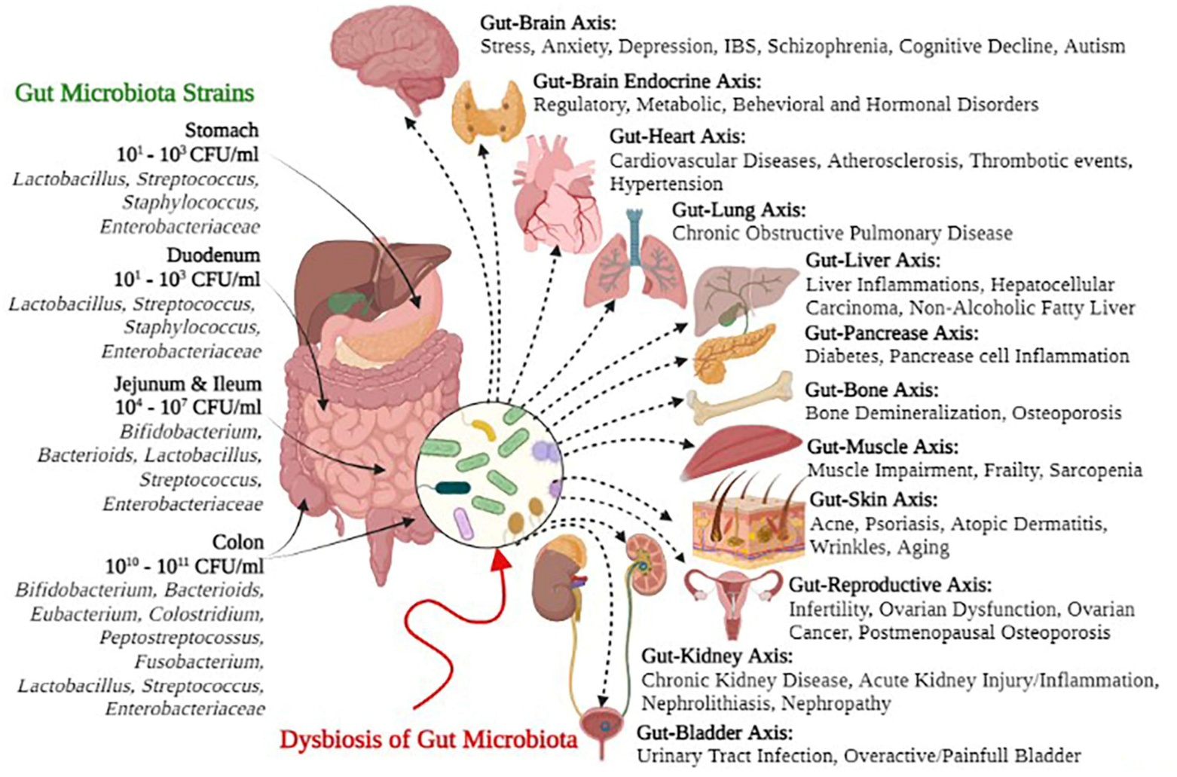
Gut microbiota
Front Microbiol. 2022 Sep 26:13:999001.

Slide 9
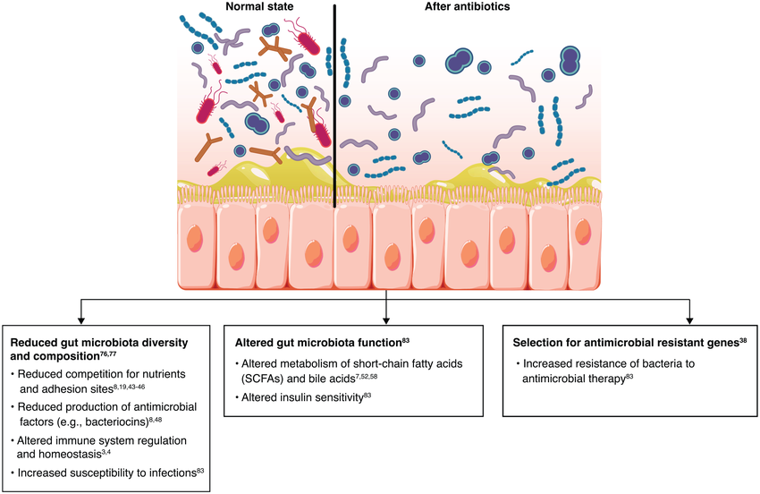
Dysbiosis of gut microbiota
Therap Adv Gastroenterol 2022 Nov 18:15:17562848221134396.

Slide 10
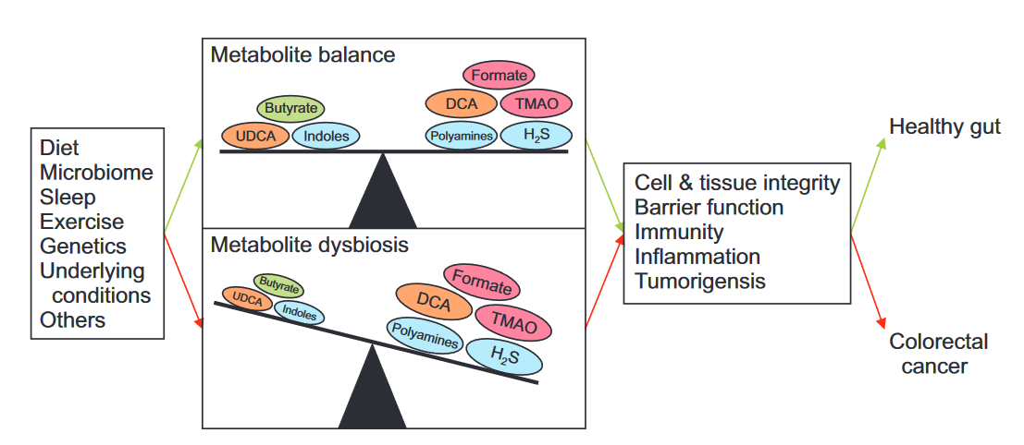
Dysbiosis of gut microbiota can cause CRC
Gut Liver. 2023 Mar 15;17(2):190-203.

Slide 11
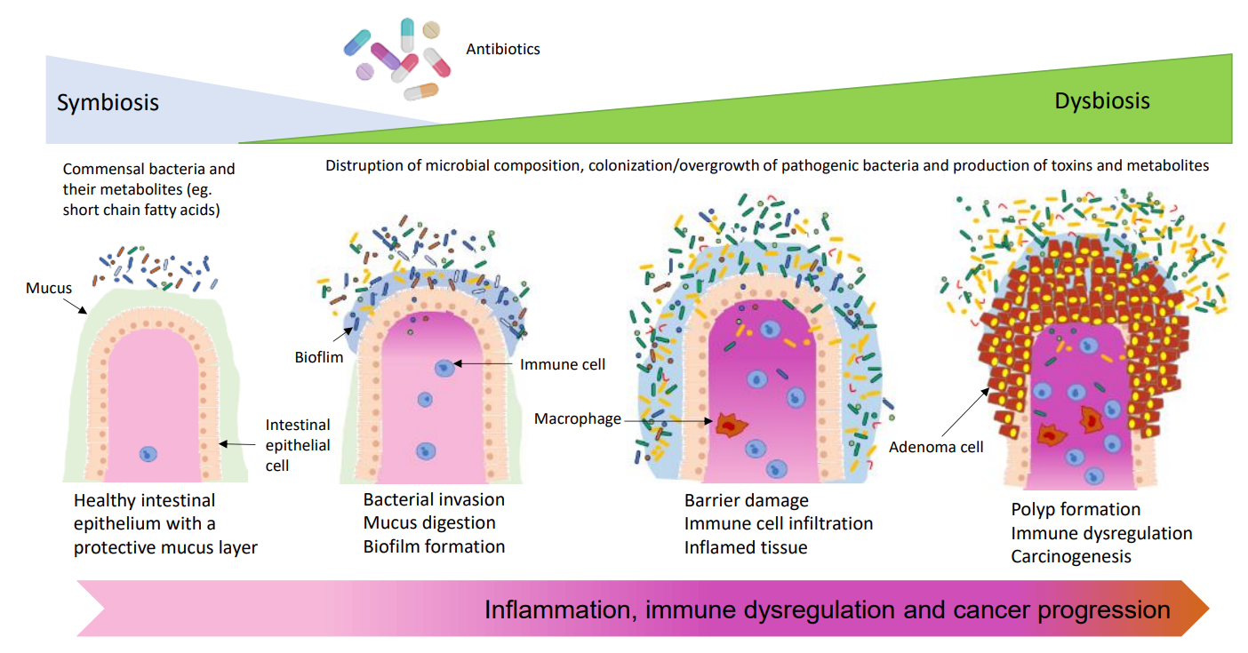
Dysbiosis of gut microbiota can cause CRC
Gut microbes, 2021. 13(1): p. e1941710

Slide 12
Aim
Antibiotic exposure
Colorectal cancer

Slide 13
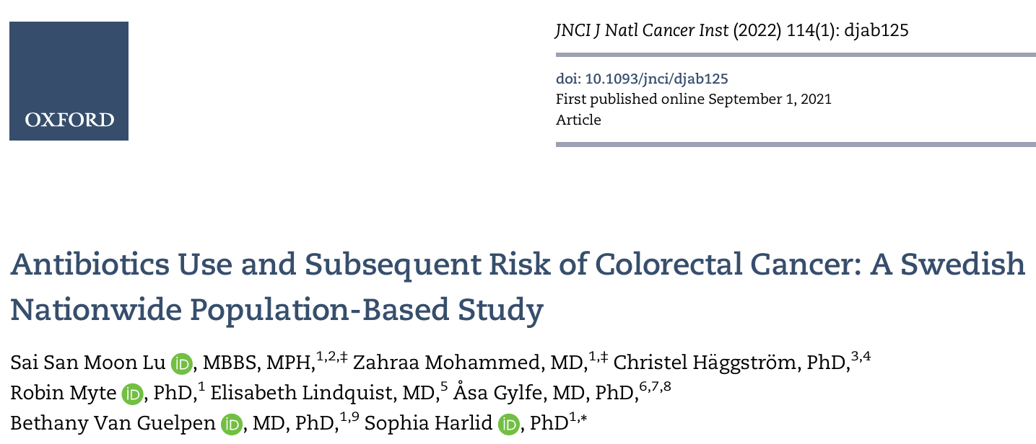
1
2

Slide 14
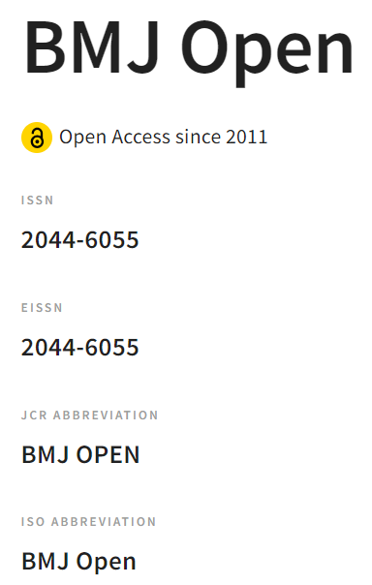
1

Slide 16
Study design
Nested case–control study
Database:
Integrated Computerised Network (Intego), Belgium
Since 1994
General practitioners
over 3 million diagnoses and 12 million prescriptions
covers more than 2% of the Flemish population

Slide 17
Study design
Participant:
Aged above 18 years old
Registered in the Intego database during 2010/1/1~2015/12/31
Case:
First diagnosis of CRC (ICPC- 2 code D75) registered by their GP during the selection interval
Index date: date of their first diagnosis of CRC

Slide 18
Study design
Control:
Match ratio: 1:4
age (±5 years), sex, the number of comorbidities (±1 disease), site of general practice, the same index date as their case counterpart
Exclusion of case:
CRC prior to the selection interval
IBD(Inflammatory bowel disease) prior to the index date

Slide 19
Flow chart

Slide 20
Flow chart

Slide 21
Study design
Exposure:
Any oral antibiotic therapy during 1–10 years prior to the index date
Prescriptions 1 year prior to the index date were not considered(to avoid protopathic bias)
Eight classes of antibiotics(ATC code): tetracyclines (J01A), amphenicols (J01B), beta-lactam antibiotics, penicillines (J01C), other beta-lactam antibacterials (J01D), sulfonamides and trimethoprim (J01E), macrolides, lincosamides and streptogramins(J01F), quinolone antibacterials (J01M) and other antibacterial drugs (J01X).

Slide 22
Study design
Exposure:
Antibiotic categories:
Based on total number of prescriptions
Non-users, low (1st–33rd percentile), intermediate (34th–66th percentile), high (67th–90th percentile), very high (above 90th percentile) and all (1st percentile and above)

Slide 23
Study design
Covariates:
DM (ICPC- 2 code T90)
Lacked registration
Tobacco use
Hereditary disorders, such as Lynch syndrome
Primary outcome:
The association between the number of prescriptions for oral antibiotics and the incidence of colorectal cancer over a period of 1–10 years

Slide 24
Study design - Statistical analysis
Continuous variables - Student’s t - test and Mann - Whitney U test
Categorical variables - Pearson χ2 test
Primary outcome analysis – conditional logistic regression analysis to estimate OR and 95% CIs

Slide 25
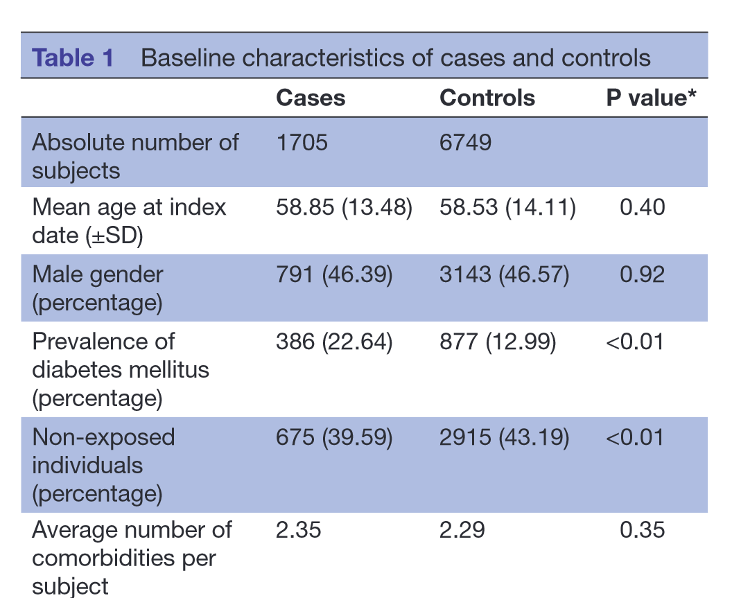
Result - Baseline characteristics
Top three most prevalent comorbidities:
hypertension, hypercholesterolaemia and asthma

Slide 26
Result - Antibiotic prescriptions
 | Cases(n = 1705) | Controls(n = 6749)
Total antibiotic prescriptions | 5,217 | 18,263
Average prescriptions per person | 3.06 | 2.71
Average interval between prescriptions | Once every 3 years | Once every 3 years and 4 months
Percentage of non-users | 40% | 43%

Slide 27
Result – Category of antibiotic prescriptions (case + control group)
Category | Number of Individuals | Percentage
Non-users | 3590 | 42%
Low exposure(1st–33rd percentile) | 2110 | 25%
Intermediate exposure(34th–66th percentile) | 1056 | 12%
High exposure(67th–90th percentile) | 1188 | 14%
Very high exposure(above 90th percentile) | 510 | 6%

Slide 28
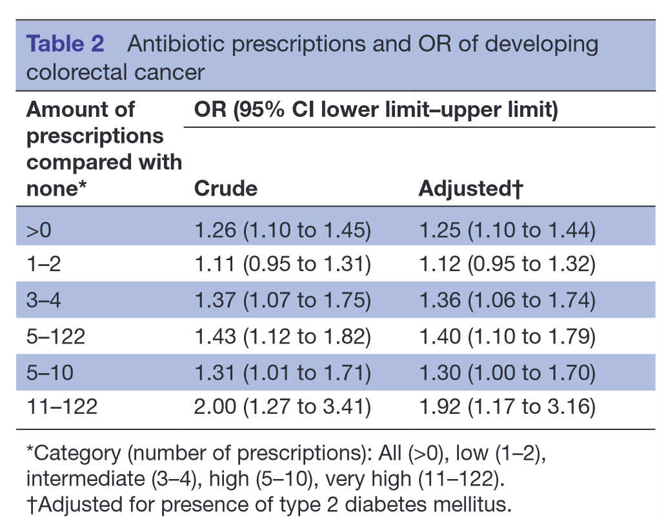
Result – Association between antibiotics and risk of CRC
All users
Low exposure
Intermediate exposure
High exposure
Very high exposure

Slide 29
Discussion
No dose response between the level of antibiotic expose and the risk of CRC
Lack of a clear increase of ORs
The CIs of all categories were overlapping with their lesser-exposed category
More like threshold type model
Possibility of a permanent altered colonic state after antibiotic exposure

Slide 30
Discussion
Strengths:
Size of more than a quarter of a million of unique individuals during the selection period
Representativeness for the Flemish–Belgian population in terms of the geological spread, age and sex

Slide 31
Discussion
Limitation:
Absence of known risk factors, especially smoking
Belgian patients are free to visit different GPs of their choice => may result in incomplete data
Case-control study => limits the power of investigating causality.

Slide 32
Conclusion
In this case–control study, prescribed oral antibiotics predicted an increased risk of CRC without a clear dosage-response relationship

Slide 33
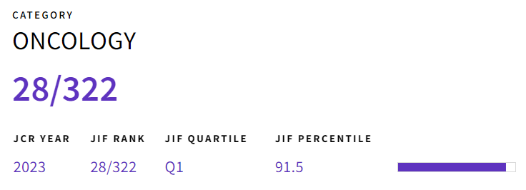
2

Slide 35
Study design
Matched case–control study
Database:
Case - Swedish Colorectal Cancer Register
Control - Total Population Register
Antibiotics use - Swedish Prescribed Drug Register
Other variables - Swedish Inpatient Register, Longitudinal Integration Database for Health Insurance Labor Market Studies

Slide 36
Study design
Study period:
2005/1/1~2016/12/31
Case:
CRC cases(ICD 10:C18.0, C18.2-18.9, C19.9, and C20.9)
Diagnosed in 2010/1/1~2016/12/31
Minimum of 4.5 years f/u with complete exposure data
Proximal colon cancer(caecum, ascending colon, hepatic flexure, transverse colon, or splenic flexure), distal colon cancer(descending or sigmoid colon), or rectal cancer(rectosigmoidal junction or rectum)

Slide 37
Study design
Control:
Match ratio: 1:5
Same year, same sex and same county as their index case at the time of diagnosis
Exclusion of case:
Previous cancer diagnosis (except non-melanoma skin cancer)

Slide 38
Study design
Exposure:
Any antibiotic therapy during study period before CRC diagnosed
Antibiotics(ATC code): J01 and J04 (anti-infective agents for systemic use) A07A (intestinal anti-infective agents P01 (anti-protozoal that could have antibacterial effects)
Antibiotics use reported as defined daily doses(DDD), a unit of comparison for drug statistics

Slide 39
Defined daily doses(DDD)
Patient A: amoxicillin 0.5 GM TID x 7 days
Patient B: amoxicillin 1 GM BID x 3 days

Slide 40
Defined daily doses(DDD)
Patient A: amoxicillin 0.5 GM TID x 7 days => 0.5 x 3 x 7 = total 10.5 GM
Patient B: amoxicillin 1 GM BID x 3 days => 1 x 2 x 3 = total 6 GM

Slide 41
Defined daily doses(DDD)
Patient A: amoxicillin 0.5 GM TID x 7 days
Patient B: amoxicillin 1 GM BID x 3 days
Patient C: clindamycin 0.6 GM TID x 5 days

Slide 42
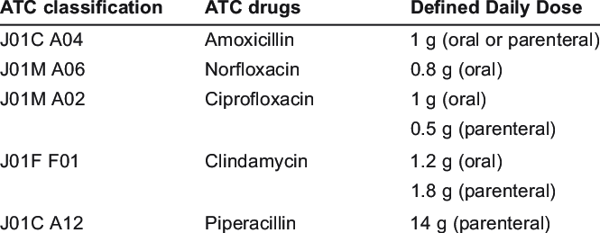
Defined daily doses(DDD)
Definition: assumed average maintenance dose per day for a drug used for its main indication in adults

Slide 43
Defined daily doses(DDD)
Patient A: amoxicillin 0.5 GM TID x 7 days
=> 0.5 x 3 x 7 = total 10.5 GM, DDD: 10.5 / 1 = 10.5 DDD-day
Patient B: amoxicillin 1 GM BID x 3 days
=> 1 x 2 x 3 = total 6 GM, DDD: 6 / 1 = 6 DDD-day
Patient C: clindamycin 0.6 GM TID x 5 days
=> 0.6 x 3 x 5 = total 9 GM, DDD: 9 / 1.2 = 7.5 DDD-day

Slide 44
Study design
Exposure:
Antibiotic categories:
based on DDD
no use (no reported use of antibiotics during the study period), low (1-10 days), moderate (11-60 days), high (61-180 days), and very high (>180 days)

Slide 45
Study design
Covariates:
Socioeconomic factors (level of education, country of birth, and marital status retrieved from the LISA database)
Health-care utilizations (number of specialist visits and hospitalizations from the Swedish Inpatient Register)
as a surrogate for potentially relevant comorbidities and health-care–seeking behavior
Primary outcome:
The association between the antibiotics use and the risk of colorectal cancer

Slide 46
Study design - Statistical analysis
Continuous variables - 2-sample t test
Categorical variables - Pearson χ2 test
Primary outcome analysis – conditional logistic regression analysis to estimate OR and 95% CIs
Dose-response effect - Trend tests
Multiplicative interaction terms – sex
Subgroup analyses (sex, age, and anatomical tumor site)
Sensitivity analyses (excluding the use of antibiotic in the 2 years prior to case diagnosis)

Slide 47
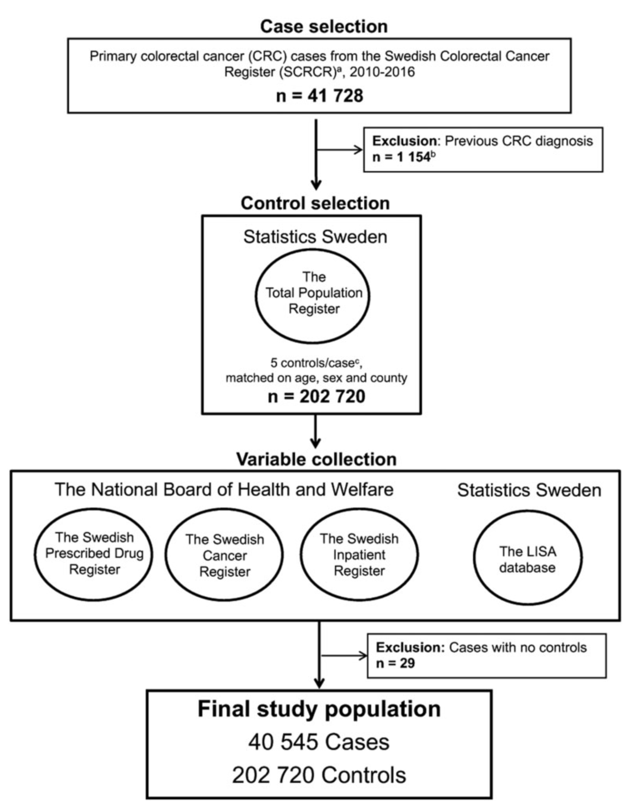
Flow chart

Slide 48
Flow chart

Slide 49
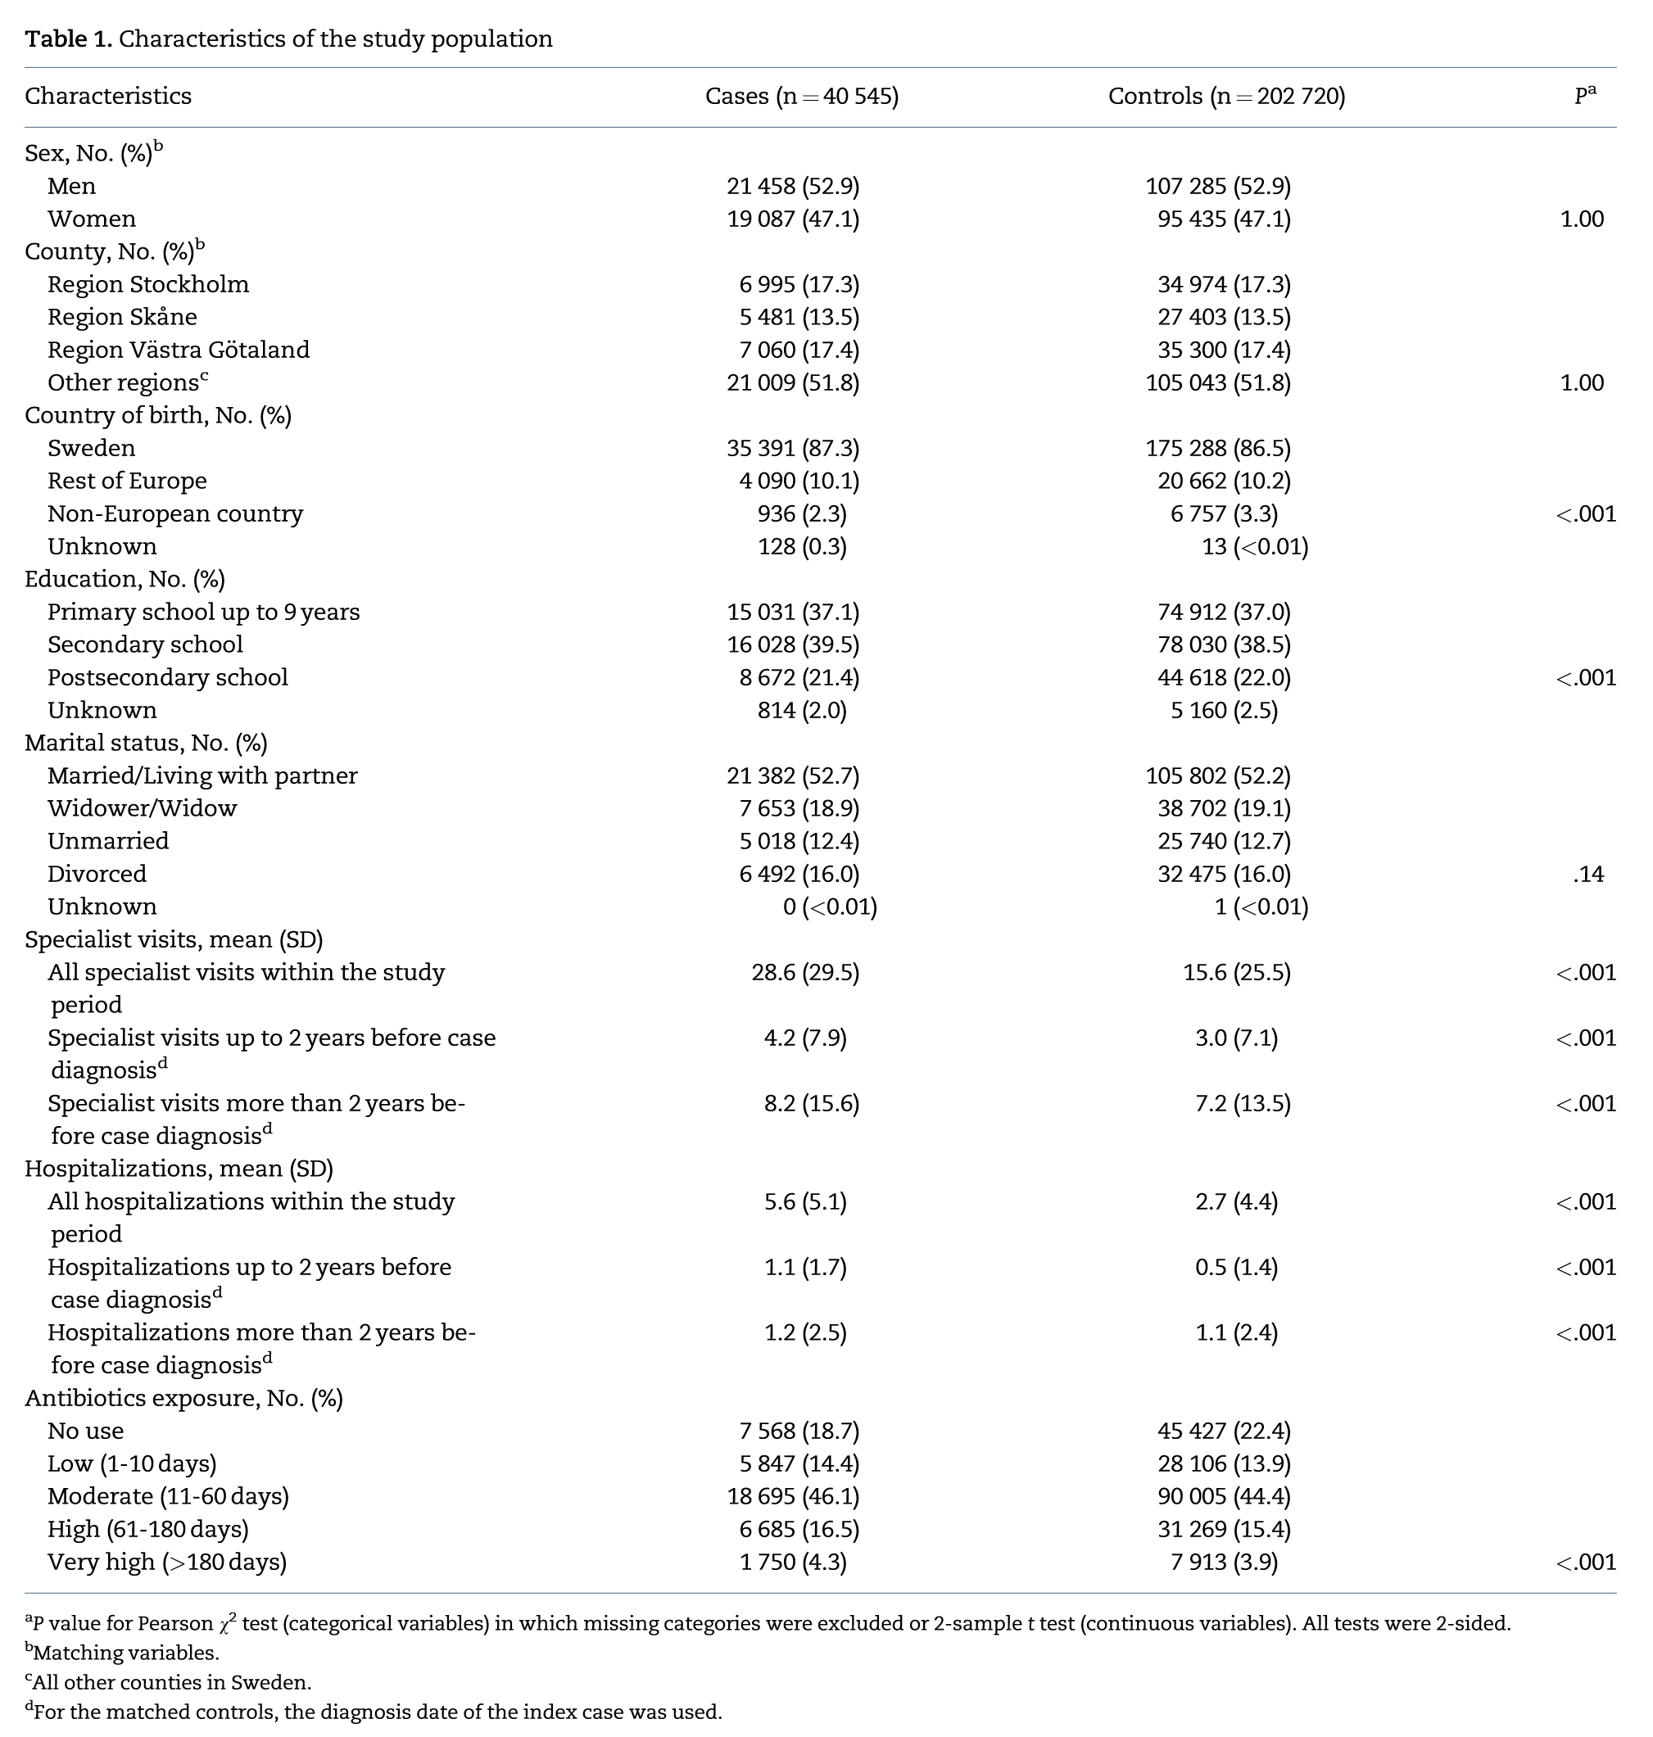
Result - Baseline characteristics

Slide 50
Result - Baseline characteristics

Slide 51
Result – Association between antibiotics use and risk of CRC by tumor site

Slide 52
Result – Association between antibiotics use and risk of CRC by tumor site
adjusted OR decreased, without statistically significant

Slide 53
Result

Slide 54
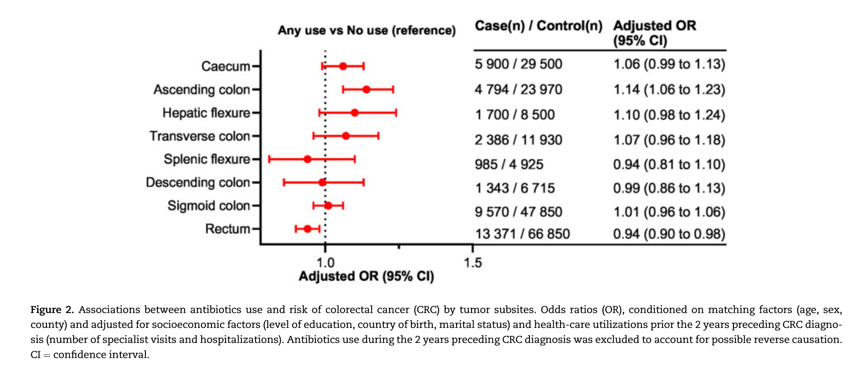
Result – Association between antibiotics use and risk of CRC by tumor site

Slide 55
Result – Association between antibiotics use and risk of CRC by tumor site
OR: 1.14
OR: 0.94

Slide 56
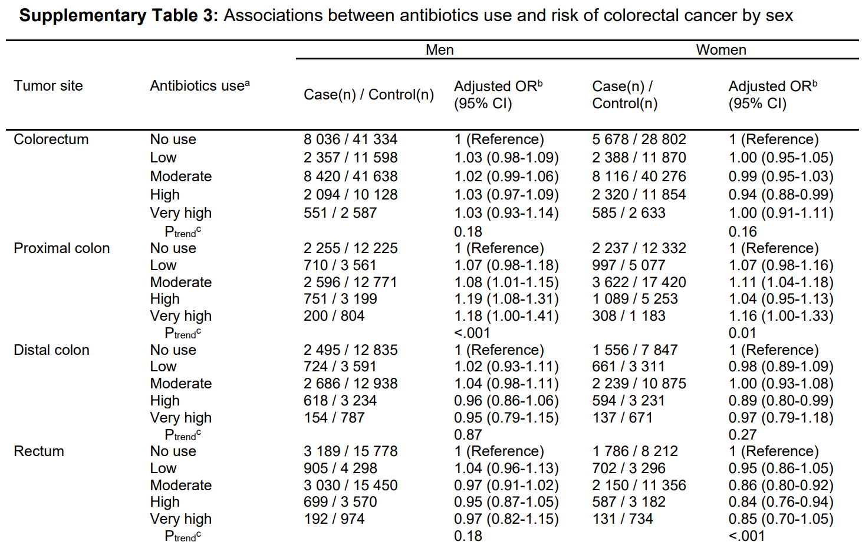
Result

Slide 57
Result
A statistically significant interaction was found between antibiotics use and sex for rectal cancer (P_{interaction} = .002)
Tests for heterogeneity showed statistically significant differences between men and women for rectal cancer (P_{het} = .004)

Slide 58
Result – Association of antibiotic use and risk of CRC by different class of antibiotic

Slide 60
Discussion
The ORs for antibiotic use differed between the proximal colon and rectum
Decreasing concentration of short-chain fatty acids along the colon => higher bacterial activity, biofilm formation, and fermentation in the proximal compared with the distal colon and rectum
Antibiotics are gradually absorbed and metabolized in the colon.

Slide 61
Discussion
Strengths:
High-quality, nationwide, registry-based data
>98% of all diagnosed CRC cases have been reported to the Swedish Colorectal Cancer Register
Swedish Prescribed Drug Register
one of the largest pharmaco-epidemiological databases in the world, with complete national data
LISA database and the Swedish Inpatient Register also have high validity
Large sample size

Slide 62
Discussion
Limitation:
Unmeasured confounding
Diet, medical comorbidities such as diabetes or inflammatory bowel disease, and use of other medications
At the time of our study, there was no national CRC screening in Sweden => matched on county of residence
Lack of data on inpatient antibiotics and antibiotics use before 2005(the start of the pharmaceutical register) resulting in less than 10 years follow-up time

Slide 63
Conclusion
This register-based study covering the entire population of Sweden found a robust association between antibiotics use and higher risk of proximal colon cancer and an inverse association with rectal cancer in women

Slide 64
Comparison of the two papers
 | Paper 1 | Paper 2
Study question | Is antibiotic use a risk factor a colorectal cancer | Is antibiotic use a risk factor a colorectal cancer
Design | Nested case–control study | Matched case–control study
Setting | Integrated Computerised Network (Intego), Belgium | Case - Swedish Colorectal Cancer Register Control - Total Population Register
Case | First diagnosis of CRC | First diagnosis of CRC
Control | Match ratio: 1:4 age, sex, the number of comorbidities, site of general practice, the same index date as their case counterpart | Match ratio: 1:5 Same year, same sex and same county as their index case at the time of diagnosis

Slide 65
Comparison of the two papers
 | Paper 1 | Paper 2
Study question | Is antibiotic use a risk factor a colorectal cancer | Is antibiotic use a risk factor a colorectal cancer
Design | Nested case–control study | Matched case–control study
Setting | Integrated Computerised Network (Intego), Belgium | Case - Swedish Colorectal Cancer Register Control - Total Population Register
Case | First diagnosis of CRC | First diagnosis of CRC
Control | Match ratio: 1:4 age, sex, the number of comorbidities, site of general practice, the same index date as their case counterpart | Match ratio: 1:5 Same year, same sex and same county as their index case at the time of diagnosis
V

Slide 66
Comparison of the two papers
 | Paper 1 | Paper 2
Sample size | Case: 1705 Control: 6749 | Case: 40545 Control: 202720
Exposure | Number of antibiotic prescription | Defined daily doses(DDD)
Outcomes measure | The association between the number of prescriptions for oral antibiotics and the incidence of colorectal cancer over a period of 1–10 years | The association between the antibiotics use and the risk of colorectal cancer
Statistical analyses | Conditional logistic regression analysis | Conditional logistic regression analysis

Slide 67
Comparison of the two papers
 | Paper 1 | Paper 2
Sample size | Case: 1705 Control: 6749 | Case: 40545 Control: 202720
Exposure | Number of antibiotic prescription | Defined daily doses(DDD)
Outcomes measure | The association between the number of prescriptions for oral antibiotics and the incidence of colorectal cancer over a period of 1–10 years | The association between the antibiotics use and the risk of colorectal cancer
Statistical analyses | Conditional logistic regression analysis | Conditional logistic regression analysis
V
V

Slide 68
Comparison of the two papers
 | Paper 1 | Paper 2
Selection bias | Little due to nested case–control study | Little because controls were selected from Total Population Register
Information bias | Patient received antibiotic from clinics not belong to Intego Patient compliance No inpatient and IV form antibiotic data | Patient compliance No inpatient data
Confounding | Only adjust DM, and match number of comorbidity Lack data of diet, smoking, BMI, exercise… | Only adjust SES, health-care utilizations Lack data of DM, diet, smoking, BMI, exercise, comorbidity…

Slide 69
Comparison of the two papers
 | Paper 1 | Paper 2
Selection bias | Little due to nested case–control study | Little because controls were selected from Total Population Register
Information bias | Patient received antibiotic from clinics not belong to Intego Patient compliance No inpatient and IV form antibiotic data | Patient compliance No inpatient data
Confounding | Only adjust DM, and match number of comorbidity Lack data of diet, smoking, BMI, exercise… | Only adjust SES, health-care utilizations Lack data of DM, diet, smoking, BMI, exercise, comorbidity…
V

Slide 70
Comparison of the two papers
 | Paper 1 | Paper 2
Results | Oral antibiotics predicted an increased risk of CRC without a clear dosage-response relationship | Robust association between antibiotics use and higher risk of proximal colon cancer and an inverse association with rectal cancer in women
Advantages | Nested case–control study Large size number | Large sample size Nationwide Use DDD for antibiotic use
Disadvantages | Lack known risk factors Only number of antibiotic prescription | Lack known risk factors No national CRC screening in Sweden

Slide 71
Comparison of the two papers
 | Paper 1 | Paper 2
Results | Oral antibiotics predicted an increased risk of CRC without a clear dosage-response relationship | Robust association between antibiotics use and higher risk of proximal colon cancer and an inverse association with rectal cancer in women
Advantages | Nested case–control study Large size number | Large sample size Nationwide Use DDD for antibiotic use
Disadvantages | Lack known risk factors Only number of antibiotic prescription | Lack known risk factors No national CRC screening in Sweden
V

Slide 72
Comment for Hung Jui’s Paper 1
Commentor:
2nd Year PhD student
Chiu- Wen Chang (T88121015)
2025.04.16

Slide 73
Comment 1
It is known to be associated with the development of short-term gastrointestinal symptoms such as diarrhea. Little is known about long-term effects of oral antibiotic exposure in the relationship between antibiotic exposure and development of colorectal cancer (CRC). Most of these might slowly turn into cancer over the course of about 10-15 years.
Q1. The pathogenesis of CRC, if one sick man turns into caner need for 10-15 years. However, this study analysis 5 years antibiotic used data, is it reasonable? Should we consider the long-term effects of relationship between antibiotic and CRC? How do you explain?

Slide 74
Response to comment 1
I agree with longer study period to assess the earlier stage of CRC
Antibiotic exposure may accelerate the CRC growth

Slide 75
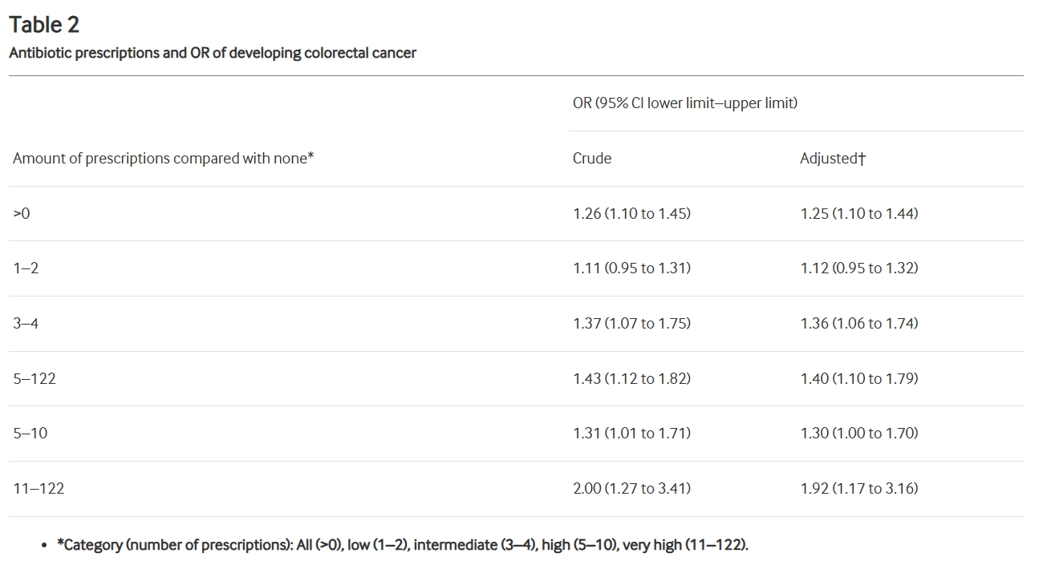
Comment 2
Table 2 shows the association between antibiotics and risk of CRC. The OR of developing CRC for antibiotic users with one or more prescriptions compared with non-users. It seems there is no increase of ORs in relationship between antibiotic amount and CRC.
Q2. In this study, it is not show an evident dose-response relationship. Do you think if it is necessary to do dose-response?

Slide 76
Response to comment 2
The author did not do trend test.
“Lack of a clear increase of ORs, the CIs of all categories were overlapping with their lesser- exposed category, an evident dose- response relationship could not be shown. “
I think trend test is needed
Patient A: amoxicillin 1 GM BID x 3 days, x 2 times Patient B: amoxicillin 1 GM BID x 7 days Number of prescription: A > B; DDD: B > A

Slide 77
Comments on Hung Jui's paper
T88134018 Yen-Chun, Wang
PhD 1st Year Student

Slide 78
Comment 1
As I understand, antibiotics should be used under medical prescription. There is strong association between health-care utilizations (number of specialist visits and hospitalizations) and antibiotics use. In the analysis of this study, they adjust for the health-care utilizations prior the 2 years preceding CRC diagnosis. Does the adjustment block the partial effect of antibiotics use?
Health-care utilizations
Antibiotics use
CRC diagnosis

Slide 79
Response to comment 1
Reverse causation bias
CRC typically develops over a period of 10–15 years, so late exposure to antibiotic is less associated to tumor growth.

Slide 80
Comment 2
Some results are hard to convince me that only low use (<10 days) will be associated with the CRC diagnosis two years or more later. I think that using continuous days not only allows for direct testing of the dose effect (the significance of coefficient in regression model), but also for further identification of the optimal cut-off point for predicting CRC diagnosis. Why don’t the authors directly use the number of days of antibiotic use as a continuous variable instead of categorizing as no use (no reported use of antibiotics during the study period), low (1-10 days), moderate (11-60 days), high (61-180 days), and very high (>180 days) use?

Slide 81
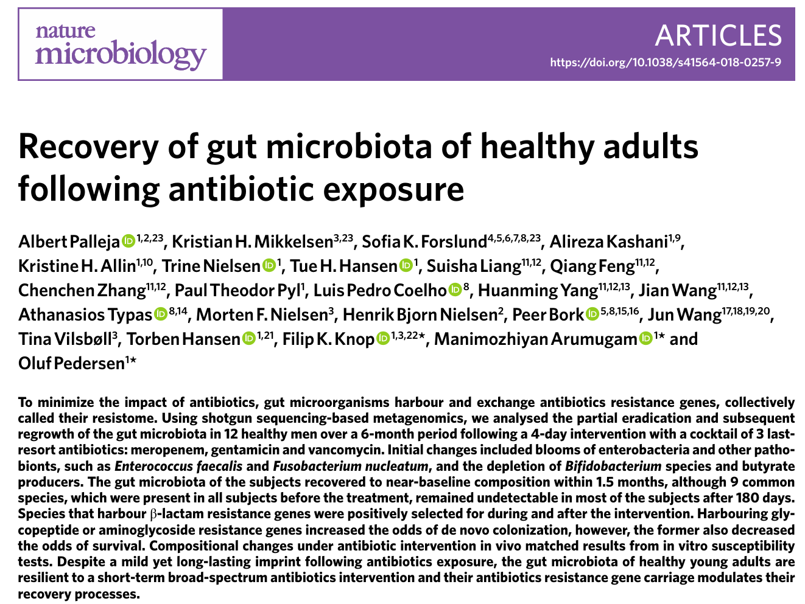
Effect of short term antibiotic use on microbiota

Slide 82
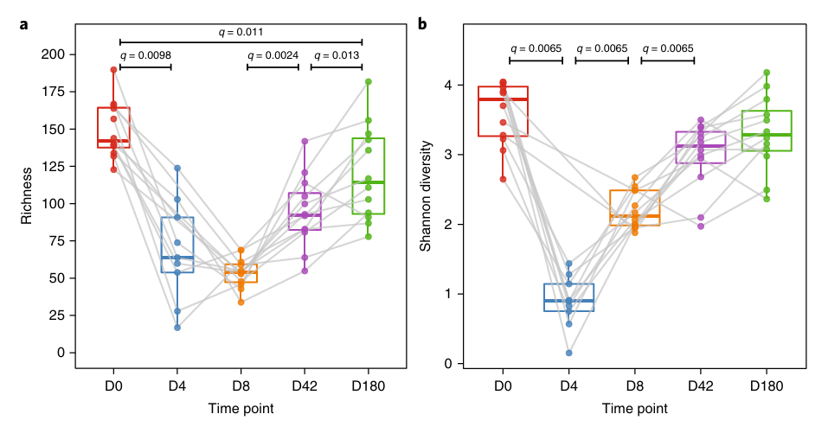

Slide 83
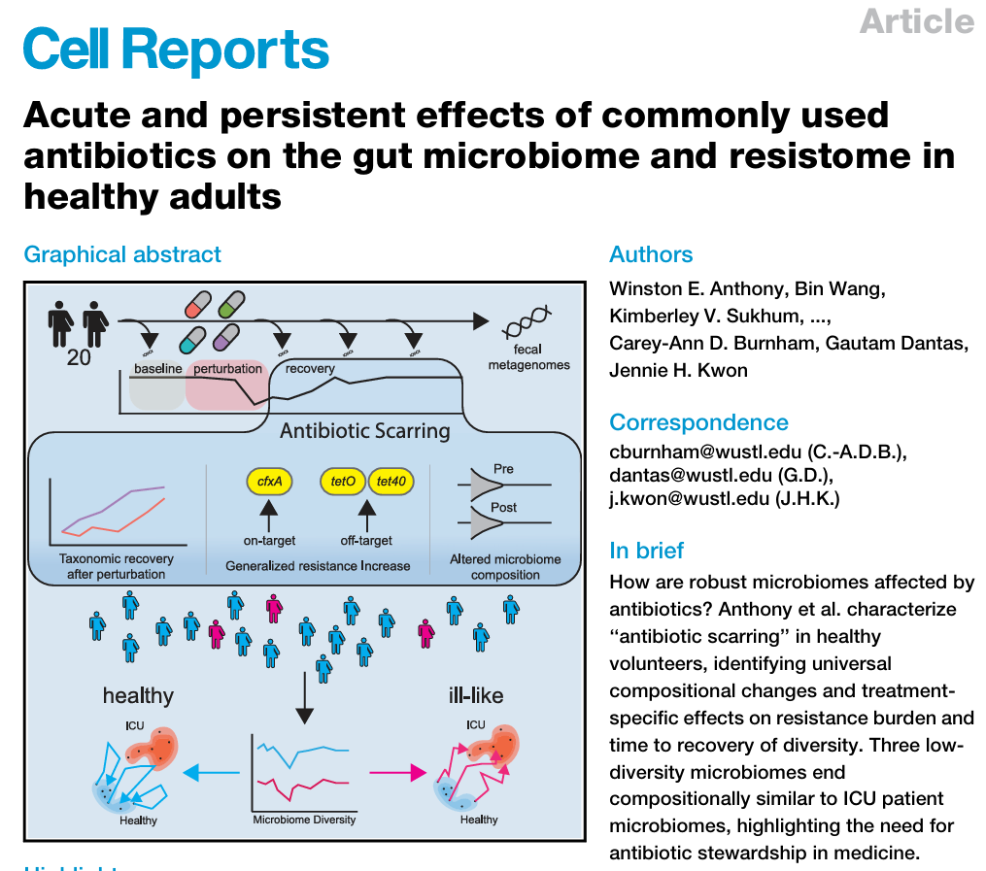
5 days

Slide 84
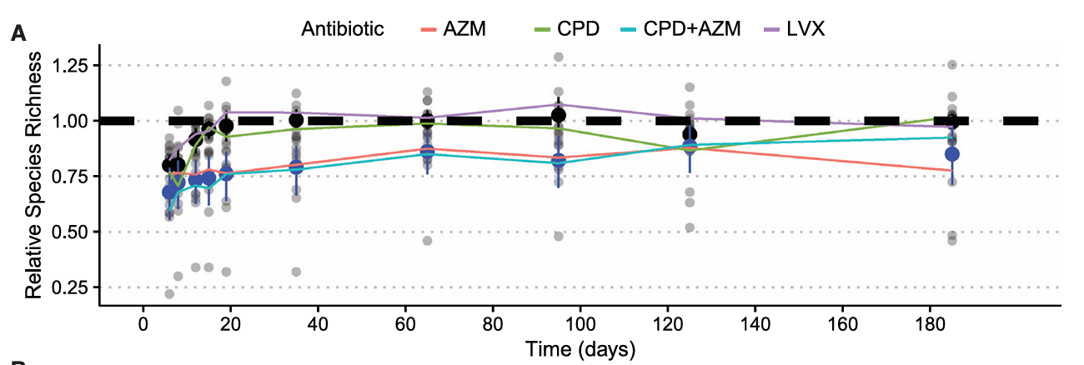

Slide 85
Why not use the number of days of antibiotic use as a continuous variable?
The result will be “every 1-unit increase in DDD-day, the OR of CRC increases by x”

Slide 86
Why not use the number of days of antibiotic use as a continuous variable?
The result will be “every 1-unit increase in DDD-day, the OR of CRC increases by x”
X may very small due to small OR in this paper

Slide 87
Why not use the number of days of antibiotic use as a continuous variable?
The result will be “every 1-unit increase in DDD-day, the OR of CRC increases by x”
X may very small due to small OR in this paper
Not useful in the clinical practice

Slide 88
Why not use the number of days of antibiotic use as a continuous variable?
The result will be “every 1-unit increase in DDD-day, the OR of CRC increases by x”
X may very small due to small OR in this paper
Not useful in the clinical practice
The relationship between DDD-day and OR may not be linear

Slide 89
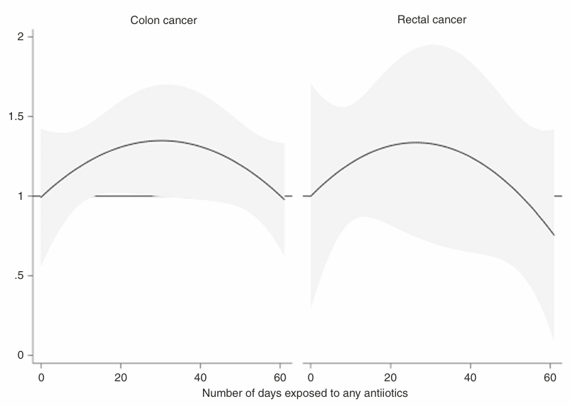
Br J Cancer. 2020 Dec;123(12):1825-1832.

Slide 90
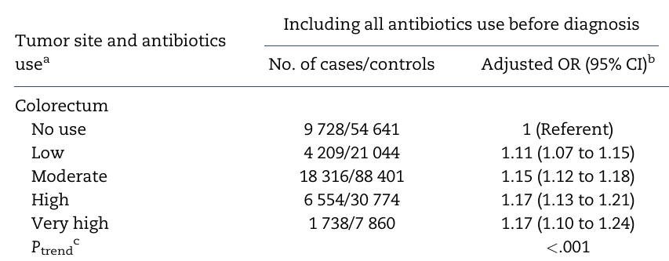
Additional comment
Table 1
Case
Control
Table 2

Slide 91
