Slide 1
Comments on Paper 1
T88127011 Mita Restinia
2nd Year PhD Student

Slide 2
Comment 1. The aim of study
The study aims to assess whether the expansion of pediatric diabetes service, including access to technology (like insulin pumps), and more frequent clinic visits—led to : improved glycemic control and reduce acute complication.
However, the study does not fully address the aim of study, as it tends to be descriptive study. Although the authors observed an improvement in HbA1c over time, it remains difficult to determine whether this improvement can be attributed solely to the expansion of diabetes services, given the absence of a control group and causal analysis.
Therefore, including data from a comparable center without service expansion would have helped isolate the effect of the expanded services from glycemic control. What are your thoughts on this matter?

Slide 3
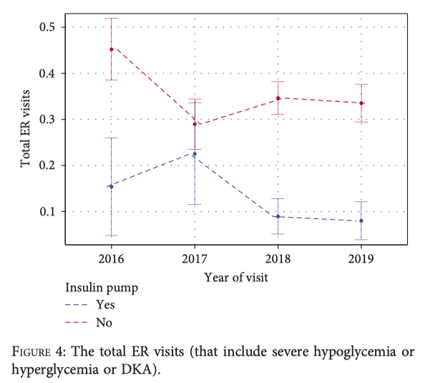
Comment 2. ER Visit Trend Analysis
The authors appropriately stratified emergency room (ER) visits by insulin modality (CSII vs. MDI), as shown in Figure 4
However, the analysis remains limited because ER visits were reported in aggregate, without disaggregation by type of acute complication (e.g., DKA, severe hypoglycemia, or severe hyperglycemia),
To enhance the clinical relevance and interpretability of the results, ER visits should be reported separately by type of complication and further stratified by insulin regimen and year. What do you think about it?

