Slide 1
Comments on Paper 1
T88127011 Mita Restinia
2nd Year PhD Student

Slide 2
Comment 1. The aim of study
The study aims to assess whether the expansion of pediatric diabetes service, including access to technology (like insulin pumps), and more frequent clinic visits—led to : improved glycemic control and reduce acute complication.
However, it does not fully address the research question. Although the authors observed an improvement in HbA1c, it is difficult to determine whether the expansion of diabetes services alone was responsible for this improvement. Including data from a comparable center without service expansion would have helped isolate the effect of the expanded services from glycemic control.

Slide 3
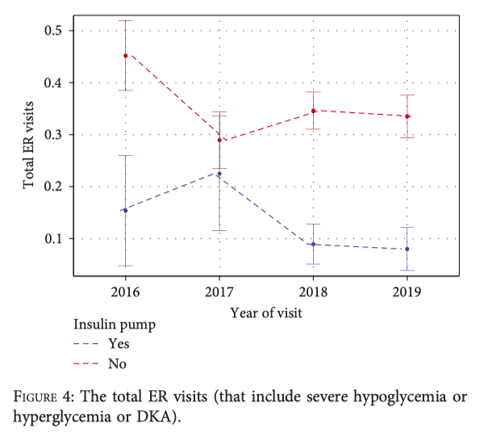
Comment 2. ER Visit Trend Analysis
The authors appropriately stratified emergency room (ER) visits by insulin modality (CSII vs. MDI), as shown in Figure 4
However, the analysis remains limited because ER visits were reported in aggregate, without disaggregation by type of acute complication (e.g., DKA, severe hypoglycemia, or severe hyperglycemia),
To enhance the clinical relevance and interpretability of the results, ER visits should be reported separately by type of complication, and further stratified by insulin regimen and year.

