Slide 1
Comment for Hung Jui’s Paper 1
Commentor:
2nd Year PhD student
Chiu- Wen Chang (T88121015)
2025.04.16

Slide 2
Comment 1
It is known to be associated with the development of short-term gastrointestinal symptoms such as diarrhea. Little is known about long-term effects of oral antibiotic exposure in the relationship between antibiotic exposure and development of colorectal cancer (CRC). Most of these might slowly turn into cancer over the course of about 10-15 years.
Q1. The pathogenesis of CRC, if one sick man turns into caner need for 10-15 years. However, this study analysis 5 years antibiotic used data, is it reasonable? Should we consider the long-term effects of relationship between antibiotic and CRC? How do you explain?

Slide 3
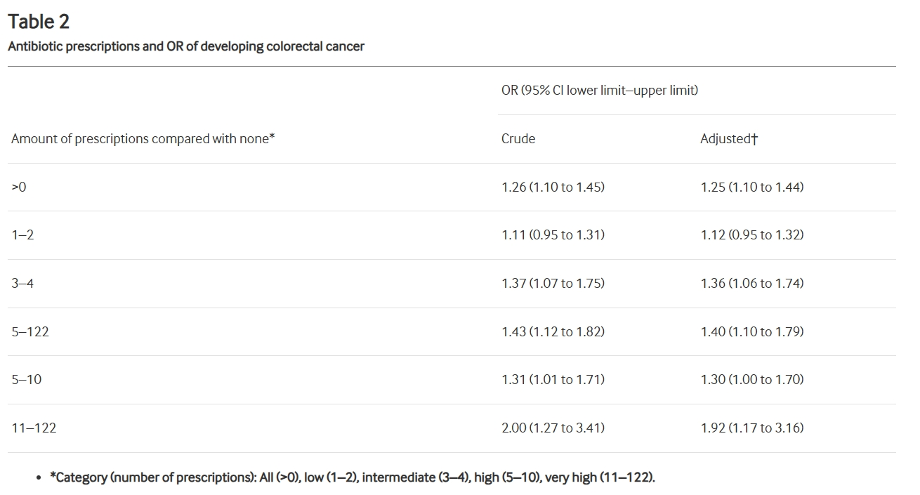
Comment 2
Table 2 shows the association between antibiotics and risk of CRC. The OR of developing CRC for antibiotic users with one or more prescriptions compared with non-users. It seems there is no increase of ORs in relationship between antibiotic amount and CRC.
Q2. In this study, it is not show an evident dose-response relationship. Do you think if it is necessary to do dose-response?

