Slide 1
Infant Safe Sleep Practices
Swati Jain
2nd Year PhD Student
Advisor: Prof. Robert Lu
9th April, 2025

Slide 2
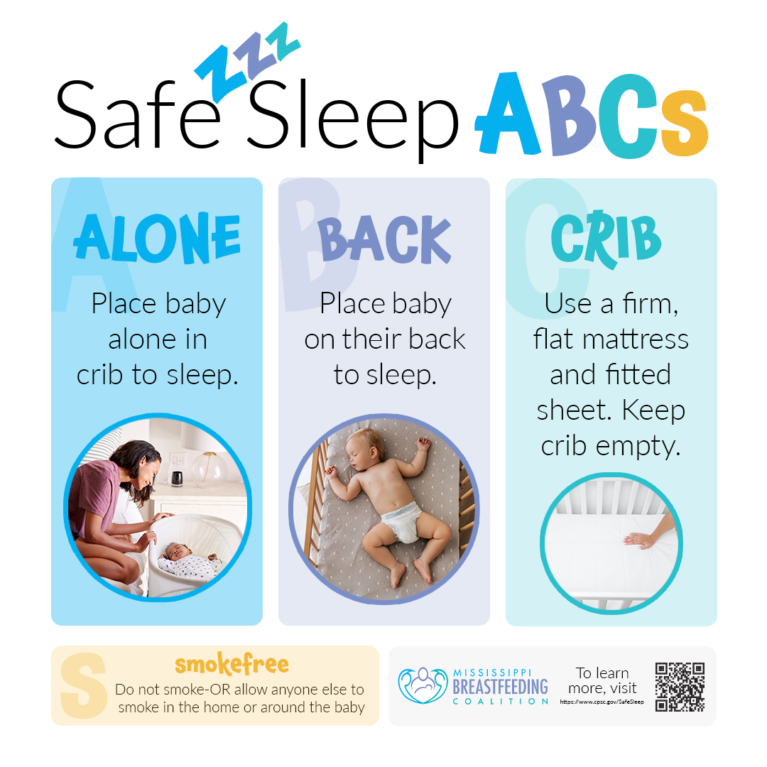
Background
Sudden Unexpected Infant Death (SUID), which includes Sudden Infant Death Syndrome (SIDS), is the leading cause of injury death in infancy. (AAP)
Sudden unexpected infant death is a sudden and unexpected death of a baby aged younger than 1 year. SUID includes sudden infant death syndrome, accidental suffocation and strangulation in bed, and other deaths from unknown causes.
The American Academy of Pediatrics (AAP) guidelines recommend safe sleep practices including: supine positioning, separate sleep spaces, and approved sleep surfaces such as cribs.
Notes:
SIDS still accounts for the top 10 causes of infant deaths in Taiwan.

Slide 3

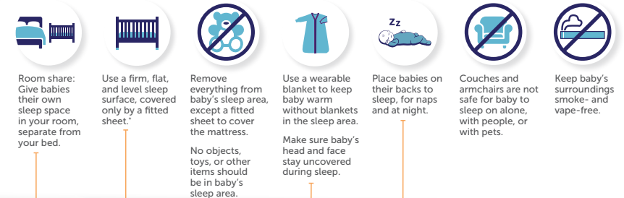
Background

Slide 4
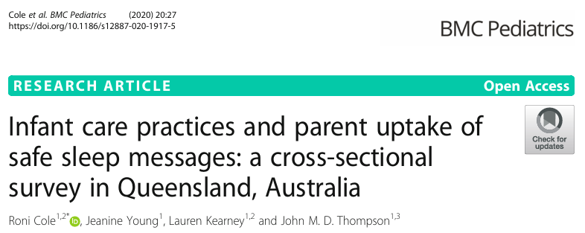

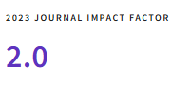
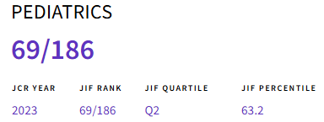
Paper-1
Corresponding Author
Dr. Roni Cole
Adjunct Research Fellow
School of Nursing,
Midwifery and Social Work
The University of Queensland, Australia

Slide 5
Sudden unexpected death in infancy (SUDI) is a term used to describe and classify deaths of apparently well infants for whom the cause of death is not immediately obvious and who would be expected to thrive; it includes sleep-related infant deaths classified as Sudden Infant Death Syndrome (SIDS), asphyxia, undetermined or ill-defined.
Modifiable infant care practices are recognized as the most important factors parents and health practitioners can influence in order to reduce the risk of sleep-related infant mortality.

Slide 6
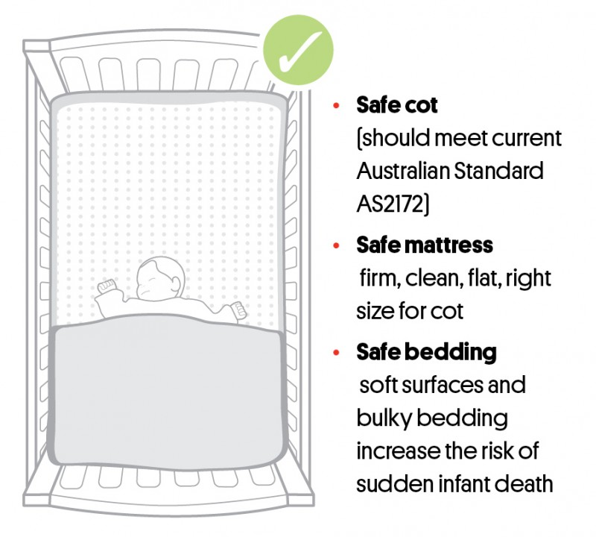
A safe sleeping environment means that all potential dangers have been removed and the baby is sleeping in a safe place. The ideal place for a baby to sleep is in a safe cot, on a safe mattress, with safe bedding in a safe sleeping place, both night and day.

Slide 7
The current public health Safe Sleeping program contains six key messages:
1) Sleep baby on back;
2) Keep head and face uncovered;
3) Keep baby smoke free before and after birth;
4) Safe sleeping environment night and day;
5) Sleep baby in safe cot in parents’ room;
6) Breastfeed baby

Slide 8
Aim: To describe contemporary infant care practices employed by families related to the current public health SUDI prevention program.
Objective: To determine contemporary infant care practices employed by Queensland families and identify consistency of practice with recommendations which underpin the current Australian ‘Safe Sleeping’ public health program.

Slide 9
Study Design: Cross-sectional study
Target Population: Queensland primary caregivers with an infant aged approximately 3 months who was born in Queensland during April–May 2017 (The three-month target age was chosen as it coincides with the period when infants are most vulnerable to SUDI ).
Data Collection: Data were collected via a self-report questionnaire.
  The Queensland Registry of Births, Deaths and Marriages (the Registry) facilitated the state-wide distribution of the survey to home addresses of eligible families (n =10,200) by using the Birth Notification register which provides the most comprehensive representation of the Queensland birth population.

Slide 10
  Questionnaires could be completed either electronically via a unique weblink or by paper via reply-paid postage.
  To increase survey response rates, on behalf of the researchers, the Registry sent a reminder letter to non responders 6 weeks after the initial distribution mail-out.
  Online data was collected via Opinio, with paper questionnaire responses entered manually into Opinio on return.
  Of the 10,200 questionnaires distributed, 302 (3%) were returned to sender (that is not received by the intended recipient), 411 (4%) actively declined participation and 3341 were completed by families (total response rate 33% of eligible births).
Statistical Analysis: Univariate analysis was used to generate descriptive tabulations for key variables. Categorical variables were compared using chi-squared statistic and continuous variables were compared using a t-test.

Slide 11
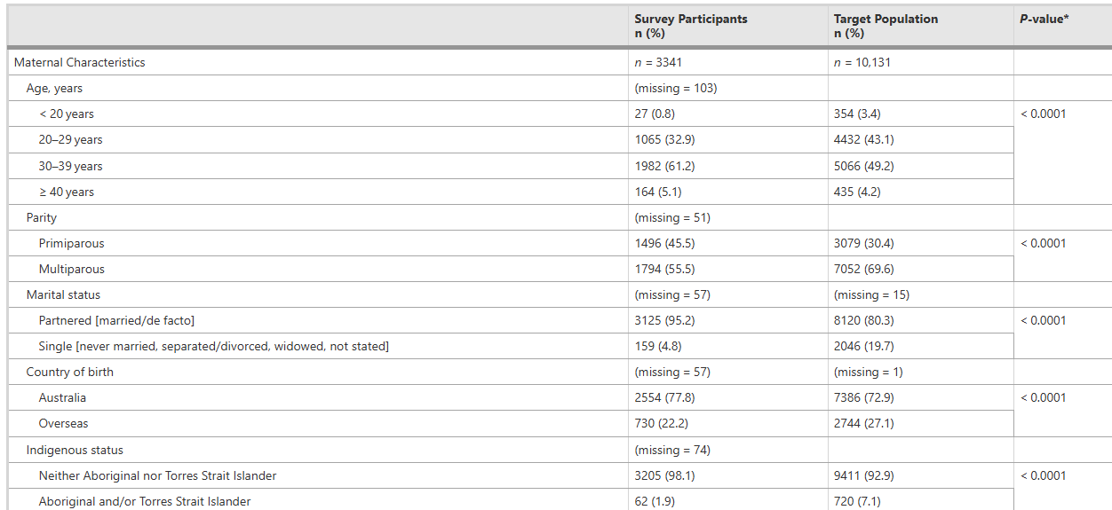





Table 1 Socio-demographics of sample population and target population
*p-value for difference between participants and target population
Notes:
The mothers who participated in the study were majorly from age group 20-39 years, 95% were married and 77.8 percent were born in Australia

Slide 12
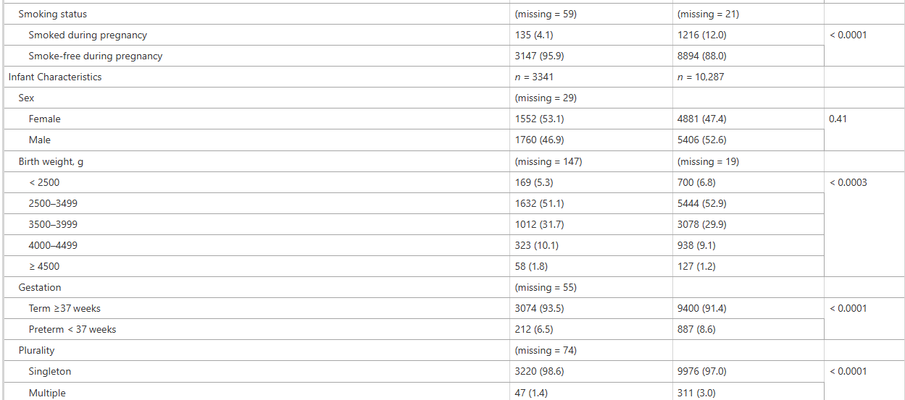


Slide 13
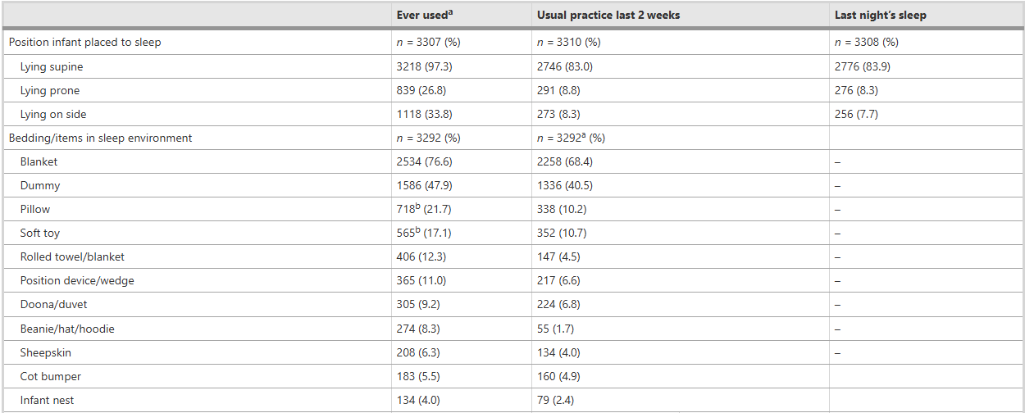










Table 2 Frequencies of key practices related to current safe sleeping program
Notes:
For 17% of babies a non-supine sleep position was usual practice in the last 2 weeks prior to survey completion.
with similar proportions of babies being placed prone (8.8%) or on their side (8.3%).
Pillow use was routine practice for 338 (10.2%) babies.
During the last 2 weeks sleeping with a soft toy was usual practice for 352(10.7%) infants.

Slide 14
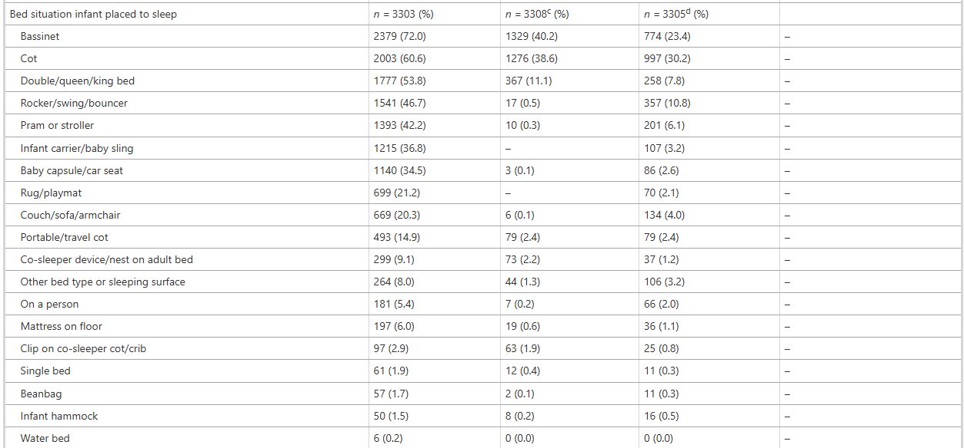


Slide 15
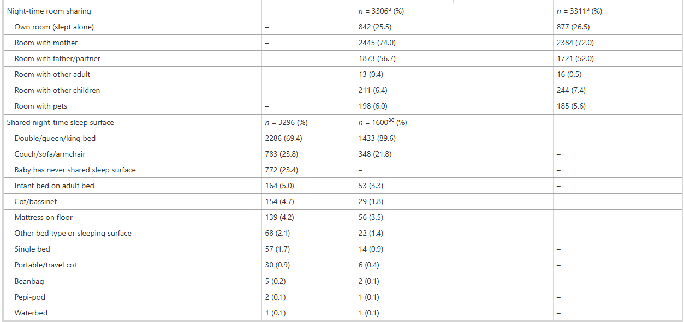

Slide 16
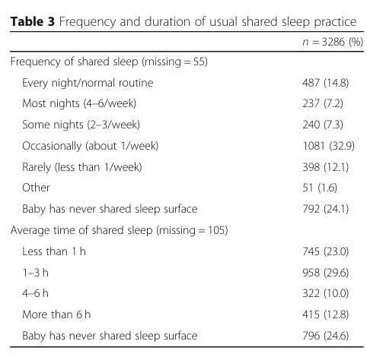
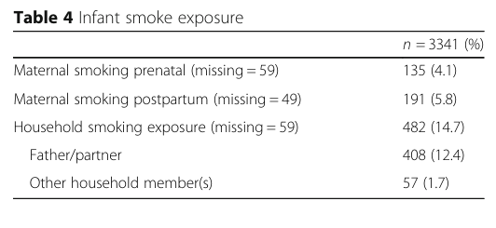


Slide 17
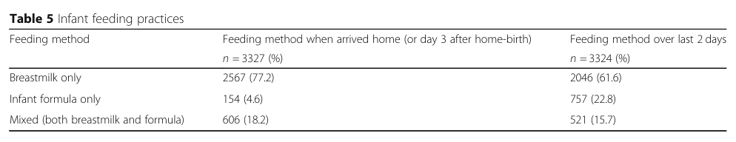
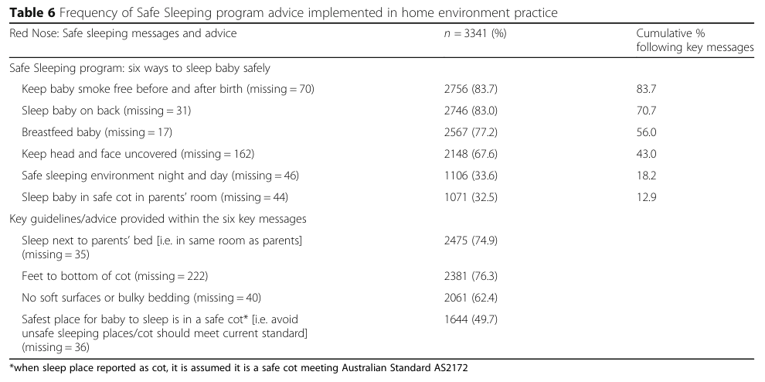
Notes:
Of the 757 (22.8%) infants who did not receive any breastmilk over the 2 days prior to completing the questionnaire, 87 (11.5%) never received breastmilk after birth.

Slide 18
Only 13% of families reported they routinely followed all six Safe Sleep recommendations. This highlights a significant gap between public health messaging and actual infant care practices.
Many participants were first-time parents, whose early habits may shape long-term behaviors—posing broader risks if Safe Sleep practices are not followed.
17% of caregivers routinely placed babies in non-supine positions, and over one-third had done so at some point, despite decades of “Back to Sleep” campaigns.
Inconsistent use of terms like “bed-sharing” vs. “co-sleeping” creates confusion, weakening the impact of Safe Sleep messaging.

Slide 19
The cross-sectional survey design using a self-report questionnaire, which limits infant care practices to a point in time, and subjects’ data to social desirability bias, likely to provide an underestimate of less socially desirable behaviours.
Survey participants were more socially advantaged and possibly more aware of public health messages which may overestimate adherence to safe sleep guidelines.
The differences in practices between respondents and non-respondents are unknown.
Recall Bias - Primary caregivers may not accurately remember or report their infant care practices, especially if some time has passed since the behavior occurred.
Study was conducted in only one state (Queensland), limiting generalizability to the whole country. A national study is needed for broader insights, especially in high-risk groups.
Notes:
How ever, a cross-sectional design also makes such a study with a large population feasible and is consistent with reported studies that have measured infant care practices and sleeping routines within home environments for the well infant population

Slide 20
The prevalence rates of infant care practices among this Australian population demonstrate many families continue to employ suboptimal practices despite Australia’s current safe sleep campaign.
Strategic approaches together with informed decisions about pertinent messages to feature within future public health campaigns and government policies are required so targeted support can be provided to families with young infants to aid the translation of safe sleep evidence into safe sleeping practices.

Slide 21

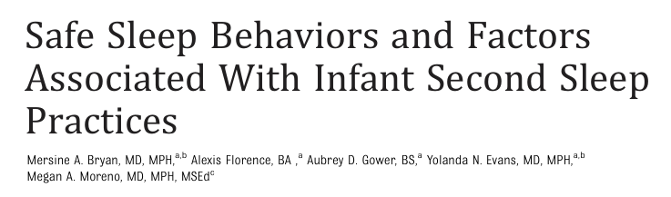
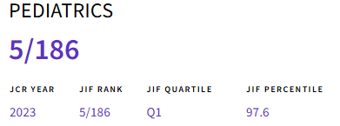

Paper-2
Corresponding Author
Mersine Alexis Bryan
MD, MPH
Dr. Bryan is currently an Assistant Professor of Pediatrics in the Division of Hospital Medicine and General Pediatrics and Attending Physician at the University of Washington School of Medicine and Seattle Children’s Hospital.

Slide 22
Sleep-related death is an important cause of infant mortality.
Despite the early success of public health campaigns such as “Back to Sleep,” there has been a plateau in the reduction of sleep-related death.
Unsafe sleep practices, such as prone positioning and bed-sharing, are modifiable factors that increase the risk of sleep-related death.
Second-sleep practices are defined as the parent-reported sleep practice after nighttime waking.

Slide 23
Aim: To examine the prevalence and safety of infant second-sleep practices.
Objective:
  The primary objective of this study was to examine infant second-sleep practices and to assess the safety of second-sleep practices consistent with the AAP Safe Sleep 2 recommendations.
  The secondary objective was to examine the associations between parent demographic characteristics and the use and safety of second-sleep practices.

Slide 24
Study Design: A cross-sectional survey of a national sample of parents with infants aged ≤12 months between March 6, 2018, and April 9, 2018.
Data Collection: The study was conducted online; all recruitment and data collection were completed using Qualtrics, a web-based survey platform.
  English speaking participants were included.
  The target study population was a diverse sample of 1500 parents of children aged ≤ 12 months.
Outcome Measures: Primary outcome was to examine the safety of parent reported infant sleep practices at two time points: (1) sleep onset, and (2) after nighttime waking.
  Secondary outcome was to examine the demographic characteristics associated with second-sleep practices and adherence to AAP safe sleep recommendations.
Notes:
Questions measured parent-report of (1) infant sleep position (supine, side, or stomach), (2) use of a separate sleep space or bed-sharing, and (3) where their infant slept (eg, crib, or adult bed).

Slide 25
Statistical Analysis: Proportions of participants who reported a second sleep practice and those who adhered to AAP sleep recommendations were calculated for three sleep practices.
Wilcoxon sign rank test was used to examine changes between the time points.
Poisson regression models compared parents who reported a second-sleep location with those who did not.
Sensitivity Analysis: A sensitivity analysis was conducted for infants aged ≤ 3 months because infants in this age range are at the highest risk for sleep-related death.

Slide 26
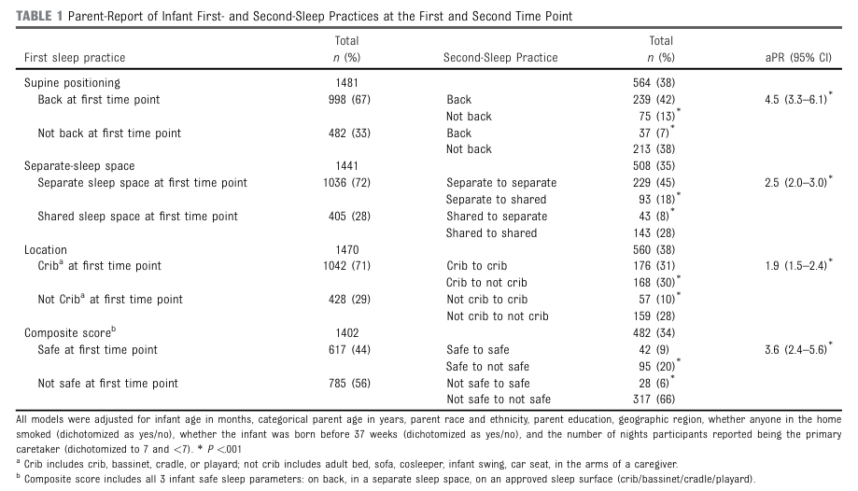













Notes:
Of 1500 respondents, 39% (n 581) reported a second sleep practice the previous night .
Sixty-seven percent of participants placed their infant supine at sleep onset.
Of those who reported a second sleep position (n 564), 42% (n 239) of parents placed their infant supine at both time points.
13 % percent of parents who placed their infant supine at the first time point did not after nighttime waking compared with 7% who changed from nonsupine to supine positioning.
Of all participants, 72% (n 5 1036) used a separate sleep space at sleep onset.
71% percent of respondents used an approved sleep surface at sleep onset.
30 % of infants were moved from a safe to a unsafe location;10% of infants were moved from an unsafe to a safe location at the second time point.
44% of participants met all 3 safe sleep practices at sleep onset.
20 % of participants changed from using all 3 safe sleep practices to not using them after night time waking; 6% of participants did not meet all 3 safe sleep criteria at sleep onset and met safe sleep criteria after night time waking.

Slide 27
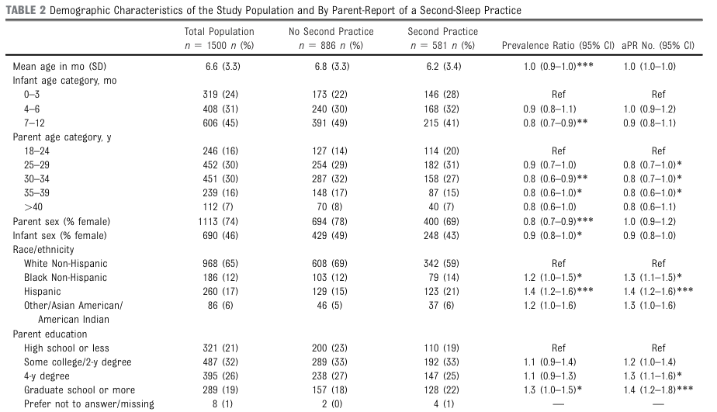












Notes:
Of 1500 participants, the mean infant age was 6.6 months.
24% of infants were less than 3 months.
74% of participants were women.
The most common parent age categories were 25 to 29 and 30 to 34years
65% identified as White, 12% identified as Black, and 17% identified as of Hispanic ethnicity.
Parents with a 4-year degree or higher education level reported a higher prevalence of second-sleep practices.

Slide 28
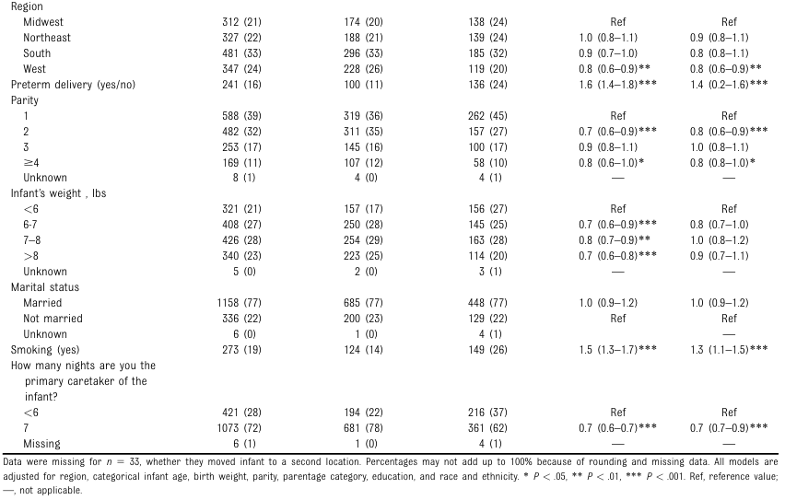
Notes:
.There was a higher prevalence of participants reporting a second-sleep practice when they identified as the primary care 7 nights per week.

Slide 29
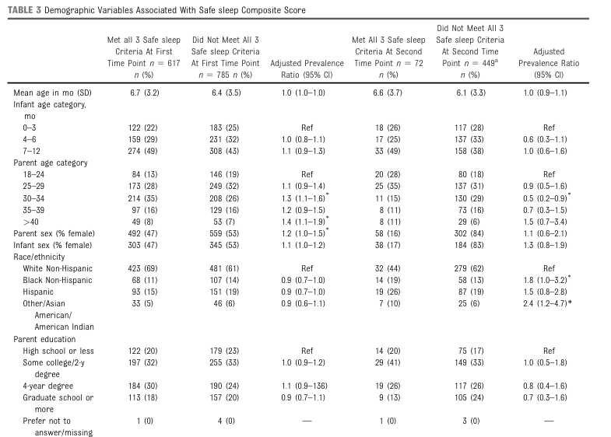




Notes:
Female participants had a higher adjusted prevalence of meeting all 3 safe sleep criteria at sleep onset, with no difference after nighttime waking.
There were no differences in the adjusted prevalence of meeting all 3 safe sleep criteria by infant age, infant sex, parent education, geographic region, the number of children, or marital status at either time point

Slide 30

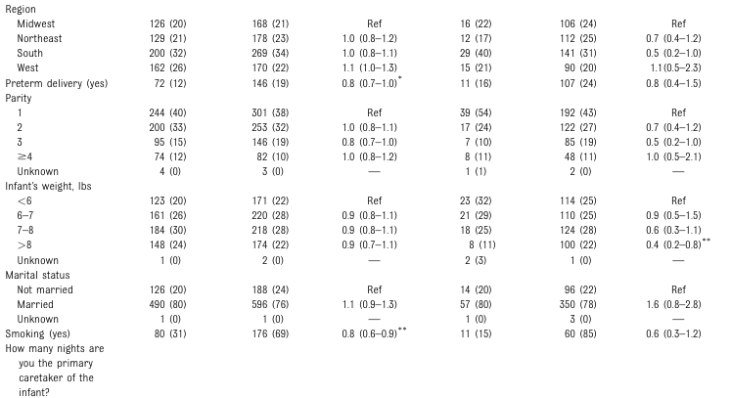
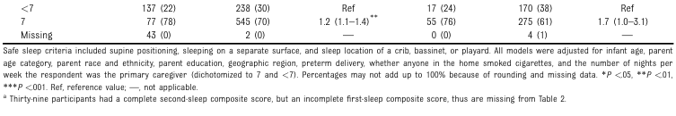




Notes:
geographic region, the number of children, or marital status at either time point.
Parents of infants who were born preterm and those with a smoker in the home had a lower adjusted prevalence of meeting all 3 safe sleep criteria at sleep onset only.
Participants who identified as the primary caretaker 7 nights per week had a higher prevalence of meeting all 3 safe sleep criteria at sleep onset only.

Slide 31
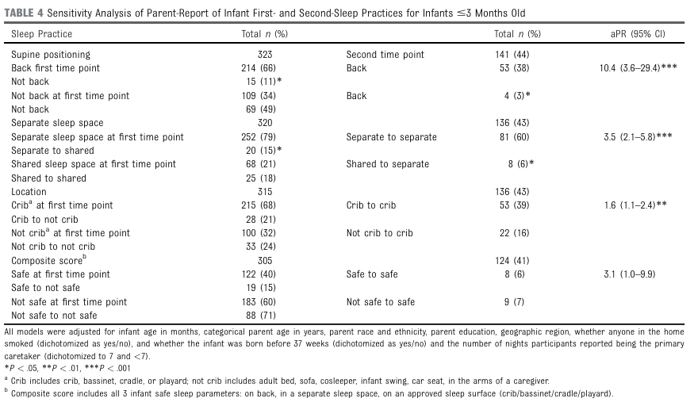
Notes:
In infants aged less than 3 months, similar findings were identified to the primary analysis for each individual sleep practice; there were no statistically significant differences for the composite score.

Slide 32
39% of parents reported changes in sleep practices after nighttime waking, with a larger proportion transitioning from safe to unsafe sleep practices, similar to previous research.
Less than half (44%) of parents adhered to all three AAP safe sleep recommendations (supine positioning, separate sleep space, and safe sleep location) at both sleep onset and after nighttime waking.
The study highlighted the role of cultural and ethnic practices in sleep behavior. Pediatricians should provide education that respects cultural differences and focuses on both sleep onset and nighttime waking.

Slide 33
Participants were selected through an online survey platform, which only reaches parents enrolled in Qualtrics panels with internet and computer access, potentially limiting the diversity of the sample.
The study relied on self-report data and only asked parents to report 2 time points and parents who have previously received education about safe sleep may have overreported safe sleep practices due to prosocial bias.
Factors influencing second-sleep safety, such as breastfeeding, were not assessed.
The study only included a sample of sleep recommendations from the AAP guidelines, rather than all of them.
Only English-speaking participants were enrolled, which excludes non-English-speaking populations and may overlook cultural influences on sleep practices.

Slide 34
Common Changes in Sleep Practices: A significant portion (39%) of parents reported a second sleep practice after nighttime waking.
Unsafe Sleep Practices: A higher proportion of parents made changes to less-safe sleep practices, such as moving from supine to prone position.
Adherence to Safe Sleep Practices: Less than 10% of the sample adhered to all three recommended safe sleep practices both at sleep onset and after nighttime waking.
Demographic Influence: Parent and infant demographic characteristics were associated with the use and safety of second-sleep practices.
Interventions focused on safe sleep should highlight the importance of safe sleep practices after nighttime waking.

Slide 35
Comparison of Papers
 | PAPER - 1 | PAPER - 2
Background Focus | Overall infant care practices and uptake of safe sleep messages | Changes in safe sleep practices after nighttime waking, highlighting the “second-sleep” period.
Knowledge Gap | Persistent suboptimal practices despite national campaigns; gap between guidelines and actual practices in the Queensland population | Lack of emphasis on safe practices during second-sleep episodes; limited understanding of how sleep practices change post sleep onset.
Study Aim | To describe current infant care practices, and assess uptake of all six Safe Sleep recommendations among Queensland families. | To examine prevalence and safety of second-sleep practices

Slide 36
Comparison of Papers
 | PAPER - 1 | PAPER - 2
Methods | Cross-sectional survey administered via mail and online, Descriptive statistics and comparison against Safe Sleep guidelines. | National online survey; Composite safe sleep score; Poisson regression models to assess differences and associated factors between sleep onset and second-sleep.
Participants | 3341 primary caregivers with infants app. 3 months old from Queensland, Australia, drawn from a comprehensive state birth registry | 1500 parents of infants ≤12 months from across the nation (USA), recruited via online panels.
Key Findings | Only 13% of families fully adhered to all six Safe Sleep messages. A significant proportion of infants were placed in risky sleep environments (e.g., non-supine positions and hazardous setups). | 39% reported practicing second-sleep. There was a notable decline in adherence to safe sleep practices after nighttime waking, with safety measures dropping sharply post-waking.

Slide 37
Comparison of Papers
 | PAPER - 1 | PAPER - 2
Strengths | Large, state-wide sample from a comprehensive sampling frame. Detailed assessment of multiple safe sleep practices. Use of both mail and online modalities. | National sample provides broader insights. Focus on a previously underexplored risk period (second-sleep). Robust statistical analysis using composite safety scores and regression models.
Limitations | Lower response rate (33%) and potential sampling bias with overrepresentation of higher SES families. Reliance on self-reported data introduces recall and social desirability bias. | Potential selection bias from using online panels. Self-reported practices may be affected by recall or social desirability bias. May miss high-risk groups not represented online.

Slide 38
Comparison of Papers
 | PAPER - 1 | PAPER - 2
Conclusion | The study concludes that despite long-standing Safe Sleep campaigns, adherence in Queensland remains low (only 13% fully compliant), signaling a need for tailored public health interventions and further research to better understand and address barriers among diverse family groups. | The study concludes that safe sleep practices significantly decline after nighttime waking, emphasizing a critical, overlooked risk period that requires expanded guidance and intervention to improve overall infant sleep safety.
Critical appraisal | The study benefits from a large, representative sample and robust data collection, though self-report bias and response rate issues must be considered when interpreting adherence levels. | While offering innovative insights into second-sleep practices with a national perspective, the study faces limitations due to potential online selection bias and self-report data challenges.

Slide 39
Response to Comments

Slide 40
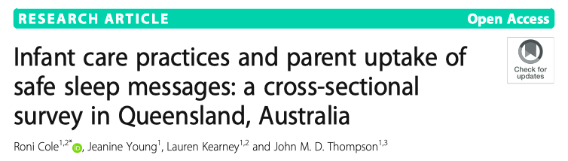
Comments on Paper 1
Mita Restinia
T88127011
2nd Year PhD Student

Slide 41
Comment 1. Response Rate
The overall response rate of 33% showed us higher portion of families did not engage with the survey. Families who chose not to participate may differ considerably in their infant care practices compared to safe sleeping program. In addition most participants have higher socioeconomic status and may have good literacy about this program. This raises concerns that the findings may overestimate safe sleep compliance.
In light of this, if you are the author, how to account for these non-respondents in interpreting the results to ensure a balanced view of safe sleep practices?

Slide 42
Comment 2. Inconsistent definition
The study highlighted significant inconsistencies in definitions such as “bed-sharing” and “co-sleeping,” which could confuse caregivers to response the questionnaire.
How might these definitional inconsistencies affect the study’s results and their interpretation? How to improve it for further study ?

Slide 43
Comment 3
The reliance on self-reported data through questionnaires may introduce social desirability bias, leading participants to provide responses they believe are more socially acceptable rather than their true practices.
Considering this potential bias, what measures were taken to validate the accuracy of the self-reported data, and how might this affect the reliability of the findings?

Slide 44
Response to Comment - 1
To ensure a balanced interpretation of safe sleep practices and account for the non-respondents, the author has highlighted the following considerations in the discussion section:
The study clearly notes that the sample is skewed toward families with higher socioeconomic status, who are more likely to be receptive to public health messaging and, therefore, more likely to comply with safe sleep recommendations. This limitation is explicitly stated in the discussion to caution against overgeneralizing the findings.
Given that socially advantaged families are more likely to participate in such research and be aware of national guidelines, the results likely overestimate the true level of compliance within the general population.

Slide 45
Response to Comment - 1
Where possible, participant demographics were compared to available state-level birth or census data. This allows for assessment of representativeness and helps in contextualizing the findings in light of who is underrepresented (e.g., lower SES families, culturally and linguistically diverse groups, Indigenous families).
The paper emphasizes the need for national, population-based studies and improved recruitment strategies that better reach underrepresented and more vulnerable populations. This would provide a clearer picture of the gaps in safe sleep compliance across different socioeconomic and cultural groups.
Although not applied in the current study, future research could consider post-stratification weighting techniques to adjust for underrepresented groups in the analysis phase, improving population-level inferences.
Notes:
By clearly communicating these limitations, ensuring transparency in reporting, and advocating for inclusive, methodologically robust future research, the study responsibly interprets its findings and provides a foundation for enhancing the reach and impact of safe sleep education programs.

Slide 46
Response to Comment - 2
Definitional inconsistencies can lead to several issues in data interpretation:
Measurement Error: Different interpretations of these terms by caregivers can result in inconsistent responses, where one respondent’s “bed-sharing” might be another’s “co-sleeping.” This misclassification can distort the reported prevalence of risky sleep practices.
Comparability Issues: Without standardized definitions, it’s difficult to compare results across studies or even different regions within the same study. This affects the external validity of the findings and limits the ability to aggregate data for broader conclusions.
Confusing Messaging: Inconsistent terminology may confuse caregivers when completing the questionnaire, leading them to provide answers based on personal interpretations rather than a common standard. This confusion can further skew results, undermining the reliability of the self-reported data.
Implications for Public Health Messaging: The lack of uniform terms means that guidelines may be interpreted differently by health professionals and caregivers alike, affecting how safe sleep recommendations are communicated and potentially reducing their effectiveness.

Slide 47
Response to Comment - 2
Recommendations for improvement:
Standardization of Terminology:
Future research should adopt standardized definitions based on established guidelines. For example, clearly distinguish between “bed-sharing” (infants sharing the same sleep surface as caregivers) and “co-sleeping” (infants sleeping in the same room but not necessarily on the same surface).
Providing Clear Descriptions:
Incorporate detailed descriptions or examples within the questionnaire. This can help respondents better understand the terms and answer more accurately.
Use of Visual Aids: Where feasible, include diagrams or images that illustrate the different sleeping arrangements. Visual aids can reduce ambiguity and provide a more concrete understanding of the terms.

Slide 48
Response to Comment - 3
In addressing the potential for social desirability bias, the study incorporated several safeguards to enhance the accuracy of the self-reported data, although it remains a limitation inherent to the design.
Anonymity and Confidentiality: The survey was designed to be anonymous, with assurances of confidentiality provided to participants. This is intended to reduce the tendency to provide “ideal” responses rather than true practices.
Pretesting and Pilot Evaluation: The questionnaire was pilot-tested with a diverse group of mothers to ensure that the questions were clear and interpreted consistently. This pretesting helps minimize ambiguity and can reduce bias by ensuring that respondents understand that honest responses are important for accurate data collection.
Dual-Mode Administration: By providing both postal and online options, the study attempted to capture responses from a broader cross-section of families. This strategy can help mitigate bias if one mode is more prone to social desirability influences than the other.

Slide 49
Response to Comment - 3
Comparison with Population Data: To further contextualize the findings, demographics from the respondents were compared with state-level birth data. This helps assess the representativeness of the sample and provides insight into potential bias if more “advantaged” groups (who might be more aware of public health messages) are overrepresented.
Effect on Reliability:
Even with these measures in place, self-reported data are susceptible to bias, as a result:
The accuracy of reported practices might be somewhat overestimated, particularly for behaviors deemed socially acceptable (like safe sleep practices).
This could mean that the actual level of adherence in the broader population might be lower than reported.
However, since the study’s purpose was to benchmark current practices and identify areas for targeted intervention, acknowledging this limitation allows the findings to be interpreted with caution and serves as a starting point for further, more objective research (e.g., observational studies).

Slide 50
Comments on Paper - 2
Pi-Ling Wang

Slide 51
Comment - 1
Confounder or Mediator
“In this study, the authors treated the following variables as confounders:
(1) infant age in months,
(2) parent age category in years,
(3) parent race and ethnicity,
(4) parent education,
(5) geographic region,
(6) whether anyone in the home smoked,
(7) whether the infant was born before 37 weeks’ gestation, and
(8) the number of nights participants reported being the primary caretaker.
However, could it be possible that some of these variables might actually function as mediators instead?”

Slide 52
Comment - 2
This study relied on self-reported data from an online survey, which might introduce recall bias or social desirability bias.
What alternative data collection methods could be considered to strengthen the validity of findings about second-sleep practices, and how might they address these biases?”

Slide 53
Response to Comment - 1
I agree with your comment that some of these variables could be mediators rather than confounders.
However, in the analyses, author opted to control for these variables to minimize potential confounding and isolate the impact of second-sleep practices as much as possible. That said, the possibility that some variables function as mediators is an important consideration that might refine the understanding of the causal pathways involved.
For further studies, employing mediation analysis techniques or developing a causal diagram could help disentangle these roles more clearly. This would provide a more nuanced interpretation of how these factors interact with second-sleep practices and could enhance the design of targeted interventions.

Slide 54
Response to Comment - 2
To strengthen the validity of findings about second-sleep practices and mitigate the effects of recall and social desirability biases, several alternative data collection methods can be considered (subject to ethical consideration and feasibility):
Direct Observation or Video Recording:
– Method: Conduct home visits or install unobtrusive video equipment.
– Benefit: Provides objective data on sleep practices and minimizes reliance on memory.
• Ecological Momentary Assessment (EMA):
– Method: Prompt parents via mobile apps or texts to report sleep practices in real time.
– Benefit: Reduces recall bias and captures spontaneous behavior, lowering social desirability influences.

Slide 55
Response to Comment - 2
Sleep Diaries:
– Method: Parents log their infant’s sleep environment and practices daily.
– Benefit: Offers contemporaneous records that can reveal patterns and reduce distant recall reliance.
Mixed-Methods Approaches:
– Method: Combine quantitative surveys with qualitative interviews or focus groups.
– Benefit: Allows deeper insight into parental behaviors and validates self-reported data through contextual exploration.

Slide 56
THANK YOU

Slide 57
Parents aged >30 years and those who were primary caretakers seven nights a week had a higher prevalence of adhering to all three safe sleep practices. Households with cigarette smoke exposure and infants born <37 weeks had a lower prevalence, highlighting these high-risk groups' need for targeted interventions.
The study highlighted the role of cultural and ethnic practices in sleep behavior. Pediatricians should provide education that respects cultural differences and focuses on both sleep onset and nighttime waking.
The findings emphasize the need for further investigation into how sleep practice patterns develop over time, particularly in relation to parental characteristics and the influence of being the primary caretaker.

Slide 58
Over one-third used soft or bulky bedding or objects like pillows or toys, increasing suffocation risks, especially with prone sleeping.
25% of infants regularly slept alone at night and nearly 50% during the day, despite room-sharing with an adult being shown to reduce SUDI risk by up to 50% through improved monitoring and responsiveness.
While cots and bassinets were most common, adult beds were the second most used at night, and bouncers or swings were often used during the day, despite not being recommended due to risks of airway obstruction and entrapment.
Over half of families ended up bed-sharing despite not planning to. Around 25% did so multiple nights a week, and 23% for 4+ hours - highlighting the need for realistic guidance that addresses unplanned behaviors.
15% of families lived in households with at least one smoker, while 4% reported maternal smoking during pregnancy. This is likely underreported due to stigma, especially since 12% is the known prevalence in the Perinatal Data Collection (PDC) for the region.

Slide 59
Recall Bias: Since the survey relied on parents' reports of past sleep practices, there could be inaccuracies due to difficulty remembering exact details of sleep practices, especially if the survey was administered after a significant amount of time had passed since the events.
Sampling Bias: The study relied on parents enrolled in Qualtrics panels, which may not be fully representative of the entire U.S. parent population. Certain groups (e.g., low-income, rural, or marginalized communities) may be underrepresented.
Non-response Bias: If certain groups of parents were less likely to respond to the survey (e.g., parents with less access to technology or those with unsafe sleep practices), the results could be biased toward safer sleep practices and more tech-savvy participants.
Cross-Sectional Design: Since the study was cross-sectional, it can show associations but not causal relationships. It cannot establish cause-and-effect between demographic factors and adherence to safe sleep practices.
Lack of Detailed Information on Safe Sleep Environment: The study did not explore specific aspects of the sleep environment (e.g., type of crib, presence of blankets, pacifiers, etc.) that may influence sleep safety.
Limited Geographical Diversity: Even though the sample was geographically representative in theory, the distribution of participants could still have been skewed, especially if there were limitations in reaching certain geographical regions (e.g., rural or remote areas).
Generalizability to Non-Parents: The study only focused on parents, which might not represent the broader population of caregivers, such as grandparents or other family members who might be responsible for the infant's sleep practices.
Lack of Long-Term Follow-Up: The study only captured data at two time points, which limits the ability to assess changes in sleep practices over time or the long-term effects of early sleep practices on infant safety.

