Slide 1
Comment for Chiu-wen's paper
PhD 2nd Year Student
T88121502 Hung-Jui Chen
2025/03/19

Slide 2
Comment 1
In table 1, the number and percentage of the 'At-risk newborn' covariate seems different between the 'Full unmatched cohort' and the 'Propensity score matched cohort A’. Could you explain why?

Slide 3
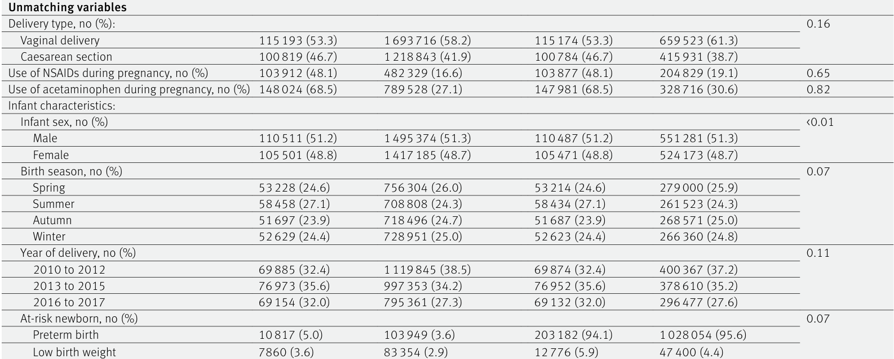

Slide 4
Comment 2
In the method, mothers were categorised into non-user, user of low dose, and user of high dose by using the 75th percentile as the cutoff.
What is the reason for selecting the 75th percentile rather than the 50th percentile or dividing the data into quartiles?"

