Slide 1
Comments on Paper 2 of Jheng Yan
Ya-Ling Hsieh (T88121031)
2nd Year PhD Student

Slide 2
Comment 1-Statistical Analysis
ASD has a strong genetic component, and if either parent has ASD, the risk of ASD in their child may be significantly higher. This study only considered the mother's ASD history but did not account for the father's age or family genetic history (such as ASD or psychiatric disorders), which may lead to an underestimation of the genetic influence.
Should the study further adjust for paternal ASD risk factors to better identify the true source of ASD risk?

Slide 3
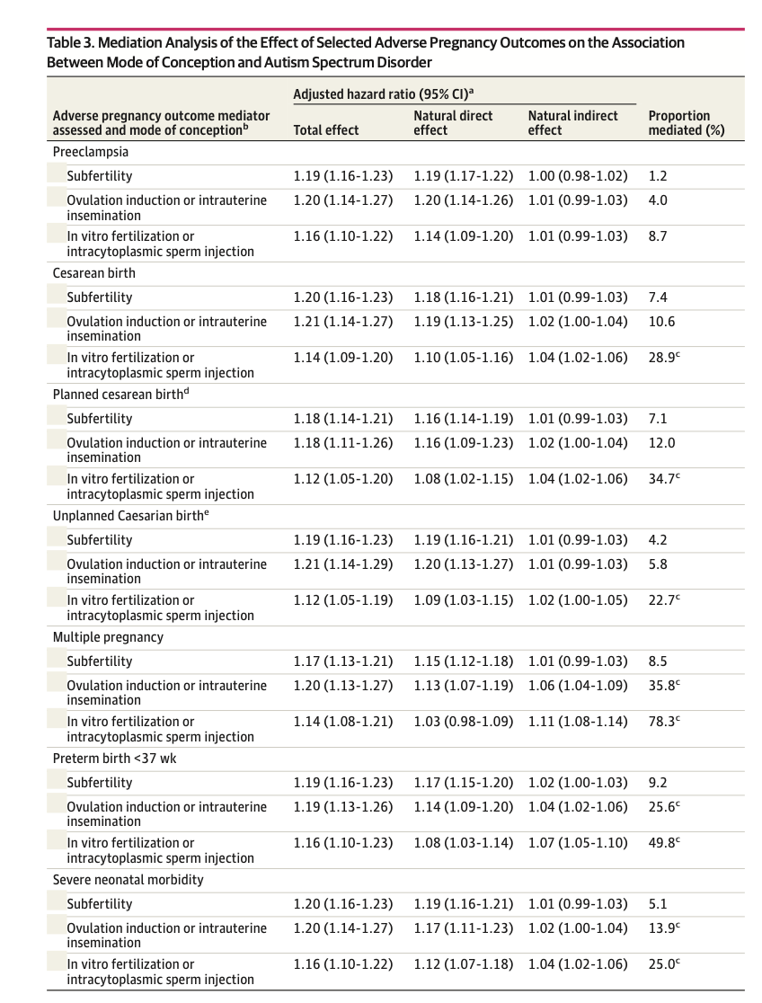
Comment 2-Results
This study shows that adverse pregnancy outcomes (e.g., cesarean birth, multiple pregnancy, preterm birth) are linked to ASD risk, especially in children conceived via IVF/ICSI.
Among these, multiple pregnancy has the strongest impact, mediating 78.3% of ASD risk.
When multiple pregnancy is accounted for, the direct effect of IVF/ICSI on ASD risk drops (aHR = 1.03, 95% CI: 0.91-1.17).
Does this suggest that IVF itself is not the main risk factor for ASD, but rather that multiple pregnancies caused by IVF are the key driver?

