Slide 1
Literature Reports
2st Year PhD student
曾元聰(Yuan-Tsung Tseng)
20250312

Slide 2
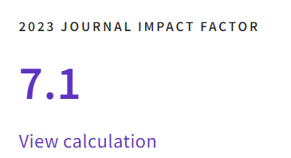
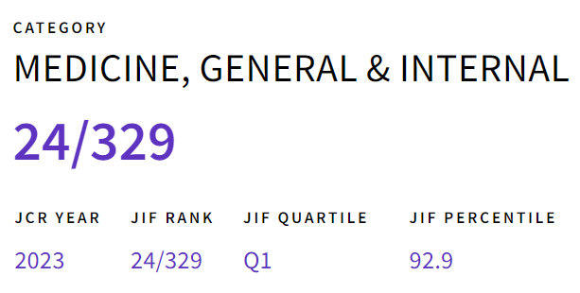
Association of the American Heart Association’s new “Life’s Essential 8” with all-cause and cardiovascular disease-specific mortality
BMC Medicine. (2023) 21:116
First author: Jiahong Sun
From Department of Epidemiology/Shandong Provincial Clinical Research Center for Emergency and Critical Care Medicine, China
2

Slide 3
Study Question
What is the association of total and individual cardiovascular health (CVH) metrics in 'Life’s Essential 8' with all-cause and cardiovascular disease-specific mortality?
Investigates risk differences across CVH score categories: Low (0–49), Intermediate (50–74), and High (75–100)
3

Slide 4
Introduction
Cardiovascular disease (CVD) is one of the leading causes of death globally, with significant economic burdens in the US.
In 2010, the American Heart Association introduced the original CVH framework as Life’s Simple 7.
4
Notes:
The importance if this topic is

Slide 5
Introduction
Life’s Simple 7 has several limitations including the confined scope of health behaviors (e.g., not including sleep health), a crude additive scoring, and less sensitivity to interindividual differences.
The AHA updated its approach from “Life’s Simple 7” to “Life’s Essential 8” by adding sleep health and refining other metrics in 2022.

Slide 6
Introduction
Metric | Simplified Categories & Scores
Diet | Assessed via a food frequency questionnaire; scored based on the HEI 2015 percentiles.
Physical Activity | Self-reported weekly moderate-to-vigorous activity; scored 0–100 based on time thresholds (e.g., ≥150 minutes = ideal).
Nicotine Exposure | Based on self-report of smoking, and secondhand smoke; scoring differentiates current, former, and never users.
Body Mass Index | scored according to standard BMI categories (<25 kg/m² is ideal).
6
Notes:
The importance if this topic is

Slide 7
Introduction
Metric | Simplified Categories & Scores
Blood Lipids | Measured as non-HDL cholesterol (total cholesterol minus HDL); ideal is defined as <130 mg/dL.
Blood Glucose | Assessed using fasting glucose and/or HbA1c; scored based on thresholds for normal versus diabetic ranges.
Blood Pressure | ideal is <120/80 mmHg, with a penalty if on antihypertensive medication.
Sleep Health (New) | Self-reported average sleep duration; ideal is 7–9 hours per night.
7
Notes:
milligrams per deciliter
millimeters of mercury

Slide 8
Knowledge gap
No existing large-scale study has examined mortality outcomes using the new “Life’s Essential 8” metrics, which now include sleep health and refined scoring for diet, nicotine exposure, and other factors.
Prior research mostly relied on “Life’s Simple 7,” lacking the continuous scoring.
Evidence is limited on how cumulative improvements in these 8 metrics, rather than just “ideal” vs. “non-ideal,” correlate with all-cause and CVD-mortality.
8
Notes:
So the aim of the study are
First!
Second!

Slide 9
Methods: design and participants
Data source:
  National Health and Nutrition Examination Survey (NHANES) from 2005 to 2018, linked to the 2019 National Death Index.
Study type:
  Prospective cohort study
9

Slide 10
Methods: design and participants
Participants:
  Initial: 39,749 adults (≥20 years) from seven survey cycles (2005–2006 to 2017–2018).
  Final: 19,951 adults aged 30–79 years after excluding:
    Ages outside 30–79 range.
    Missing data on cardiovascular health (CVH) metrics.
    Pregnancy or breastfeeding status.
    Ineligible data on death or follow-up years.
Follow-up: Median of 7.6 years
10

Slide 11
Methods: outcome measurement
Primary Outcomes:
  All-Cause Mortality
  Cardiovascular Disease (CVD)-Specific Mortality
CVD-Specific Classification:
  Defined using ICD-10 codes (I00–I09, I11, I13, I20–I51, I60–I69)
11

Slide 12
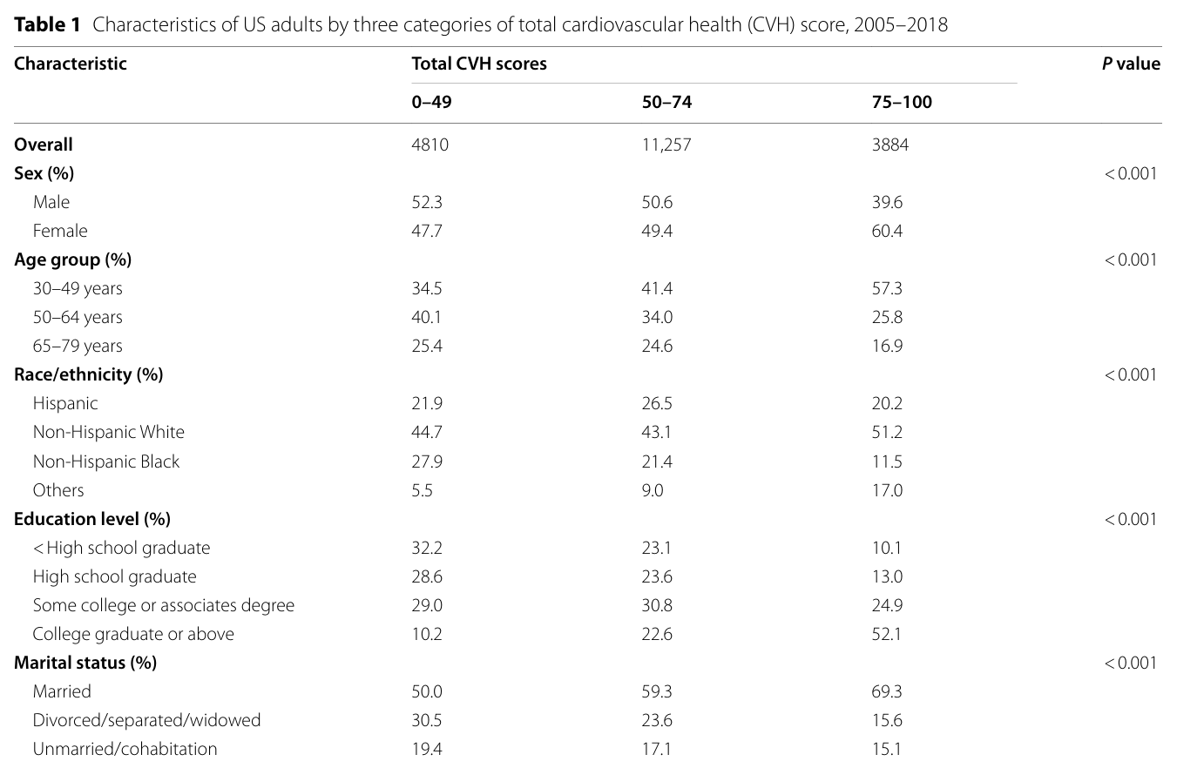
Methods: baseline characteristics
12

Slide 13
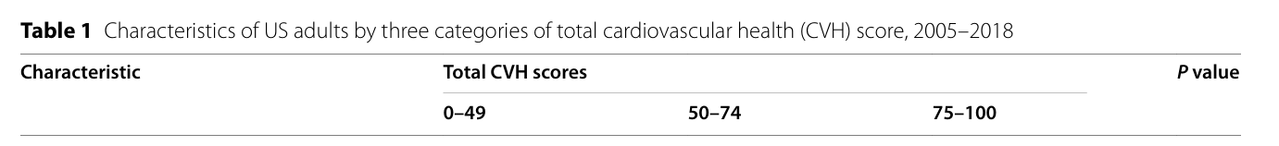
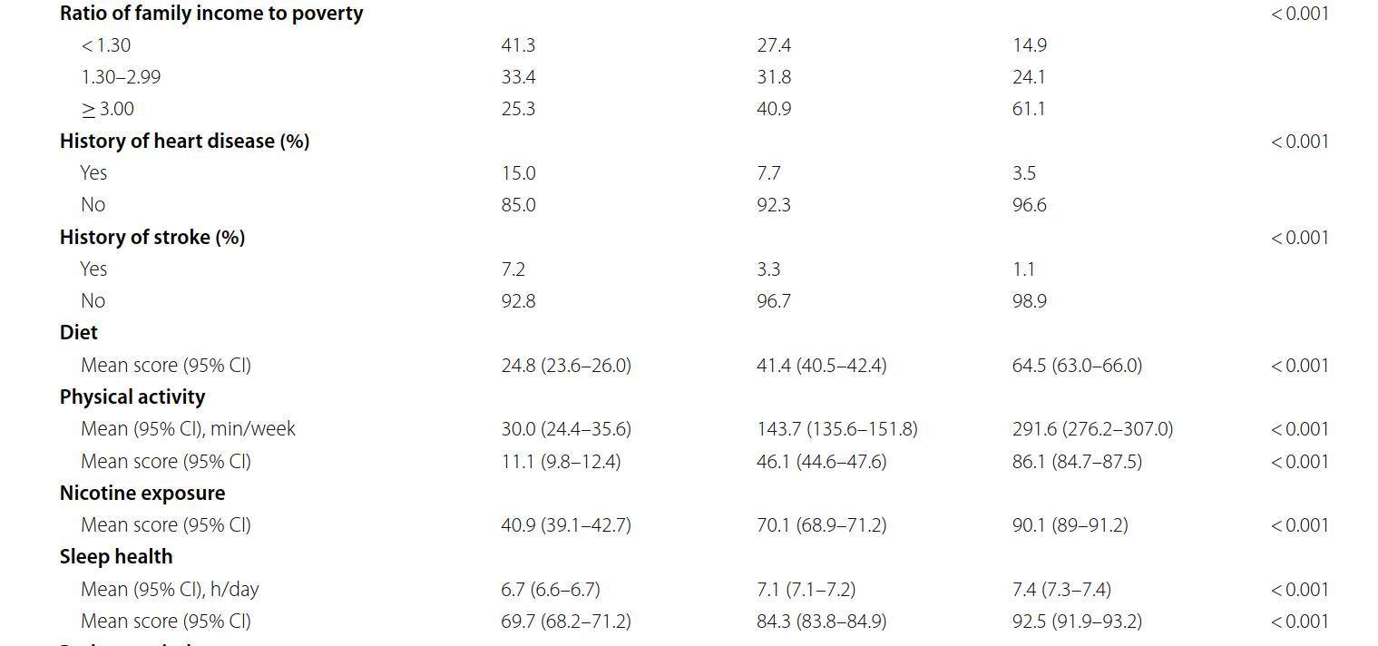
Methods: baseline characteristics
13
Notes:
Liver cancer is associated with higher exposure to Sulfur

Slide 14
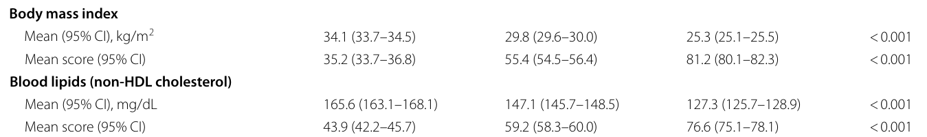
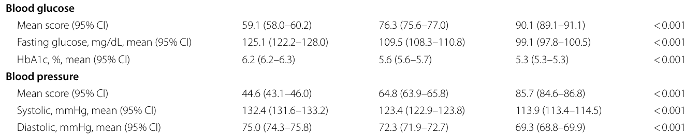
Methods: baseline characteristics
14
Notes:
Liver cancer is associated with higher exposure to Sulfur

Slide 15
Methods: Statistical analysis
Cox Proportional Hazards Models:
  Estimated hazard ratios (HRs) for all-cause and CVD-specific mortality.
  Adjusted for baseline covariance.
Population-Attributable Fractions (PAFs):
  it represents the percentage of deaths that could potentially be avoided.
Restricted cubic splines:
  it represents the dose–response relationships between CVH scores and mortality.
15
Notes:
These independent variables were included due to their previous relevance in literature on PoD and their availability through DC data.
In eight countries (Brazil, Chile, Colombia, Costa Rica, El Salvador, Mexico, Peru, Uruguay) urbanization of the place of residence was available and was included in the model.

Slide 16
Results
16

Slide 17
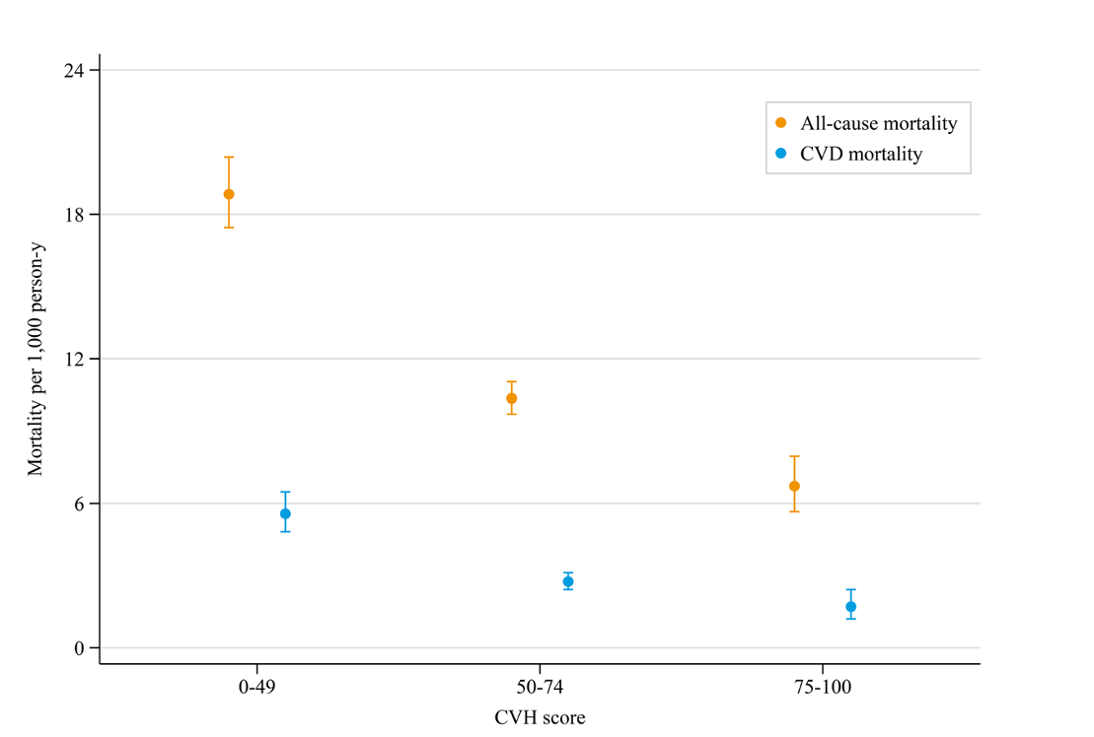
Key Finding:
As the overall Life’s Essential 8 score from low to high
All-cause and CVD-specific mortality rates significantly decrease.
Fig. 1 Age- and sex-standardized all-cause and CVD-specific mortality rate per 1000 person-years by total scores of cardiovascular health metrics

Slide 18
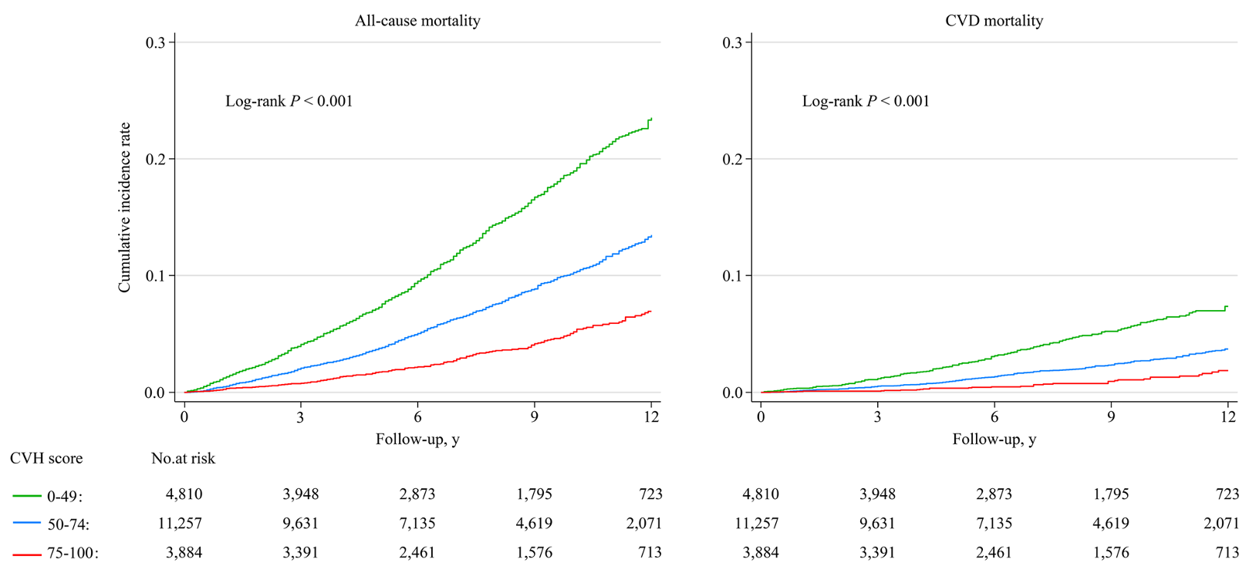
Higher Life’s Essential 8 scores are associated with significantly lower cumulative all-cause and CVD-specific mortality over time.
18

Slide 19
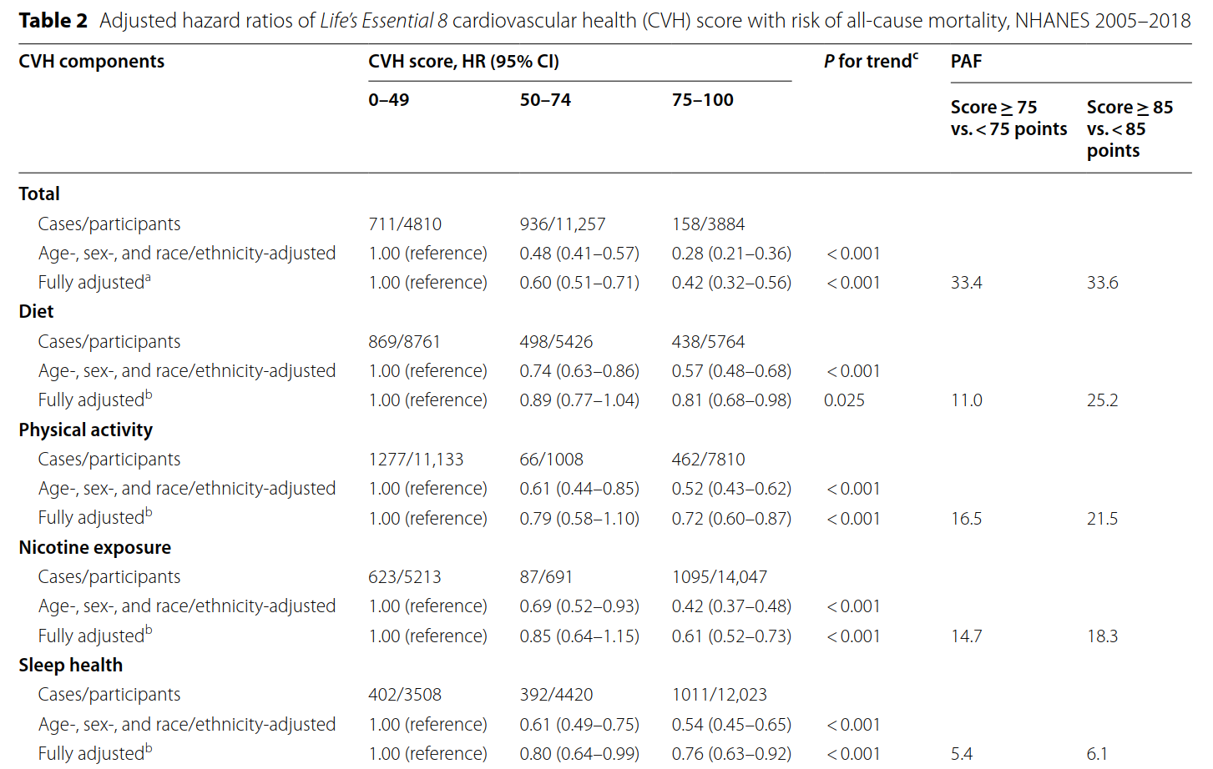
Risk of all-cause mortality
19

Slide 20
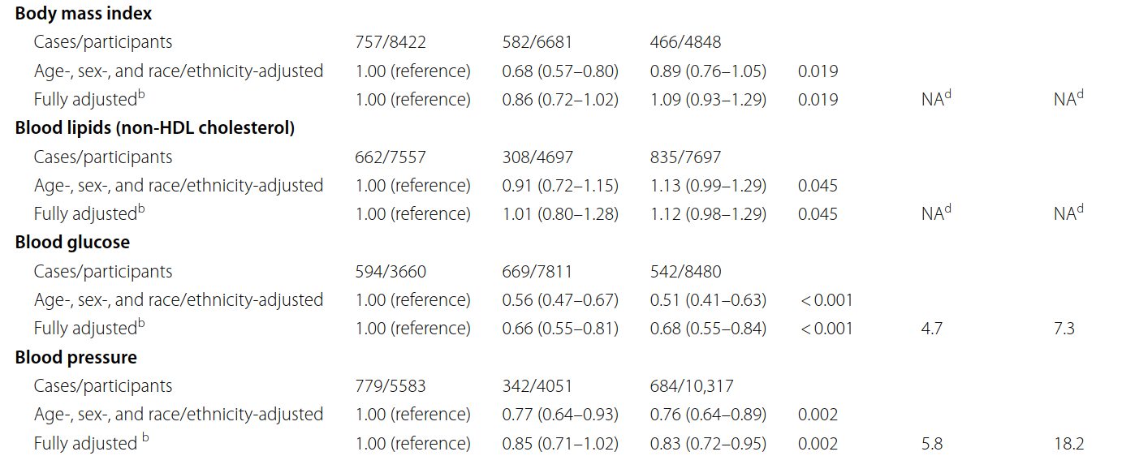
Risk of all-cause mortality
20

Slide 21
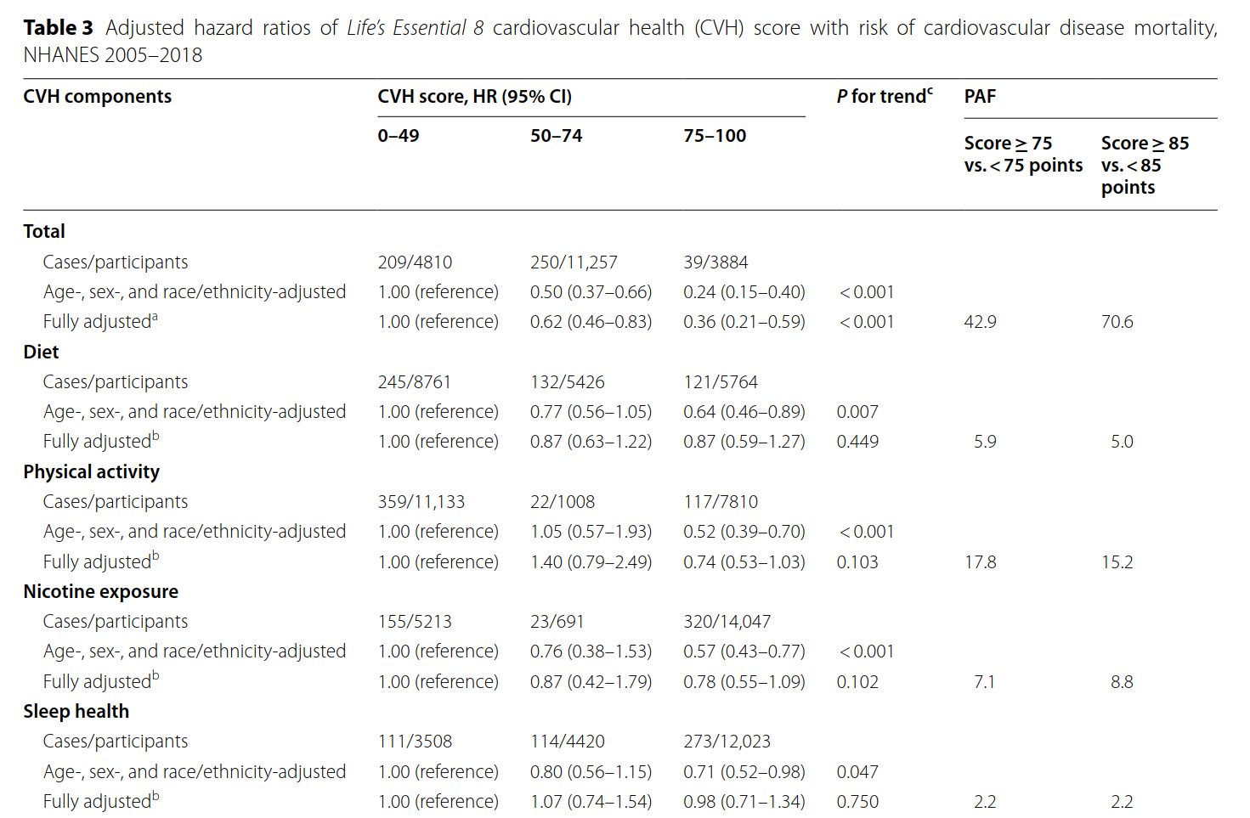
Risk of cardiovascular disease mortality
21

Slide 22
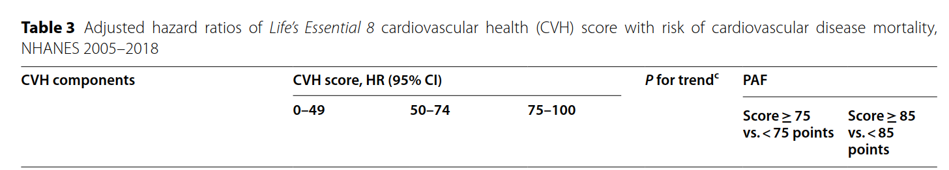
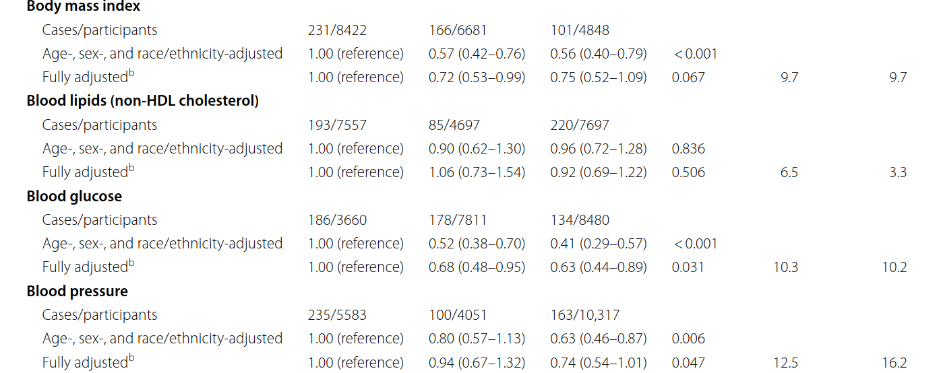
Risk of cardiovascular disease mortality
22

Slide 23
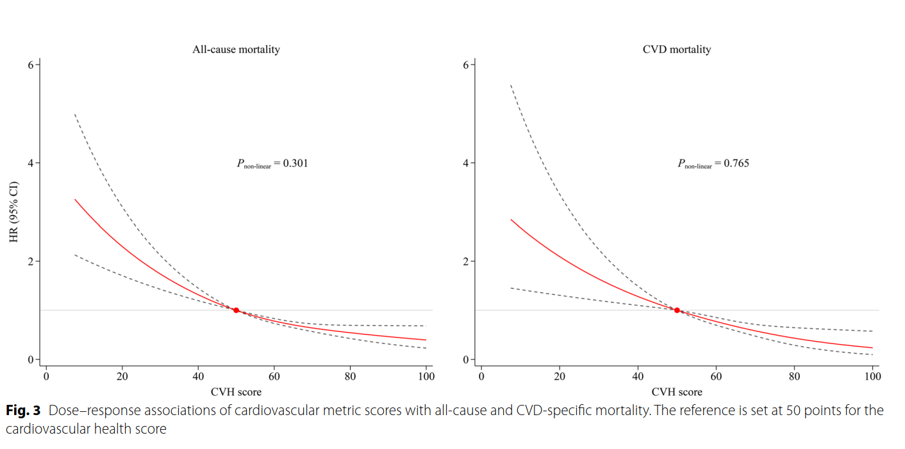
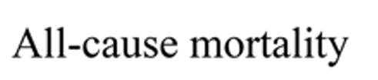
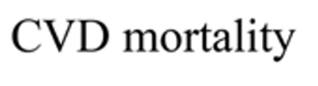
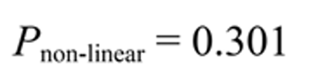

Linear Relationship of LE8 and Mortality Risk
23
Notes:
As CVH scores increase (moving right on the X-axis), the hazard ratio for both all-cause and CVD-specific mortality steadily declines, indicating a lower risk of death.
improvement in CVH score tends to reduce mortality risk.

Slide 24
Discussion
Limitations
Four lifestyle factors are self-reported, which may lead to recall bias.
Only a single baseline measurement was conducted, without considering long-term changes in the indicators.
Despite multivariable adjustments, there may still be residual confounding from unmeasured or unknown variables.
The study population consists of US adults aged 30–79 years, limiting generalizability.
24

Slide 25
Discussion
Limitations
The overall CVH score in “Life’s Essential 8” is calculated using equal weights for each of the 8 indicators, which may overlook the different impact of each indicator on mortality risk.
25

Slide 26
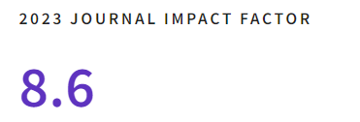
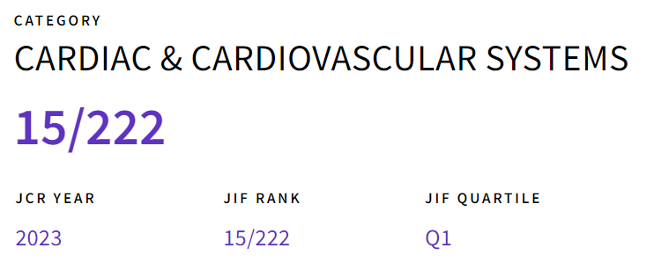
Life’s Essential 8 and the risk of cardiovascular disease death and all-cause mortality in Finnish men
European Journal of Preventive Cardiology (2023) 30, 658–667
First author:
Nzechukwu M. Isiozor
Institute of Clinical Medicine, University of Eastern Finland, Finland;
26

Slide 27
Study Question
This study aims to examine the association between the “Life’s Essential 8” (LE8) and the risk of cardiovascular disease (CVD) death and all-cause mortality among Finnish men.
27

Slide 28
Knowledge gap
LE8 metric has not yet been evaluated in European populations
28
Notes:
So the aim of the study are
First!
Second!

Slide 29
Methods: design and participants
Data Source:
  Kuopio Ischaemic Heart Disease (KIHD) study in Eastern Finland, focused on middle-aged and older men.
29

Slide 30
Methods: design and participants
Inclusion:
  Men aged 42–60
  Able to complete baseline measurements
Exclusion:
  Pre-existing cardiovascular disease
  Missing essential baseline data
Final Sample
  Of the initial 2682 participants, after excluding those with a history of CVD and missing data, a total of 1662 men were included in the analyses
30

Slide 31
Methods: outcome measurement
Mortality measurement: National death registry database
Outcomes:
  Cardiovascular disease (CVD) death
  All-cause mortality
Follow-up Duration: Median of 30 years
31

Slide 32
Statistical Analysis
Cox Proportional Hazards Model used to assess the association between LE8 scores and mortality risk
  Adjustments: Age, alcohol intake, socioeconomic status, etc.
Restricted cubic splines:
  it represents the dose–response relationships between CVH scores and mortality.
32

Slide 33
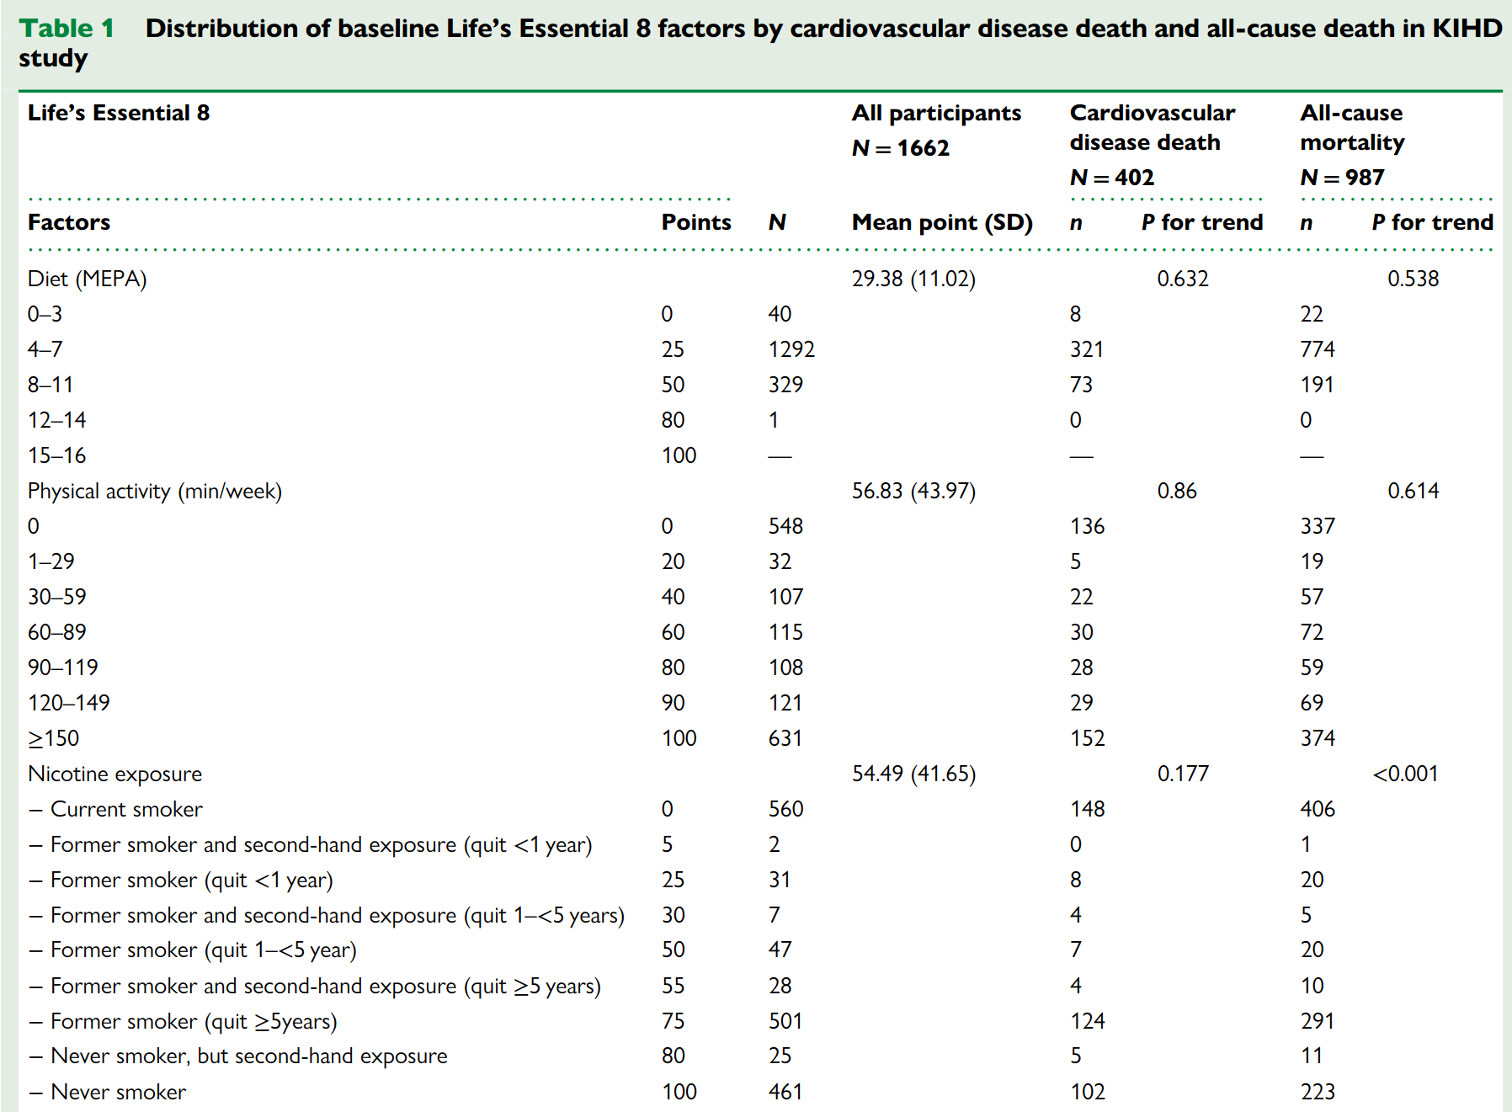
Methods: baseline characteristics
33
Notes:
In this table, each factor is divided into multiple small categories to reflect the new, more granular scoring criteria. While this approach provides greater detail and precision, it can also make the table appear more complex and harder to read at a glance.

Slide 34
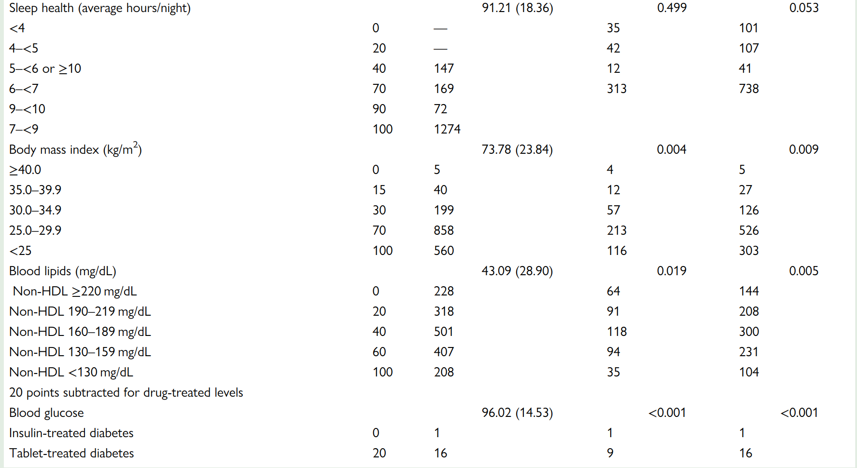
Methods: baseline characteristics
34

Slide 35
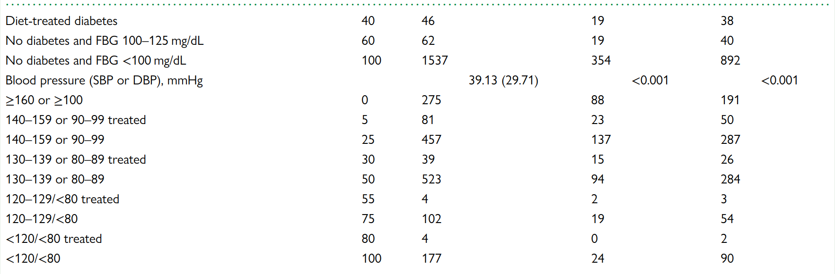
Methods: baseline characteristics
35

Slide 36
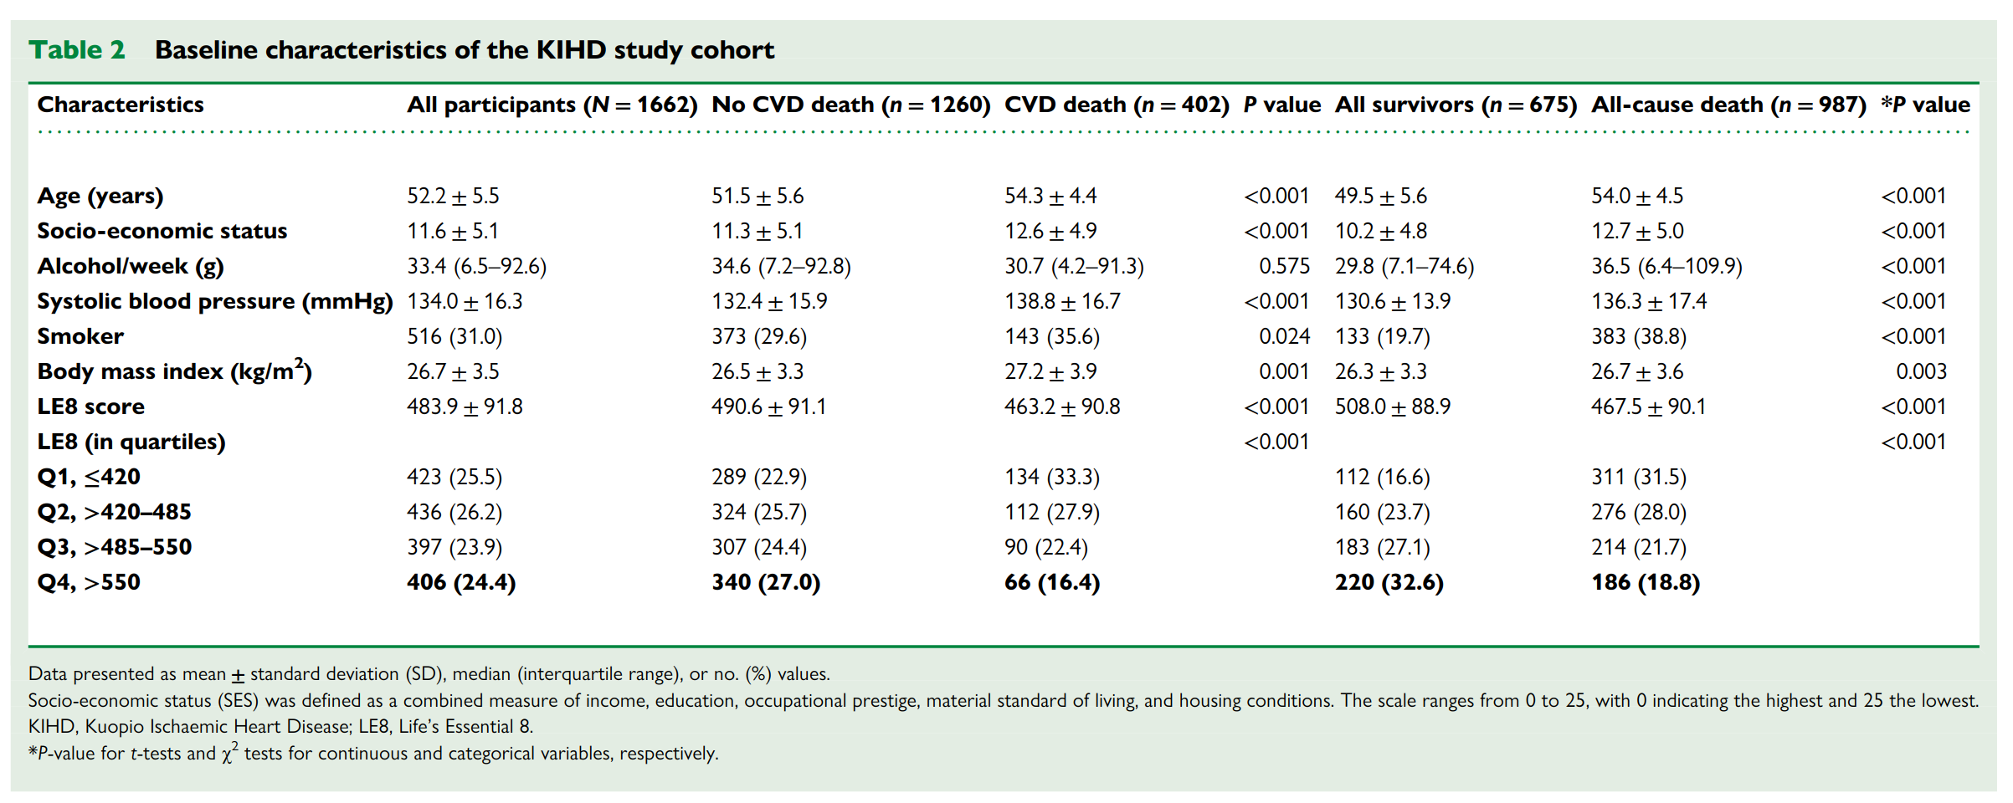
Methods: baseline characteristics
36

Slide 37
Results
37

Slide 38
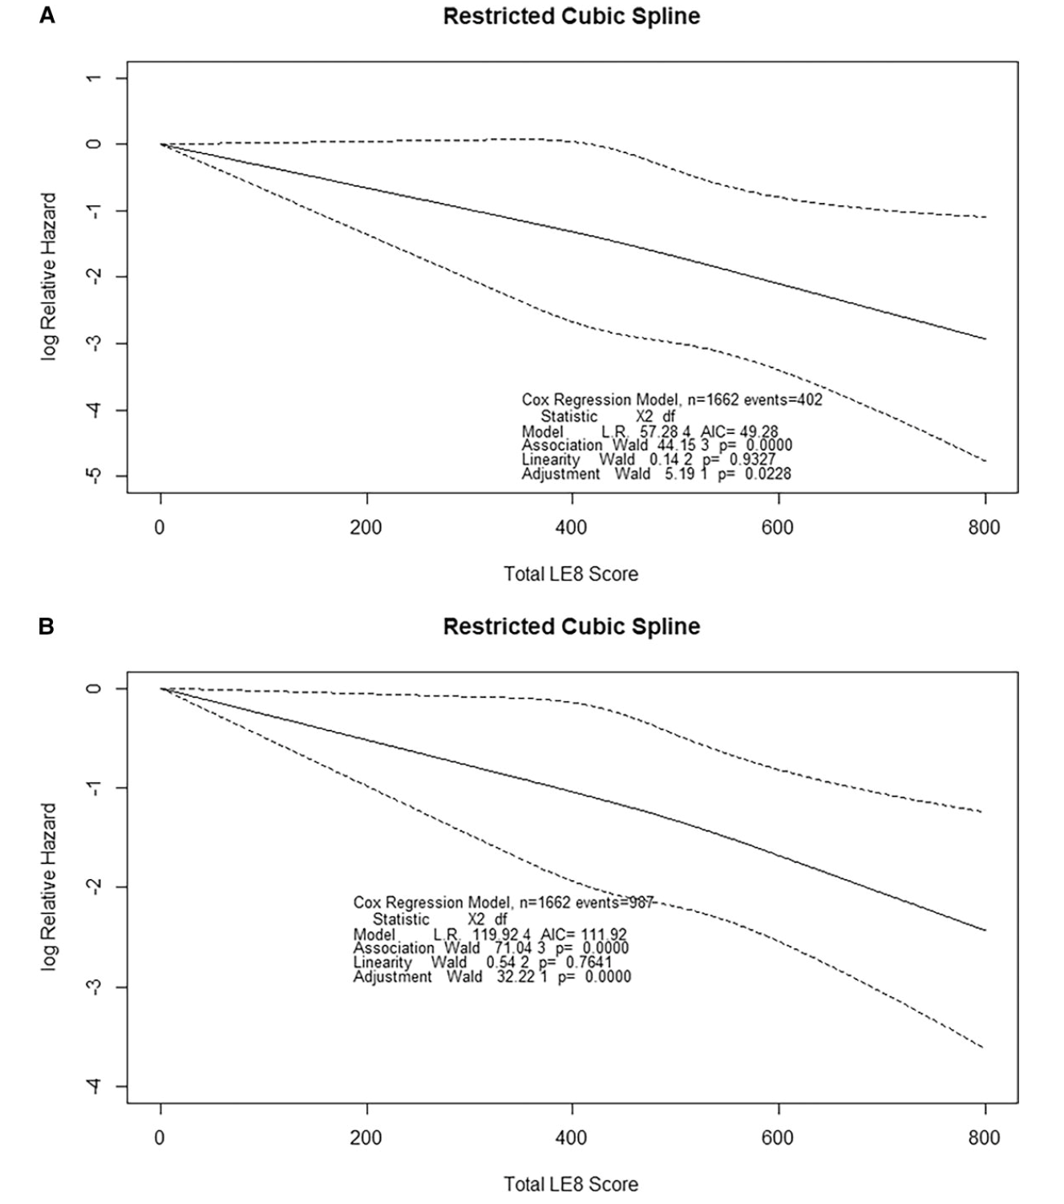
(A) CVD mortality
Key Finding:
Both curves show a downward (negative) slope.
                Higher LE8 score corresponds to a lower risk of CVD mortality (Panel A) and all-cause mortality (Panel B)
(B) all-cause mortality
Notes:
µg/m³ Microgram/Cubic meter

Slide 39
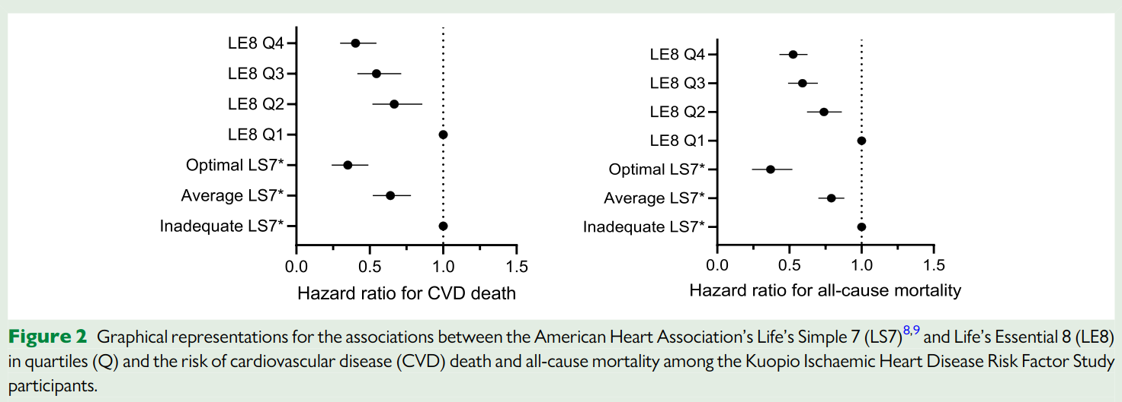
The highest quartile of LE8 or optimal LS7 have the lowest relative risk of death.
These findings reinforce that improving multiple health behaviors and can reduce long-term mortality risks.
39

Slide 40
Discussion
Limitations
Single Baseline Measurement
  All Life’s Essential 8 factors were assessed only once at baseline, which may not reflect changes in health behaviors or clinical parameters over time.
Self-Reported Data
  Several variables relied on self-reported questionnaires, introducing potential recall bias or misclassification.
Limited Generalizability
  The study focused on middle-aged and older men from Eastern Finland. Results may not be fully applicable to women, younger groups, or other populations.
40

Slide 41
Discussion
Limitations
Residual Confounding
  Despite adjusting for key variables, unmeasured or unknown confounders could still affect the observed associations.
Long Follow-up but No Repeated Measures
  Although participants were followed for up to 30 years, the lack of repeated measures means interim changes in LE8 factors were not captured.
41

Slide 42
Comparison of the two papers
 | Paper 1 | Paper 2
Study question | The association of the LE8 cardiovascular health metrics with all-cause and cardiovascular disease-specific mortality
design | Prospective cohort study
Data Source | NHANES 2005–2018, linked with the 2019 National Death Index | Kuopio Ischaemic Heart Disease (KIHD) Study in Finland
participants | 19,951 US adults (aged 30–79, both sexes) | 1662 Finnish men (aged 42–60)
Follow-up Duration | Median Follow-up: 7.6 years | Median Follow-up: 30 years

Slide 43
Comparison of the two papers
 | Paper 1 | Paper 2
Statistical Analyses | Cox Proportional Hazards Models Restricted Cubic Splines Population-Attributable Fractions (PAFs) | Cox Proportional Hazards Models Restricted Cubic Splines
results | high LE8 (≥75) had: • 58% lower risk of all-cause mortality • 64% lower risk of CVD- mortality | Men in the highest quartile (Q4) had a: 48% lower risk of all-cause mortality 60% lower risk of CVD death
advantages | Large, nationally representative sample (includes both sexes and multiple ethnic groups) Newly refined LE8 metrics with additional sensitivity in scoring Provides PAFs for public health implications | Long-term follow-up 30 years Adds evidence from a European male population
Notes:
GBMM focuses on between-class differences in intercepts and slopes;individuals within each group start at thesamevalue[20].WeusedGBMMsinceourstudyfocusesontrajectorygroupidenti-fication,ratherthandistinctpopulationswithinsubgroups
GBMMresults are simple and easy to interpret compared with other models,

Slide 44
Comparison of the two papers
 | Paper 1 | Paper 2
disadvantages | Relatively short follow-up (median 7.6 years) Self-reported lifestyle factors Only once baseline data used Residual confounding remains | Smaller sample size Study restricted to middle-aged men from Eastern Finland Self-reported lifestyle factors Single baseline measurement of LE8 Residual confounding remains
Notes:
GBMM focuses on between-class differences in intercepts and slopes;individuals within each group start at thesamevalue[20].WeusedGBMMsinceourstudyfocusesontrajectorygroupidenti-fication,ratherthandistinctpopulationswithinsubgroups
GBMMresults are simple and easy to interpret compared with other models,

Slide 45
Association of the American Heart Association’s new “Life’s Essential 8” with all-causeand cardiovascular disease-specific mortality: prospective cohort study
Jiahong Sun1†, Yanzhi Li2†, Min Zhao3, Xiao Yu4, Cheng Zhang5, Costan G. Magnussen6,7,8 and Bo Xi1*
Comments on Paper – 1
By: Swati Jain
PhD 2nd Year
T88127037
12th March, 2025

Slide 46
Comment 1
As per the findings of the CARDIA (Coronary Artery Risk Development in Young Adults) study “Adults between ages 18 and 30 who have several risk factors for heart disease are two to three times more likely to develop atherosclerosis, a strong predictor of future heart disease, later in life”.
The study’s conclusion emphasizes "primordial and primary prevention efforts targeting CVH metrics.”
Do you think excluding adults aged 18–30, when risk behaviors are first established and CVH trajectories are set, might lead to an underestimation of the lifetime burden of modifiable risks? And How might this exclusion impact the study’s relevance to primordial prevention, which aims to prevent risk factors before they develop, and what effect could this have on early intervention strategies and the accuracy of population-attributable fraction estimates for mortality?

Slide 47
Response 1
Underestimation of Lifetime Risk
  Excluding the 18–30 age group may underestimate the effect of early unhealthy behaviors on cardiovascular health
  leading to lower population-attributable fraction (PAF) estimates and an inaccurate assessment of preventable mortality.
Reduced Relevance to Primordial Prevention
  Primary prevention focuses on avoiding the development of risk factors
  but the study's exclusion of young adults may understate the importance of early interventions (e.g., smoking cessation, healthy diet promotion), potentially affecting policy recommendations and clinical prevention strategies.
Notes:
While these limitations do not invalidate the study’s conclusions, they may weaken its guidance for public health strategies and early intervention efforts.
這樣的影響雖然不至於顛覆研究結論，但可能會 削弱其對公共衛生和早期介入策略的指導價值。

Slide 48
Comments for Yuan-Tsung’s paper 2
PhD 1st year student
Yang-Han Lin

Slide 49
Comment 1
This study uses the baseline LE8 score to evaluate mortality.
In the discussion, the authors only mention that using baseline assessments could underestimate the associations due to the potential for regression dilution bias.

Slide 50
Comment 1
However, this study has a long follow-up period and participants may change their lifestyle habits or modify their medication for disease treatment.
Without follow-up assessments of LE8 scores, do you think the study results remain reliable?

Slide 51
Comment 2
According to the study results, although a higher LE8 score reduces the risk of cardiovascular mortality, it does not effectively define a cut-off point for active intervention.
Diabetes, hypertension, and dyslipidemia already have well-defined treatment targets.
If we need to spend time calculating the LE8 score but cannot determine the next step, is calculating LE8 truly necessary?

Slide 52
Response 1-1
Lack of Repeated Measurements
  Ideally, repeated LE8 assessments would enhance causal inferences by capturing whether continued improvements or declines in CVH metrics.
  The absence of follow-up LE8 data is a limitation, it primarily underscores the potential underestimation of the true effect size.

Slide 53
Response 1-2
The Long-term Follow-up
  The study cannot capture the full benefit of improvement or worsen over time, making the estimated effect size more conservative than it might actually be.
  A 30-year follow-up is valuable because it captures late-onset events.

Slide 54
Response 2-1
LE8 Score Lacks a Fixed Intervention Threshold?
  It still offers important benefits in both clinical and public health contexts.
Comprehensive Risk Assessment
  LE8 integrates multiple health behaviors and factors into one measure.
  This comprehensive view can highlight broader lifestyle issues (like sleep or nicotine exposure), because these issues may be overlooked when focusing on a single biomarker.

Slide 55
Response 2-2
Population-Level Strategy
  From a public health standpoint, LE8 can guide resource allocation by identifying subgroups with lower overall cardiovascular health.
  This promotes a broader approach to prevention by addressing multiple risks together rather than isolating each factor.
Beyond Medication:
  Lifestyle changes reduce CV risk beyond medication adjustments.

