Slide 1
Tips of academic writing
NCKU Public Health PhD Research Seminar
Li-Jung Elizabeth Ku
June 4, 2025
Slides provided by
Tsung-Hsueh (Robert) Lu

Slide 2
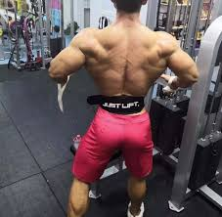
Shape of IMRAD
Introduction
Introduction
Methods
Methods
Results
Results
Discussion
Discussion

Slide 3
General concept GC
Introduction
Specific concept SC
Methods
Operational Measure OM
Results
Specific concept SC
Discussion
General concept GC

Slide 4
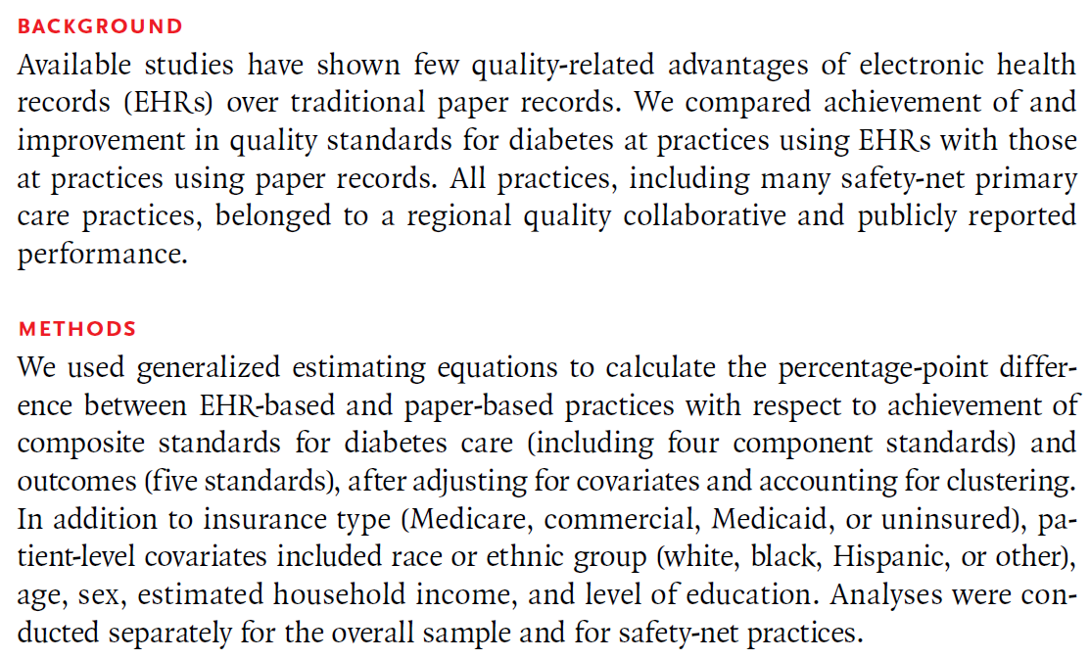
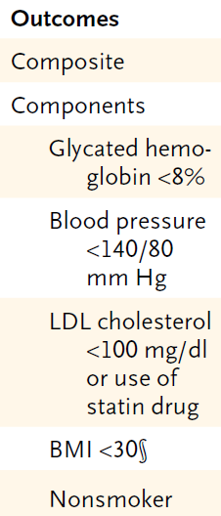
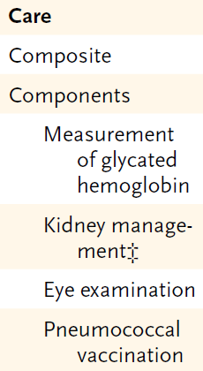
GC: Quality of diabetes care
SC: Care and outcome standards
OM:

Slide 5
GC: Quality improvement
SC: Hospital level risk-standardized mortality
Ann Intern Med 2014;160:380-388

Slide 6
GC: Medication Nonadherence
SC: Adherence to hydroxychloroquine
OM: measured adherence using the proportion of days covered
Arthritis Care Res 2019;71:903-13.

Slide 7
GC: Area-level Predictors
SC: Contextual factors: racial composition, socioeconomic status, concentration of health care resources
OM: zip code-level, county-level, state level socio-demographic variables from the American Community Survey, and health resources from Area Health Resources Files.
Arthritis Care Res 2019;71:903-13.

Slide 8
How to write introduction?
Introduction
Known
Background knowledge (sometimes very plain English because different profession makes one feel worlds apart)
Importance
Previous studies (selected dialogue papers)
However (despite, yet, whereas, although)
Limitations or conflict findings
Therefore
What is the niche of this study to solve limitation

Slide 9
Shape of introduction?
Introduction
Known Essential background and importance
Known Narrow down to previous studies especially key dialogue papers and authors (reviewers).
However Limitations, inconsistent findings, or unknown.
Therefore This study aimed to

Slide 10
How to find out key dialogue papers and authors (reviewers).
Who are your expected readers?
General public
Similar professionals
Scholars with specific interests
Particular persons
Papers and authors used the
same data
same setting
same analysis methods

Slide 11
Different data for mortality studies
Data in High income countries
Multi-centers patients follow up
Population-based cohort studies
Insurance claims data
Registry data linkage
National vital registry
Data in low income countries
Household survey
Single hospital data
Global health estimate (e.g., GBD)

Slide 12
How to find out key dialogue papers and authors?
1.General search
2.Notifying the author
3.Chasing the author
with series of papers

Slide 13
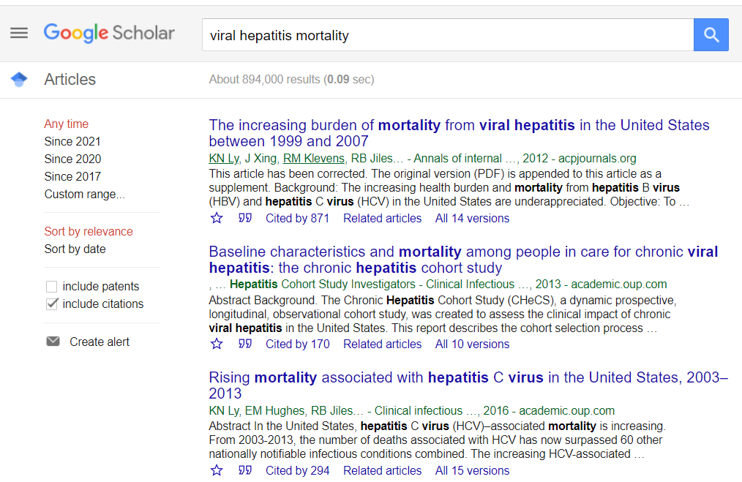
General search
Notifying the author

Slide 14
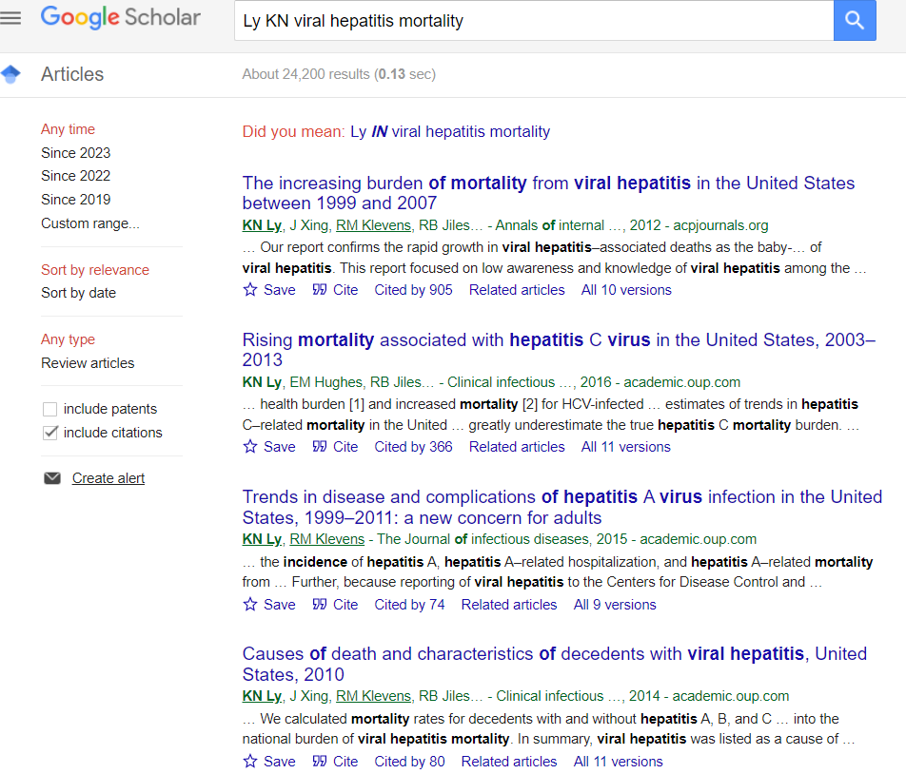
Chasing the author
with series of papers

Slide 15
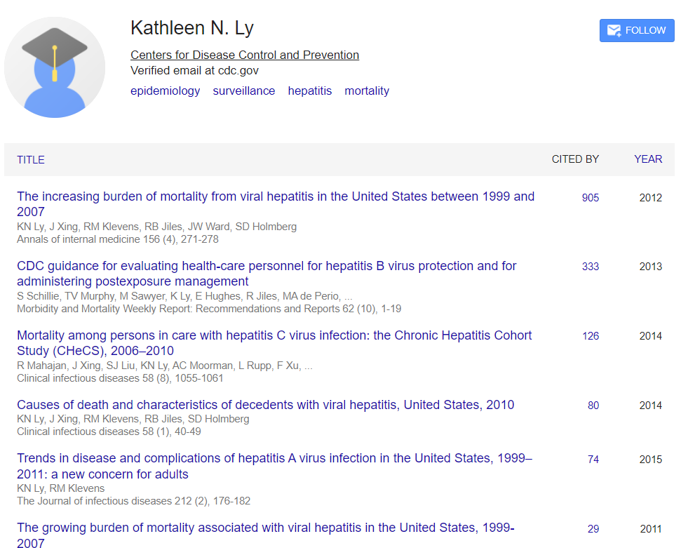
Chasing the author
with series of papers

Slide 16
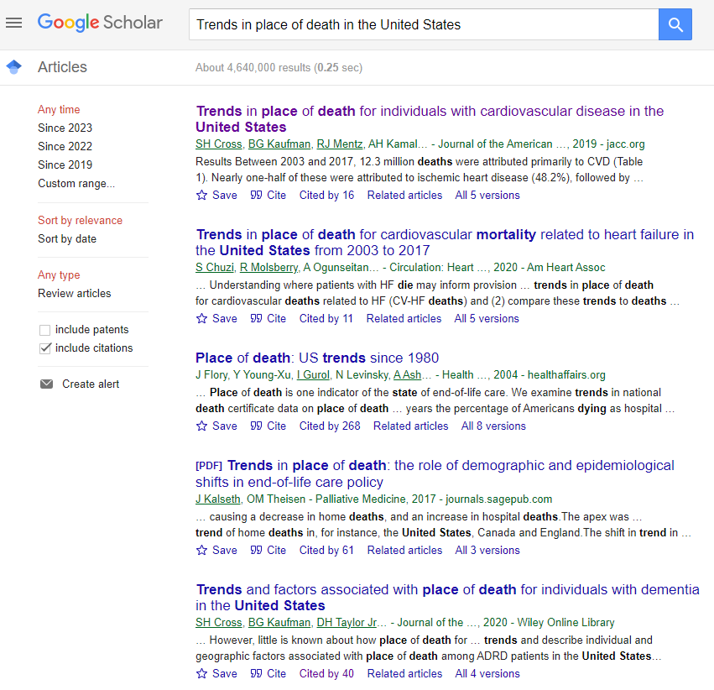
General search
Notifying the author

Slide 17
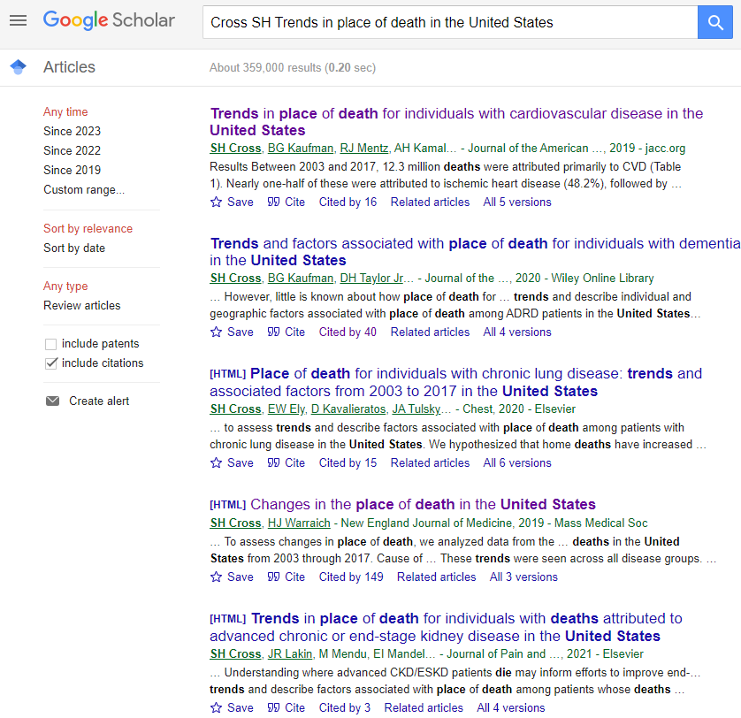
Chasing the author
with series of papers

Slide 18
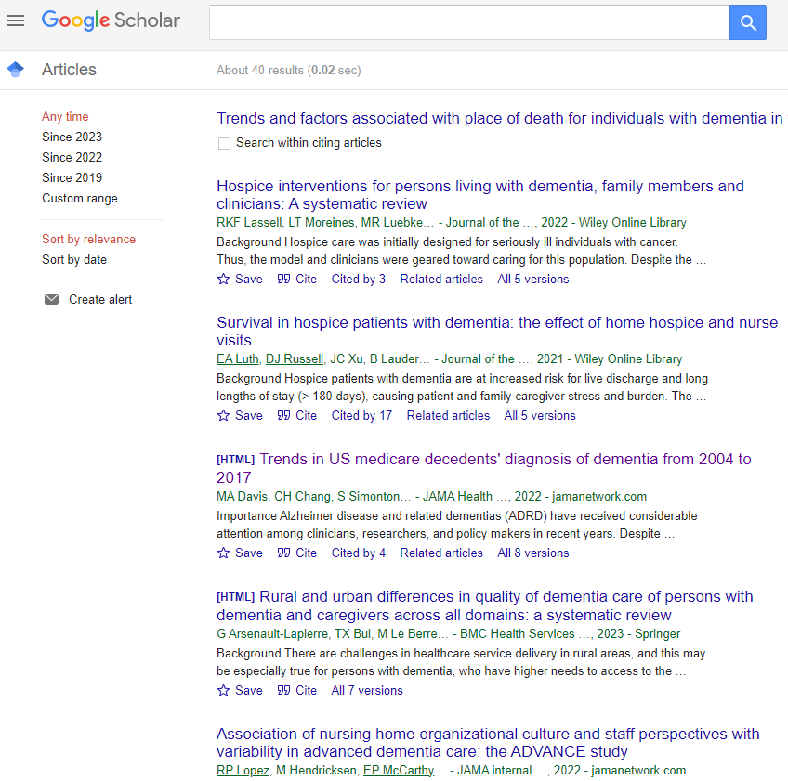
Cited by: Try to find out updated relevant papers and authors

Slide 19
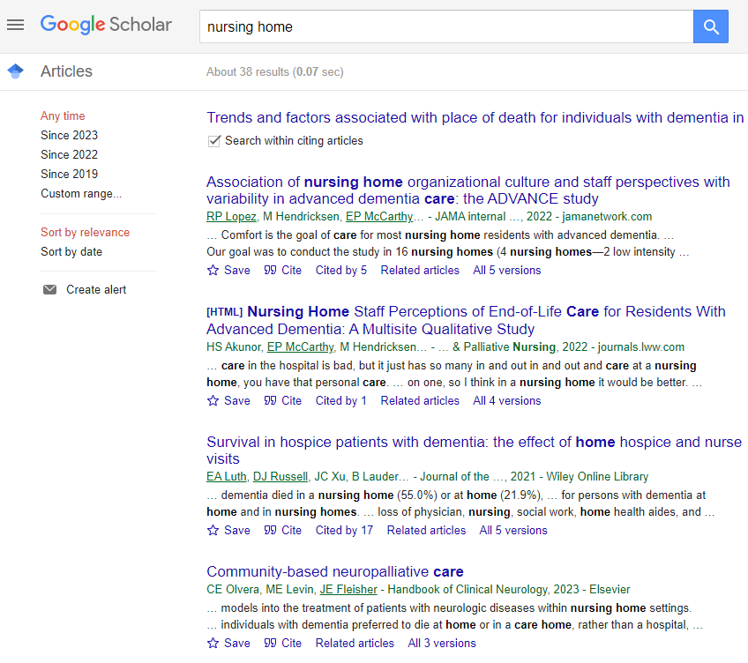

Slide 20
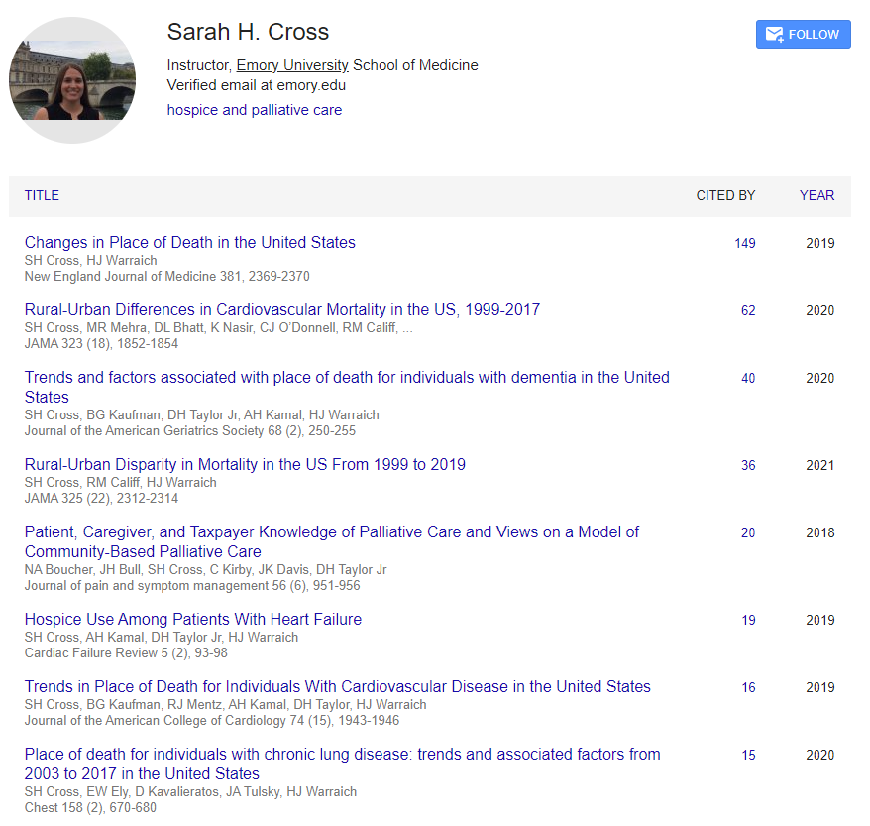
Chasing the author
with series of papers

Slide 21
How to write introduction?
Introduction
How many words are suitable for the introduction?

Slide 22
How to write introduction?
Introduction
What is the most important word in introduction?
However

Slide 23
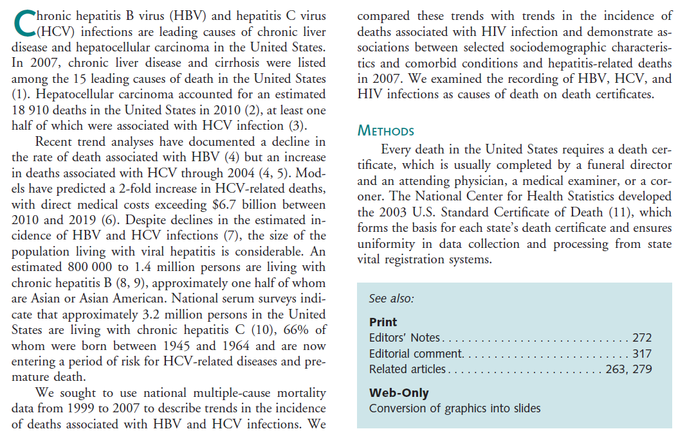
Ann Intern Med 2012;156:271-278

Slide 24
Ann Intern Med 2012;156:271-278
Word count: 288 (P1:74, P2:141, P3:73)
Known
Background knowledge P1: S1
Importance P1: S2-S3 leading causes of death and number of deaths
Previous studies P2: S1-S5
However P2: S3 incidence decline but deaths increased
Therefore
We … P3: S1-S3

Slide 25
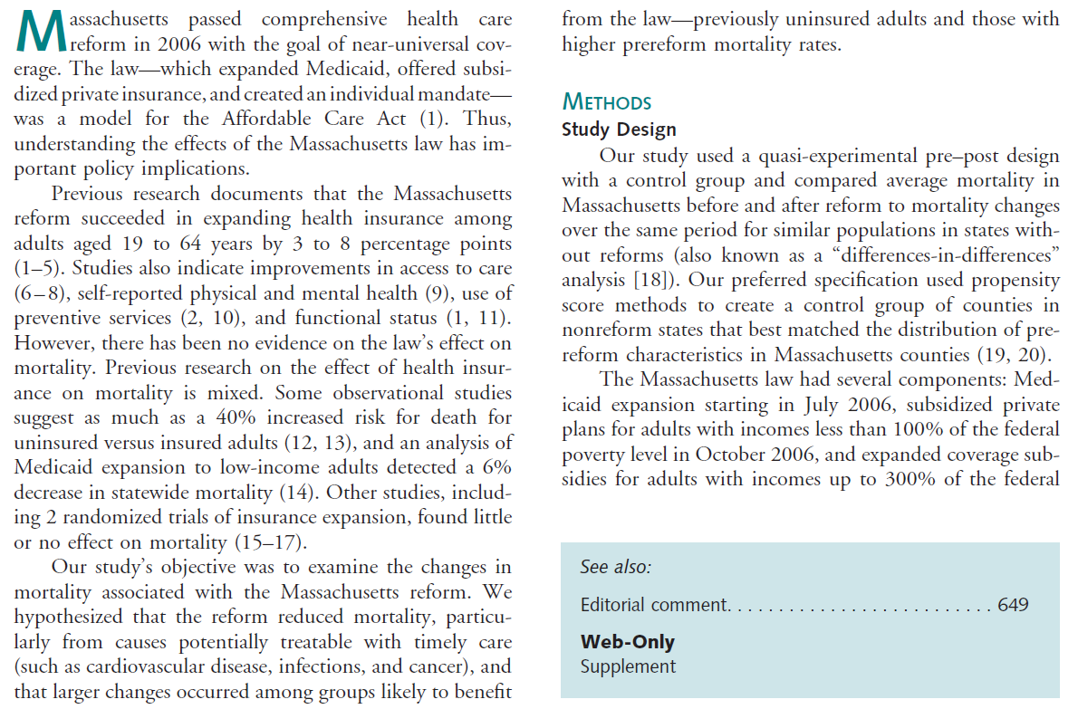
Ann Intern Med 2014;160:585-593

Slide 26
Ann Intern Med 2014;160:585-593
Exercise for YOU (Word count: 241)
Known
Background knowledge P？: S？-S？
Importance
Previous studies
However P？: S？
Therefore
Our study … P？: S？

Slide 27
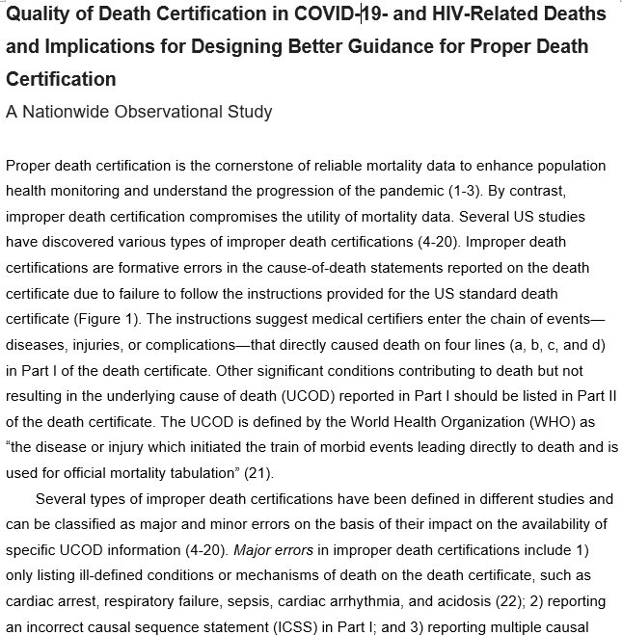
Word count:
483
P1:174,
P2:177,
P3:132,
Why so long?
People are not familiar the instruction of death certification
Types of improper death certification
I do not have specific dialogue papers

Slide 28
UCC principle
Unity
Only one theme in one paragraph.
All supporting sentences supporting one topic sentence, most of the time the first sentence.
Coherence
Sentence followed by sentence should be connected with some logics (sequential, causal, including or examples [such as]).
Completeness
All supporting sentences should in some extent support the topic sentence.

Slide 29
Shape of introduction?
Introduction
Known Essential background and importance
Known Narrow down to previous studies especially key dialogue papers and authors (reviewers).
However Limitations, inconsistent findings, or unknown.
Therefore This study aimed to

Slide 30
Why the editor will send out your manuscript for external review?
Because you explicitly indicated that you can resolve one limitation of previous studies.

Slide 31
Level and volume of neonatal intensive care and mortality in very-low-birth-weight Infants N Engl J Med 2007;356:2165-75.
We,^{4,6} as well as other investigators,^{5,9-17,22-25} have previously demonstrated a relationship between the level of NICU care and neonatal outcome. However, most previous studies, including our own, involved relatively small samples or narrowly defined networks and thus could not adequately assess interaction between volume and level of care. 樣本數小與侷限特定醫療體系
In addition, most studies were based on data collected before the routine use of surfactant-replacement therapy, which has substantially improved mortality rates among very-low-birth-weight infants.在例行使用表面張力素治療之前的研究

Slide 32
The effect of neonatal intensive care level and hospital volume on mortality of very-low-birth-weight Infants Med Care 2010;48:635-44.
Phibbs et al,¹³ evaluated …One limitation of their analysis was that their adjustment for differences in case-mix between hospitals concentrated on neonatal factors. This study builds on the Phibbs analyses by adjusting for potential differences in both antenatal and delivery factors, in addition to neonatal factors, which may differ by hospital site of delivery. …統計調整只針對新生兒因素
Further, the Phibbs study made no comment on the relative importance of level and volume… In this study, we …explicitly determine the relative effects of level and volume on perinatal mortality.
沒有討論層級與服務量的相對影響

Slide 33
Very low birth weight hospital volume and mortality : an instrumental variables approach
Med Care 2012;50:714-21.
Most studies have generally found small to moderate reductions in mortality with increasing volume.⁴⁻⁶ However, one study has reported … small mortality increases with volume above this threshold.
減少或增加的結果有衝突
A main analytical challenge in volume-outcome studies that only rely on adjusting for observable confounders is the potential bias in volume-effect estimates due to self-selection into hospitals based on volume and “unobserved” individual-level confounders, such as maternal/fetal health risks.
只控制可觀察變項，沒有控制不可觀察變項

Slide 34
Do not submit your manuscript if you did not write however in the introduction
However, ……
Inconsistent findings of previous studies.
Gap between daily practice and guideline.
Theoretical debates.
Update the figures
The limitations of previous papers are the however in your introduction:
Small sample size, short observation period, poor measure, no control of some covariates, statistical model not robust, narrow outcome observed

Slide 35
Operational definitions so that people can get the same results following the steps you wrote.
How to write methods？
Methods
Data sources, sampling, data collection
Measurements of dependent (outcome) variable
Explicitly write out the ICD codes while using administrative data
Measurements of independent (exposure) variable
Please write out the whole questions in your survey and how you combined the items
Measurements of covariates
Statistical analysis

Slide 36
Using subtitles
Effect of a multifactorial intervention on mortality in type 2 diabetes.
N Engl J Med 2008;358:580–591.

Slide 37
Modifying the topic from papers in dialogue
系統性紅斑性狼瘡(SLE)
Ann Intern Med 2017;167:777-85.
MMWR 2002;51:371-4.
J Rheumatol 1995;22:1663-8.
Arthritis Rheum 1981;24:762-9.

Slide 38
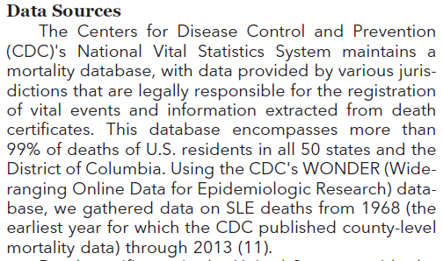
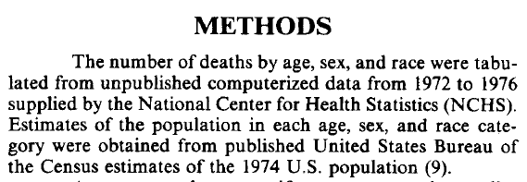
Ann Intern Med 2017;167:777-85.
MMWR 2002;51:371-4.
J Rheumatol 1995;22:1663-8.
Arthritis Rheum 1981;24:762-9.

Slide 39
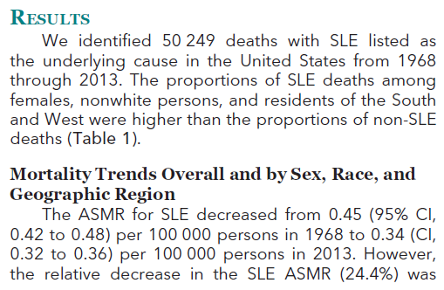
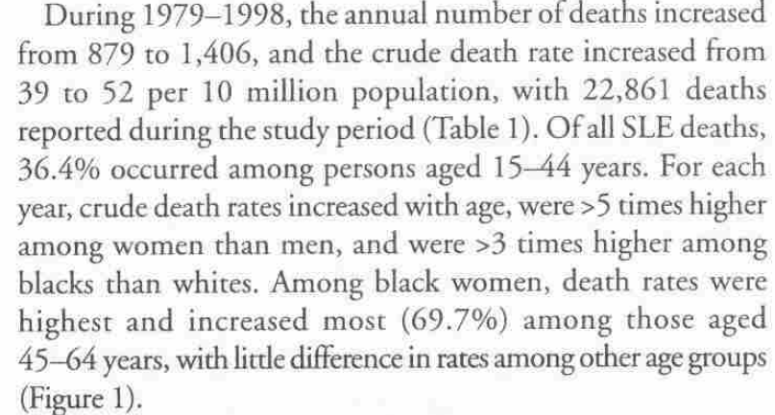
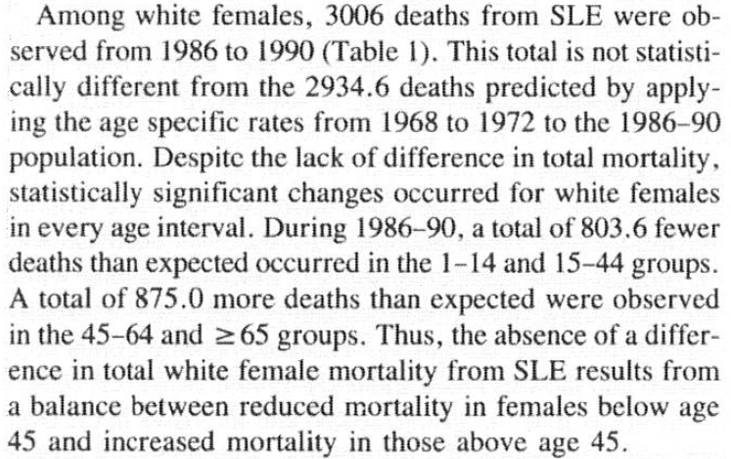
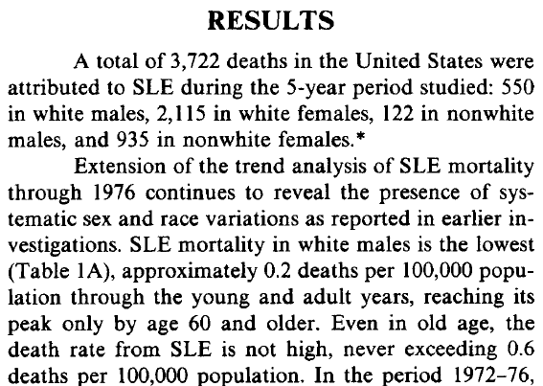
Ann Intern Med 2017;167:777-85.
MMWR 2002;51:371-4.
J Rheumatol 1995;22:1663-8.
Arthritis Rheum 1981;24:762-9.

Slide 40
How to write results?
Results
Do not repeat the objective results in tables and figures in text. Guide readers to see selected results and expressed your subjective claims or assertions.
Skill 1: Using texts to summarize results
Half of the respondents were unsatisfied. Three-fourths of unsatisfied were males.
Skill 2: Point out (highlight) the extreme values or most important values
Waiting time was the item with highest score.
Skill 3: Directional points
The percentage of males (22%) was higher than (similar to) the females (18%).
21, 23, 22, 24, 26 The trend was increasing (stagnated)

Slide 41
Trends and outcomes of malignant hyperthermia in the United States, 2000 to 2005. Anesthesiology 2009;110:89–94.
惡性高熱
Malignant hyperthermia is a drug-induced genetic emergency closely related to anesthesia

Slide 42
Effect of a multifactorial intervention on mortality in type 2 diabetes.
N Engl J Med 2008;358:580–591.

Slide 43
How to write discussion？
Discussion
Answer research question using concepts
Dialogue with previous studies
Strengths and limitations of this study
How to make the limitation as strength?
Clinical and policy implications and suggestions for future studies

Slide 44
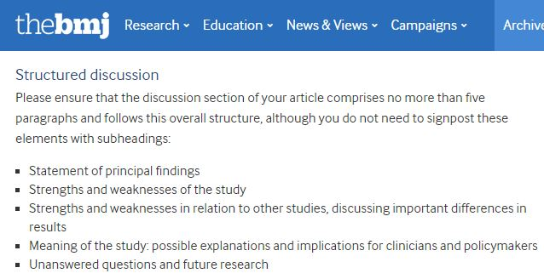

Slide 45
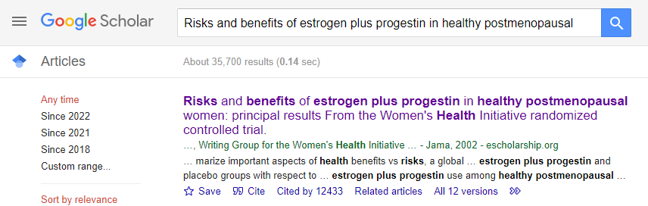
How to transform limitation into strength？ 反敗為勝

Slide 46
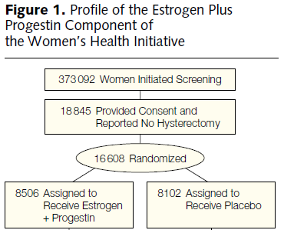

Slide 48
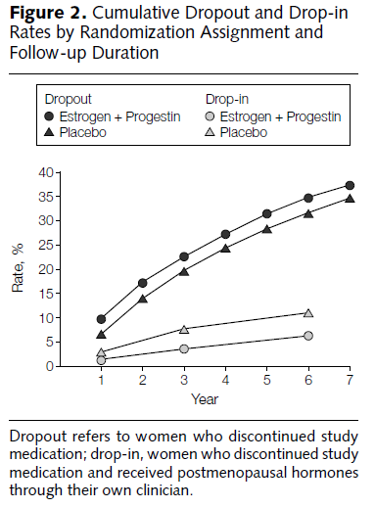

Slide 49
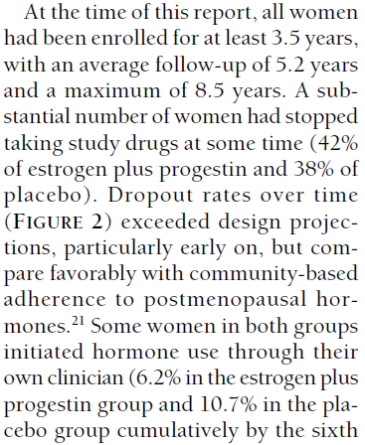
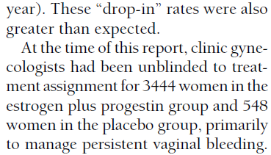

Slide 50
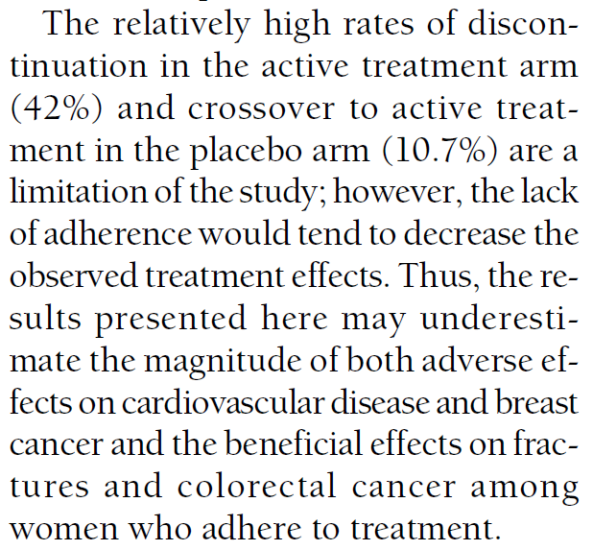
How to transform this serious limitation into strength？

Slide 51
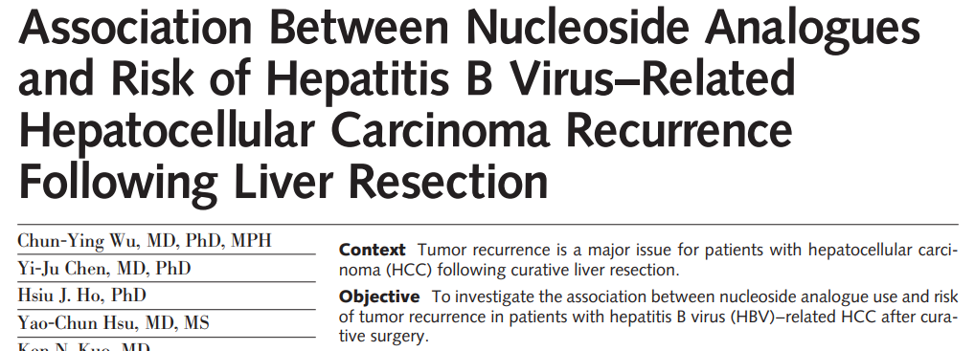
Notes:
https://jamanetwork.com/journals/jama/fullarticle/1391401

Slide 52
Refine the observational study design
Denominator
Numerator
Taking anti-HBV drug
HBV
HCC
OP
Recurrence
Deaths
Notes:
B肝病毒（HBV)->肝細胞癌 (HCC)

Slide 53
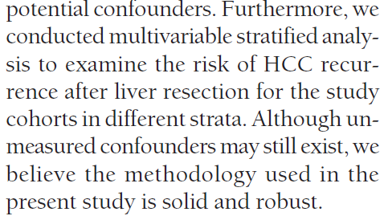
We have tried several available efforts to minimize the biases.

Slide 54
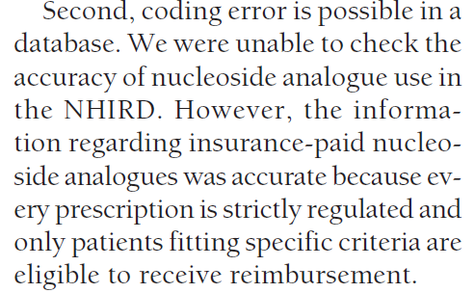
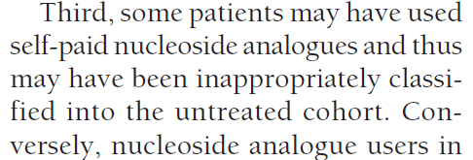

Slide 55
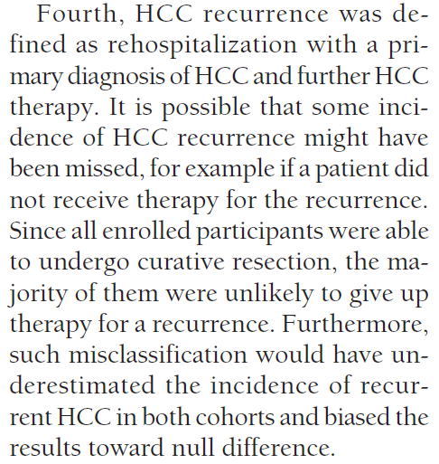

Slide 56
Notes:
We used the incident user design with follow-up for each patient beginning on the date of first prescription of nucleoside analogue in the treated cohort. The follow-up for the untreated cohort began on the first day after the index hospitalization for liver resection.

Slide 57
Homework due June 11th
Using the template slide (page 12) and follow the three steps to find your core paper by searching your research topic.
Follow the template slides (p.16-18) and paste your search results into a PPT file and add a 4th slide to list the name of your target journal
Each submit your HW to Moodle by noon next Wed. The instructor will pick 2 students to present in class.
This exercise will also help you to prepare for the next lecture “How to choose the right journal to submit your manuscript?”

