Slide 1
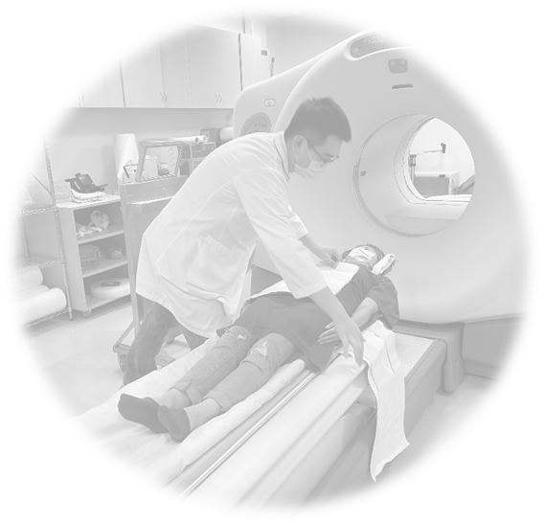
Systemic ignorance and institutional neglect in the care of patients who suffer from Disorders of Consciousness—a solution through Public Health. National Cheng Kung University April 23, 2025
Timothy J. Lane, Ph.D.
Research Fellow, Academia Sinica
Associate Editor, Consciousness and Cognition

Slide 2
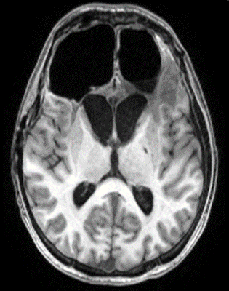
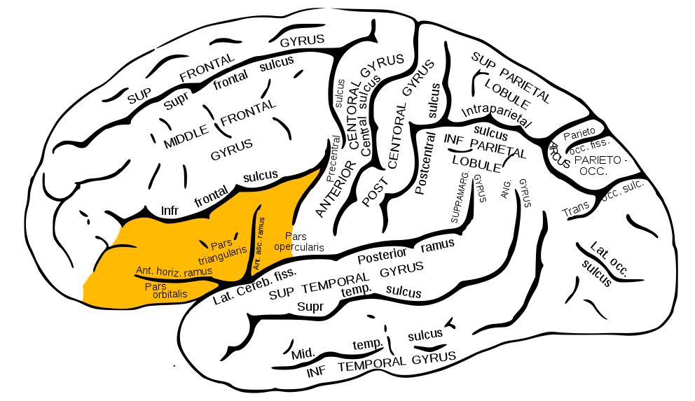
Imagine you are an ER neurologist: of PFC, only left inferior frontal gyrus remains—would you try to keep patient alive?

Slide 3
What would your diagnosis or prognosis be?
R. Pico: “the human prefrontal cortex…is the only place in the biophysical world where thought is produced and propagated in the conscious frame of reference.”
Only the left, inferior frontal gyrus of Prefrontal Cortex remains.
Patient arrives comatose; later emerges into Vegetative State (Unresponsive Wakefulness Syndrome, UWS).
Note: many of Taiwan’s ‘famous’ MDs advocate euthanasia for UWS patients.
Fractures severe; due to leakage, repeatedly lapses into comatose state.
Is he conscious? Is there any hope that he will recover? Any treatment?

Slide 4
79 Days Later

Slide 5
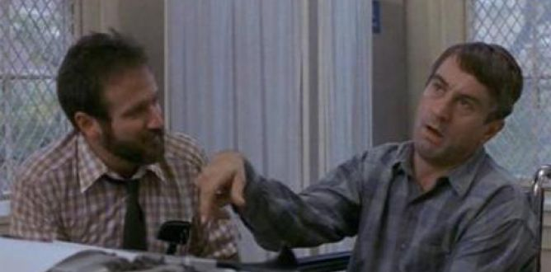
Medical consensus prior to 2000
Consciousness closely associated with language, episodic memories, etc.
Achieved by about 3 or 4 years of age.
Removal of foreskin does not require anesthesia. (Pain is conscious, so no consciousness, no pain.)
Prior to 1973, “vegetative state” had not even been described.
But as early as 1993 reports of high rates of misdiagnosis. Yet, no action taken.
In fact, consciousness can lapse for 40 years and be recovered—case described by Oliver Sacks in “Awakenings”. Encephalitis lethargica
etiology here. More common
etiologies; TBI, anoxia, stroke.

Slide 6
Why does consciousness matter?
Because consciousness is all that you are, all that you will ever be.
Without it, you, yourself, cease to exist.
Descartes famously wrote: “I think; therefore, I am.” More appropriate to say: “I experience; therefore, I am.” That is: no experience = no you.
Unless, self can remain even without experience. https://doi.org/10.1016/j.concog.2020.103029
Current definition of death: “…an individual who has sustained either (1) irreversible cessation of circulatory and respiratory functions, or irreversible cessation of all functions of the entire brain, including the brain stem, is dead.”
Nonsense: Neither (1) nor (2) necessary. Proper definition of death: lost capacity to reboot consciousness. “Irreversible cessation of ability to reboot consciousness.”

Slide 7
Elementary definition of consciousness
Consciousness is what you lose when…..A Negative Definition
You are under general anesthesia (e.g. propofol but not ketamine)
You are in deep, slow-wave NREM sleep (so dreaming not included)
You experience an absence seizure (a form of epilepsy)
You are either comatose or “vegetative” (Unresponsive Wakefulness Syndrome)

Slide 8
No consensus on a formal definition
Events that we can recognize in ourselves, non-inferentially, or ‘straight off’.
Our private, subjective, non-inferential experiences.
Or, “controlled hallucinations”: when we are awake, modulated by sensory input from the world. But when we are asleep, not modulated, resulting in the crazy content of dreams.
It does not represent the world; instead, it is a model of the world that we rely upon to try to anticipate what will happen, so that we can respond accordingly.
It is probably Bayesian: that is, prior probabilities and the brain’s spontaneous, intrinsic activity greatly influence content of that model.
A Free Energy Principle View: in the waking state, neuronally, it works to minimize surprise — i.e., reduce the difference between its predictions and actual input.
Downside: to be self-aware is to be aware of self-mortality—causes many problems.

Slide 9
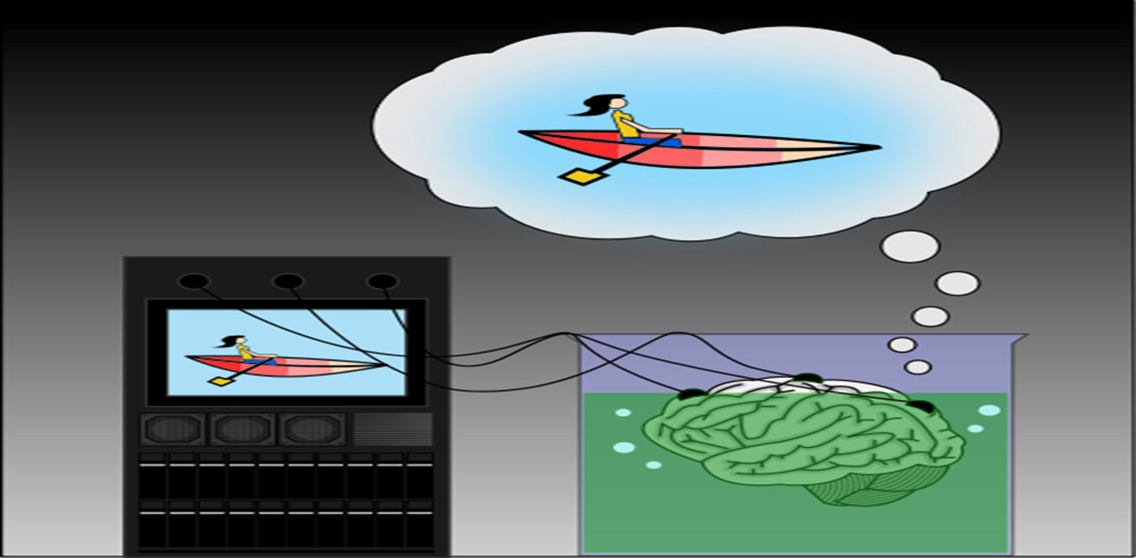
Roughly, can be thought of as inner, subjective movie. Note, the external world is not necessary.

Slide 10
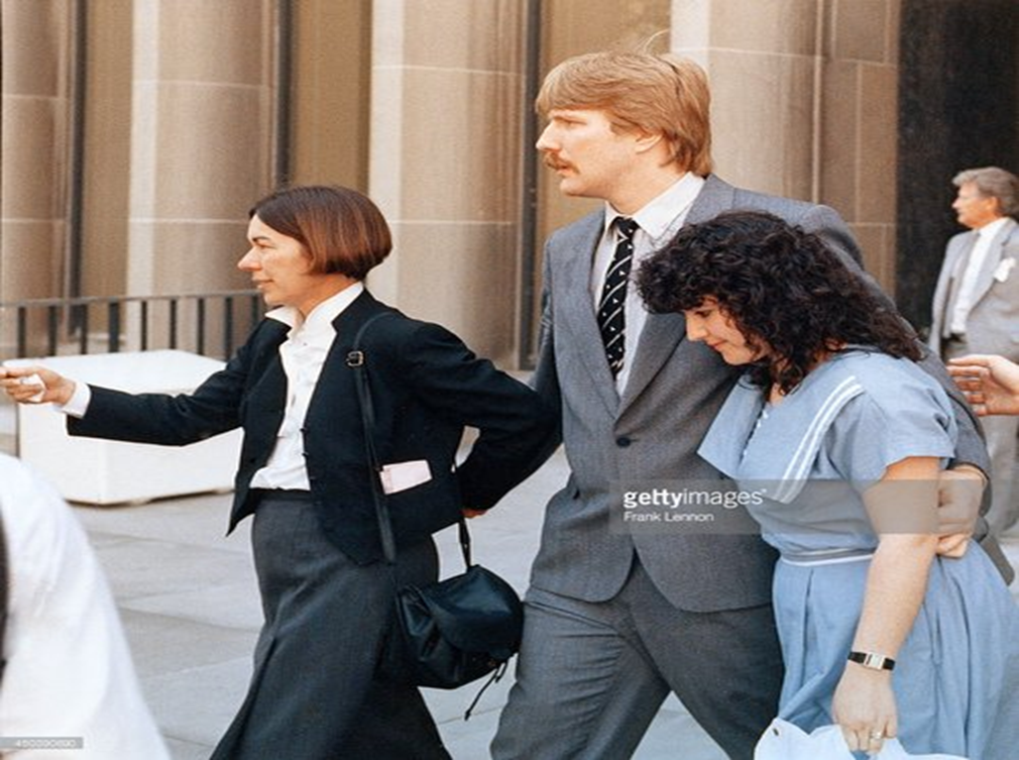
Uncertainty as regards function of consciousness: we can do a lot without it. Case of sleepwalking, sleep texting, etc.

Slide 11
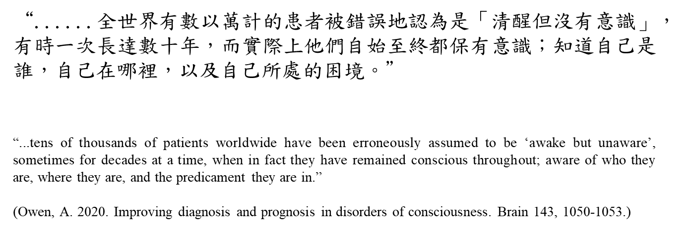
So what’s the problem that I care about?

Slide 12
https://health.ltn.com.tw/article/breakingnews/5002551
“Imagine that you are fully conscious, but your family, friends and healthcare workers all believe you are vegetative. You hear people discussing euthanasia, cessation of medical treatment, or moving you to a long-term care facility, none of which are able to monitor for signs of recovery. Illness is intrinsically terrifying, but nothing terrifies more than to be fully aware while those you love and those who decide your medical fate regard you as nothing more than an insentient collection of water, calcium and organic molecules, waiting to die. Horrified, you scream, “I’m here.” But no one hears you.”

Slide 13
How could this be?
Clinical Consensus has long been known to be unreliable, but bureaucratic inertia. Clinician’s rules-of-thumb (Admission CT, age, etiology, duration, etc.)
Use of old scales: Glasgow vs. CRS-R.
Improper use of new scales: posture, time of day, arousal, etc.
Discovery of Cognitive-Motor Dissociation: >25%/Detectable by EEG or fMRI.
Rushed into nursing home at 28 days, where invariably deteriorate.
Medications (e.g. anti-seizure meds) that inhibit recovery of consciousness.
Remember: brain is the most complex entity in the known universe.

Slide 14
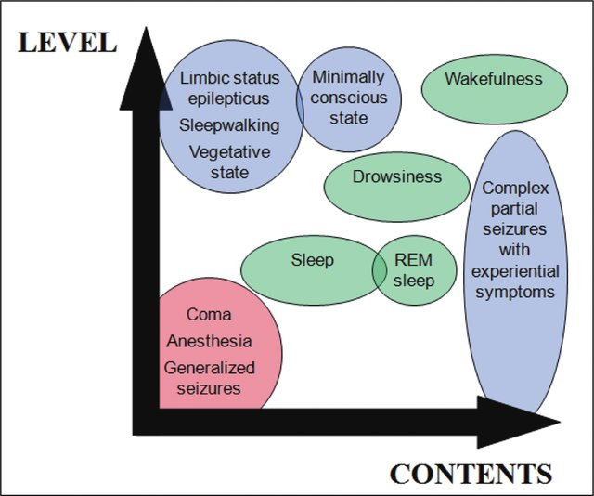

Slide 15
What are my clinical goals?
Improve Diagnosis
Improve Prognosis
Improve Therapy
Improve Quality of Life

Slide 16
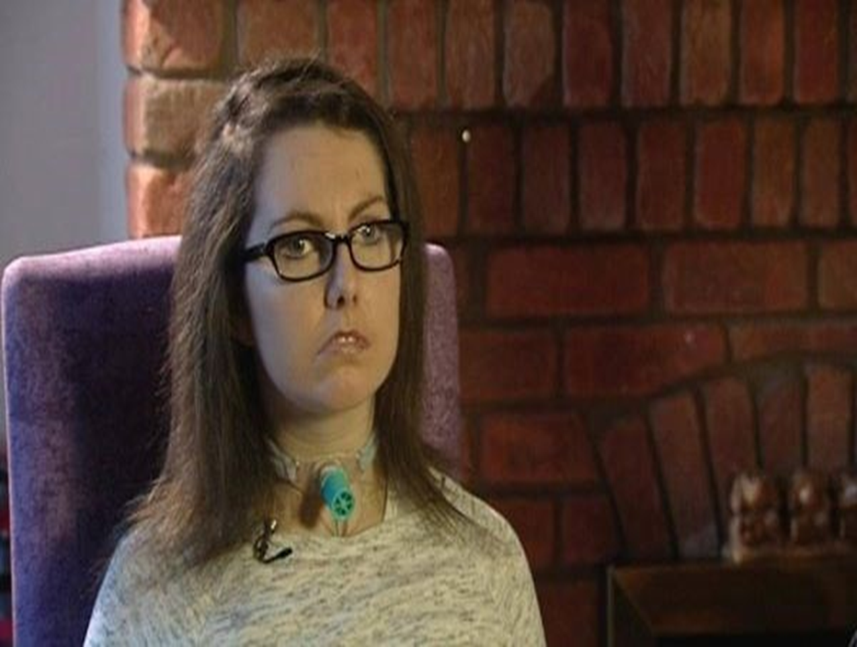
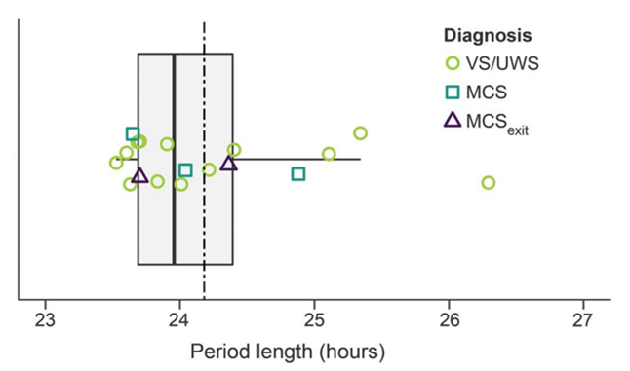
Example of misdiagnosis: Circadian Rhythms—Locked-In

Slide 17
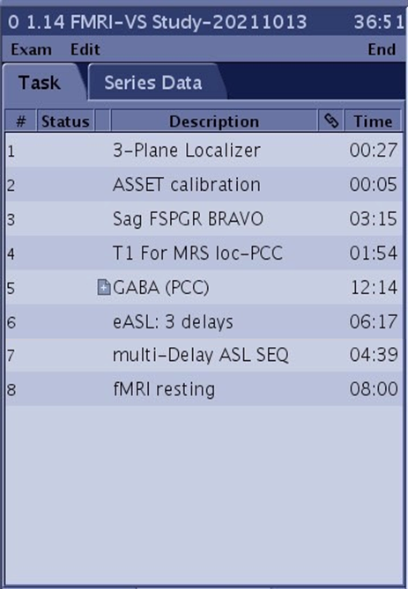
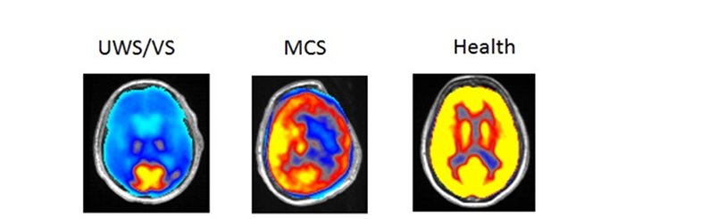
Diagnosis: Cerebral Blood Flow vs. Brain metabolism
PET for brain metapolism
Compare FDG-PET to fMRI ASL：
1. Brief, < 7 m
2. 25% of cost
3. Non-invasive
4. No radiotracer
5. Accessible
fMRI, ASL for cerebral blood flow

Slide 18
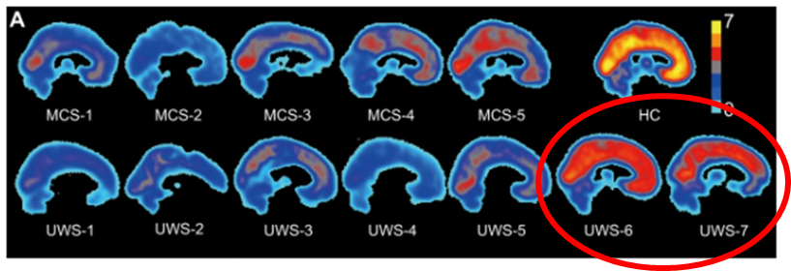
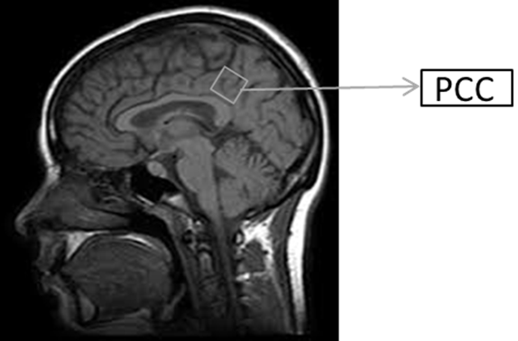
Focus on neurotransmitter, GABA-A Receptor
PET for GABA-A Receptor, accuracy。
But impractical, so search for substitute.
Use PCC-GABA：
1. Brief, <13 m.
2. Cheap.
3. No tracer or contrast.
4. Consistent with one theory of consciousness (IIT—Hot Zone)

Slide 19
Prognosis
Suppose the diagnosis is accurate.
Moved into nursing home or some similar facility, including the Genesis Foundation.
Why so fast? Hospitals don’t like “chronic” patients, because they make less money.
From the day they move out of hospital, care deteriorates, drastically. At most they occasionally see ENT or dermatology.
New methods: olfactory sniff response, work with Cambridge. Cheap, easy….promising.

Slide 20
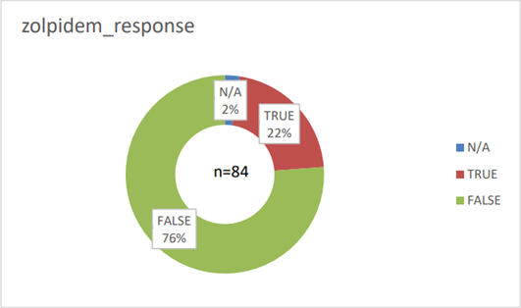
Therapies
1. Zolpidem/stilnox 10 mg
2. Double-blind (Placebo)
3. Monitor 3-4 hrs.
4. Assess with CRS-R, 15 m
5. Coheres with GABAA-receptor conjecture concerning capacity for consciousness.
A Seattle group, using zolpidem off-label, 30 mg per day, reports a 50% success rate. Because etiologies vary, varied therapeutics, precision medicine is required.

Slide 21
Quality of life
Circumvent language or gestures.
Communicate directly with the brain.
Slow, digital computer communication.
Ask daily life issues.
Restore human dignity/autonomy, their right to decide.
Families even probe existential questions.

Slide 22
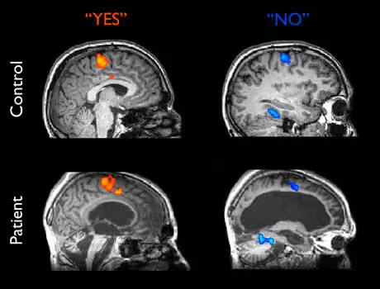
Brain imaging for communication I

Slide 23
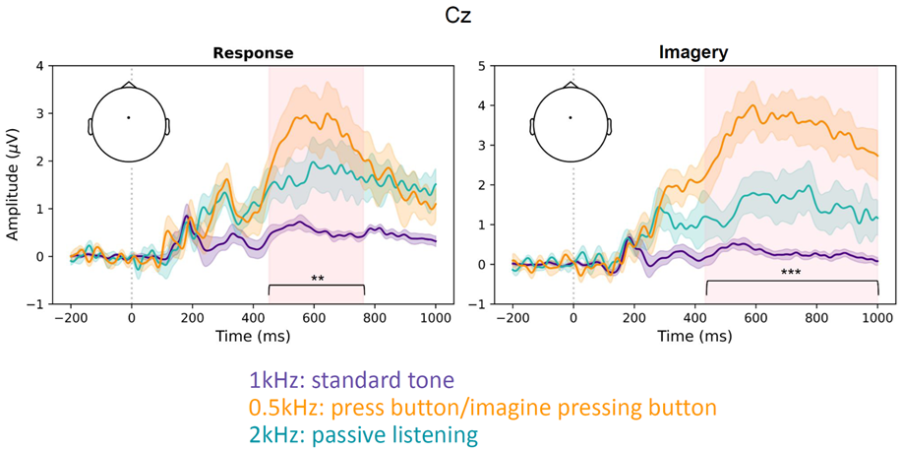
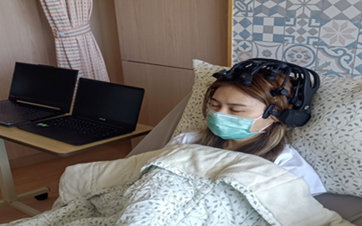
Brain Imaging for Communication II

Slide 24
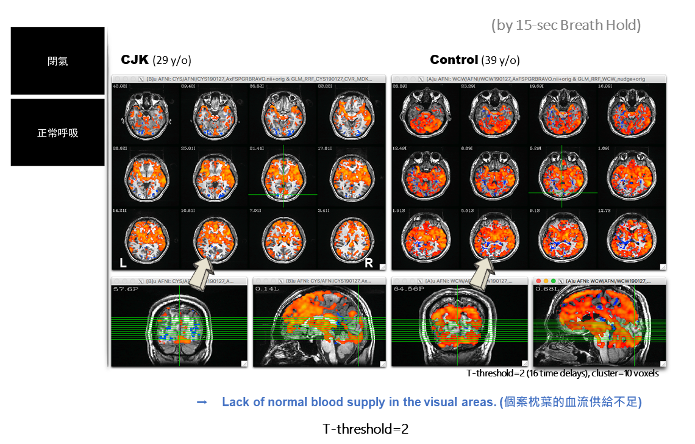
Other problems of consciousness: blindsight fMRI

Slide 25
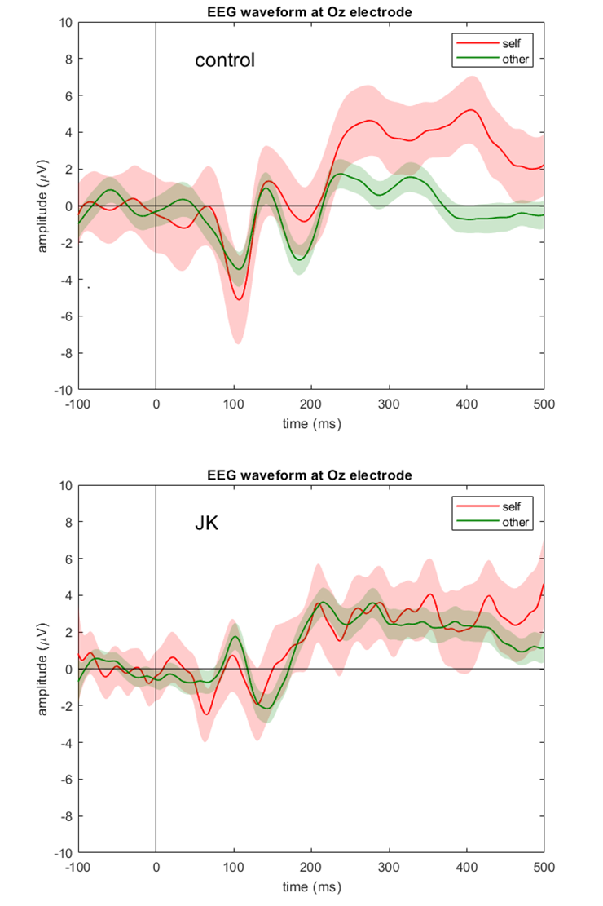
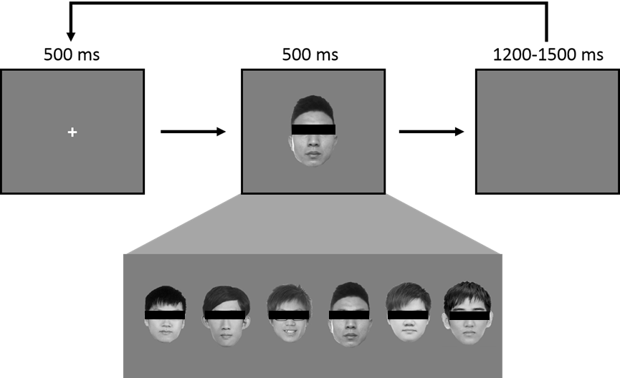
Blindsight JK ERP

Slide 26
Public Health: Prevention
Traumatic brain injury, as example.
Helmet laws already passed
But not enforced
Other two main causes: stroke and anoxia/hypoxia. NHI already does a fairly good job with these two.
Of these, anoxia/hypoxia is the most problematic, because it causes global problems and medical records unreliable.
Still, prevention is not where Pub Health can be of most help.

Slide 27
Public Health: Policy and Advocacy
But you will be asked, how many DOC patients are there?
Genesis Foundation says >30,000
MOHW says <6,000
What accounts for the difference?
This leads us back to ignorance: too much ignorance in medical circles pertaining to DOC.
Need to correct haphazard mechanism for counting.
Need to deal with bureaucratic inertia.

Slide 28
Public Health: Policy and Advocacy
But you will be told that the most important problems pertain to too few young people and too many old people.
In other words: we need to concentrate resources on cultivating the health of young people, as well as on various forms of elderly cognitive decline (I deliberately omit reference to AD or other forms of dementia).
In short: DOC is low priority.
So what can you say?

Slide 29
Public Health: Policy and Advocacy
Concentrate on what can be done without great expenditure of resources.
Collaborate with Liege Coma Science Group—don’t reinvent the wheel.
Improvements in prognosis: concentrate on olfactory response.
On diagnosis: a one-time expenditure of 25~30,000 NTD on FDG-PET is not extravagant. Hopefully, ASL for CBF, at 5~7,000 NTD can substitute.
Therapy: at least medications like amantadine and zolpidem/stilnox are not expensive and should be tried.
Concentrate in one location—research medical center conjoined with a long-term care facility. Only in this way can ensure that there will be proper follow-up after patient leaves hospital. In Taiwan would have to be NTUH, Veterans, or NCKU. Most likely NCKU, due to space and costs.
Quality of life: EEG communication with motor cortex is not expensive.

Slide 30
Public Health: Policy and Advocacy
Protect families of DOC patients from exploitation.
Currently in Taiwan stem cells (mesenchymal), Transcranial magnetic stimulation (TMS), ultrasonic scalpel, etc. all being used, without any evidence that they work.
They are used because they are not covered by NHI, so self-payment, often from families who are very poor.
Although I claim no expertise in Chinese/herbal medicines, I believe the same is true here.
Be certain to make it clear that there is no evidence whatsoever that these are effective.

Slide 31
Public Health: Policy and Advocacy
Protect the patients from abuse.
Many are abandoned by their families.
They deteriorate in long-term care facilities.
They are never given a rigorous, up-to-date, neurological assessment.
Provider-centered care is the norm—e.g. giving sedatives to make patients easier to care for, while at the same time inhibiting recovery.
Be aware that currently, not even one long-term care facility provides proper care for DOC patients. The best of them are nothing more than a greenhouse.
Only the wealthy can provide adequate care.

Slide 32
Public Health: Research
Distinguish Social from Scientific Problems.
We waste exorbitant amounts of NSTC, MOHW, MOE, etc. funds every year because proposed research is tied to a social problem. In other words, it appears to be important.
But we vastly overfund bad research, simply because it claims to be about children or old people. (Of course not only brain-related resources.)
In other words, already wasting resources that could be redirected to DOC.
Not only do we need to be careful with anything diagnosed by DSM-V (e.g. ADHD), we also need to exercise caution in expenditures on neurodegenerative problems, like Alzheimer’s Disease (e.g. beta-amyloid plaque). Even General Anesthesia…..
But striking a delicate, diplomatic balance, obviously not easy. Current referee system is defective.

Slide 33
Public Health: distribution of and competition over resources
Pragmatic-Idealism
Ideal is improve diagnosis, prognosis, therapy, and neuroimaging communication with brain?
Pragmatic: How much can we really achieve here, on our own, and how to minimize fights with other interest groups over competition for scarce resources.
In the end, need at least one person who Is relentless.
Are there additional reasons to convert some existing resources to DOC?

Slide 34
Public Health: Ethics and Human Rights
We already know that the rate of misdiagnosis is high, prognosis cannot be done within 28 days, therapy lags behind international standards, and follow-up care is non-existent.
Bluntly: many conscious patients treated as insentient “vegetables”.
This means we are depriving them of human rights.
Maybe 10 years ago ignorance was an excuse; today it is no longer an excuse.
There is a compelling ethical reason to at minimum expend resources to identify those who are covertly conscious. (Kantian, not Utilitarian Ethics)
A harsh truth: many UWS patients stronger claim to personhood than AD patients. But AD patients treated far better. How to apply triage?

Slide 35
Public Health: public education and lobbying
Among other things, severe cognitive decline increasingly appears to be the result of lowered level of consciousness.
In other words, by focusing on consciousness we are getting at the root cause. Cognitive decline is a symptom of diminished consciousness.
The same might be true for depression—it may turn out to be severely altered level of consciousness.
What we are certain of is that consciousness is always listed as one among the top two or three most difficult problems in science.
Great nations take on great challenges.
Is Taiwan’s future just semi-conductors?

Slide 36
“You, your joys and your sorrows, your memories and your ambitions, your sense of personal identity and free will, are in fact no more than the behavior of a vast assembly of nerve cells and their associated molecules.”
Francis Crick

