Slide 1
Ecological Study
A study in which the units of analysis are populations or groups of people, rather than individuals. An example is the study of association between median income and cancer mortality rates in administrative jurisdictions such as states and countries. (John M. Last. A Dictionary of Epidemiology (4th edition). A handbook sponsored by the I.E.A., 2001, p. 57)

Slide 2
Some Examples

Slide 3
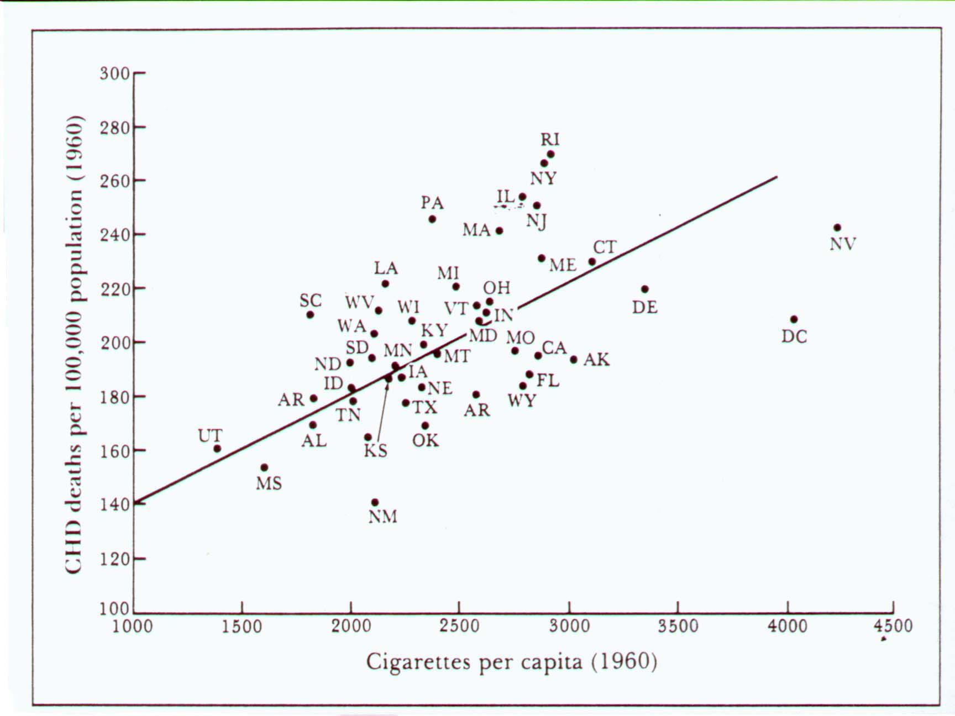

Slide 4
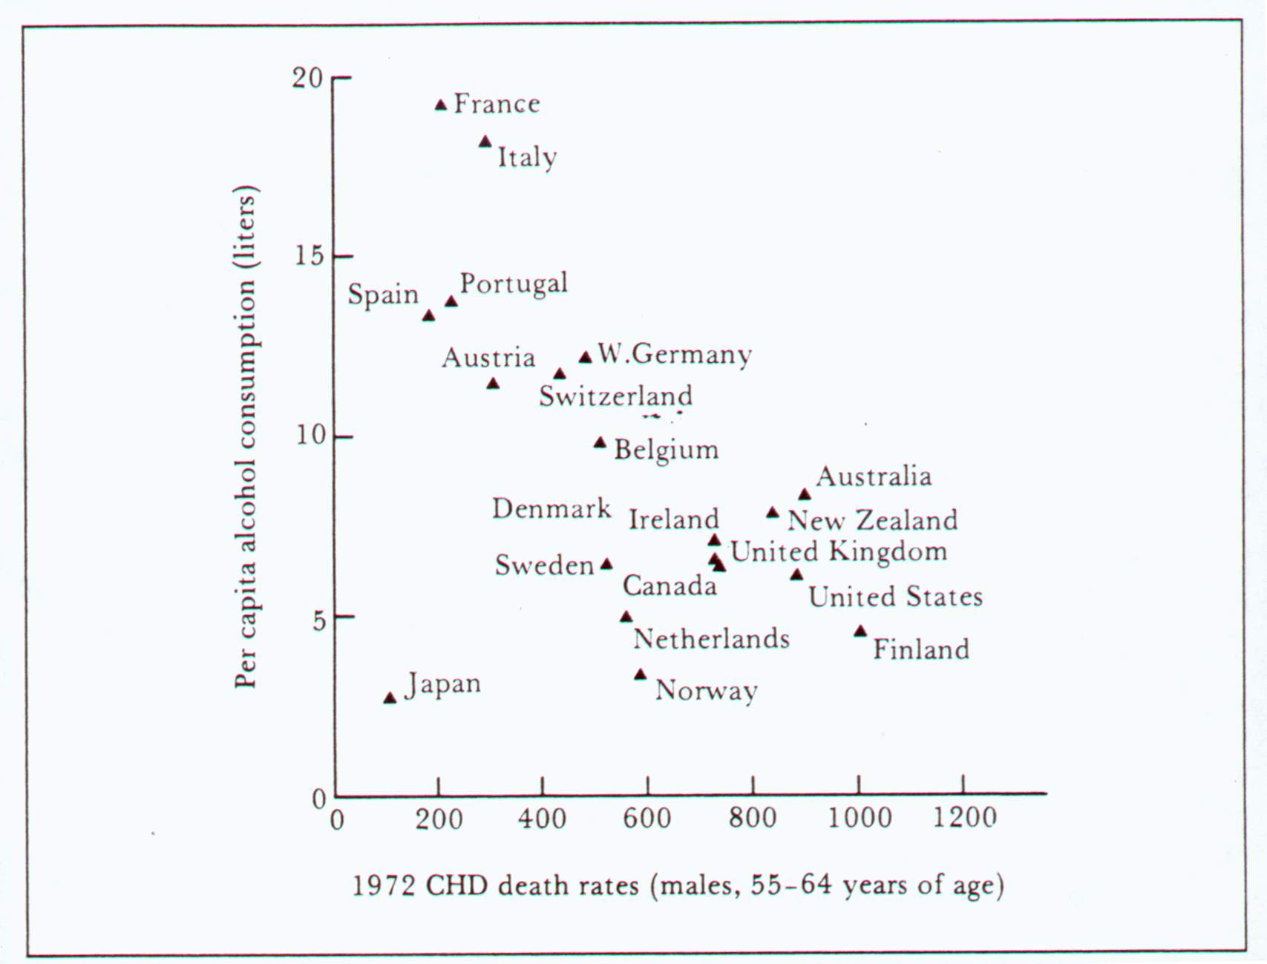

Slide 5
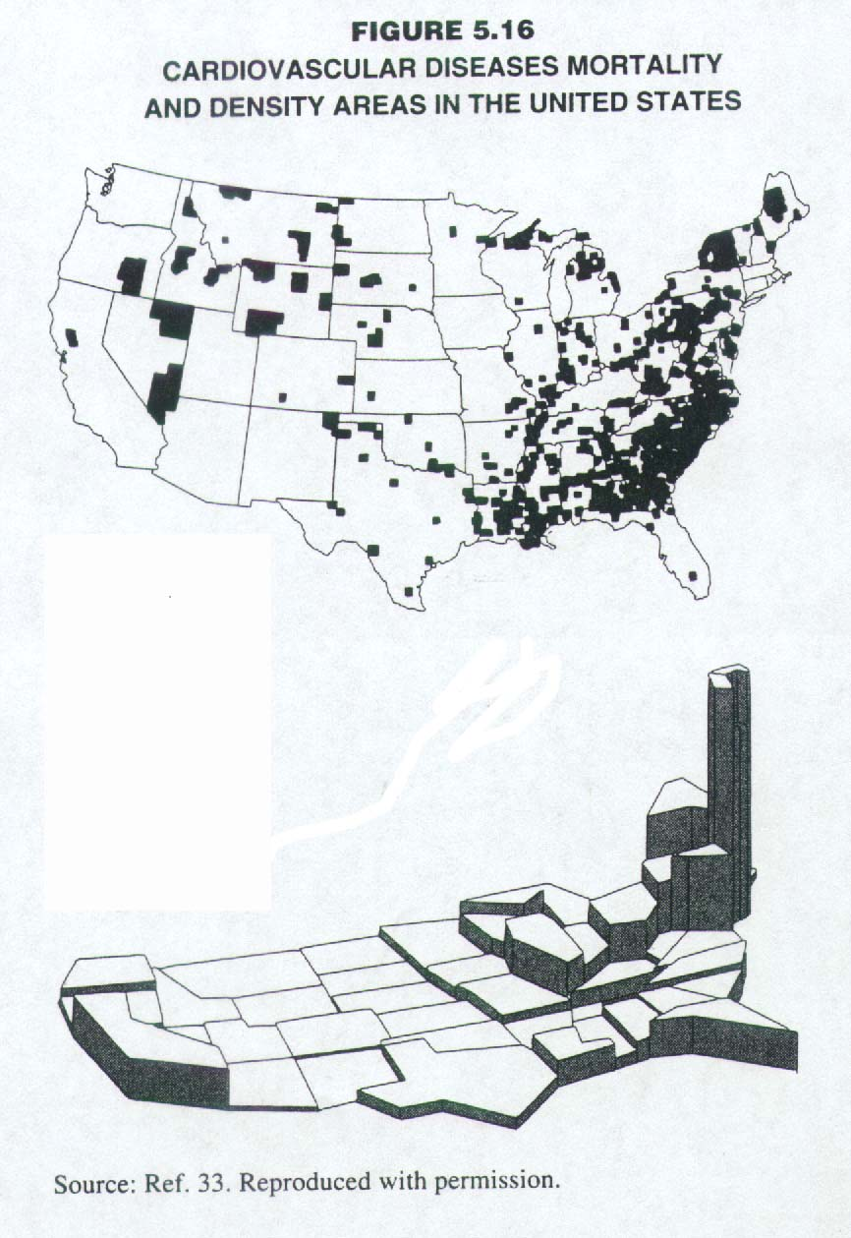

Slide 6
Ecological Fallacy
Syn: aggregation bias, ecological bias
This bias that may occur because an association observed between variables on an aggregate level does not necessarily represent the association that exists at an individual level. (John M. Last. A Dictionary of Epidemiology (4th edition). A handbook sponsored by the I.E.A., 2001, pp. 56-57)

Slide 7
An Example Demonstrating The “Ecology Fallacy”

Slide 8
A Cross-sectional Survey in Taipei
Sick
Well
Total
High Exp
10
90
100
Low Exp
90
810
900
Total
100
900
1000
Prevalence Rate Ratio（PRR）=（10/100）÷（90/900）＝1
Proportion of subjects with high exposure（X）＝100/1000＝0.1
Proportion of sick subjects（Y）＝100/1000＝0.1

Slide 9
A Cross-sectional Survey in Taichung
Sick
Well
Total
High Exp
45
255
300
Low Exp
105
595
700
Total
150
850
1000
Prevalence Rate Ratio（PRR）=（45/300）÷（105/700）＝1
Proportion of subjects with high exposure （X）＝300/1000＝0.3
Proportion of sick subjects （Y）＝150/1000＝0.15

Slide 10
A Cross-sectional Survey in Kaohsiung
Sick
Well
Total
High Exp
100
400
500
Low Exp
100
400
500
Total
200
800
1000
Prevalence Rate Ratio （PRR）=（100/500）÷（100/500）＝1
Proportion of subjects with high exposure （X）＝500/1000＝0.5
Proportion of sick subjects （Y）＝200/1000＝0.2

Slide 11
An Ecological Correlation Was Noted between Higher Exposure and Prevalence of Getting Sick
Taichung
Kaohsiung
Taipei

Slide 13
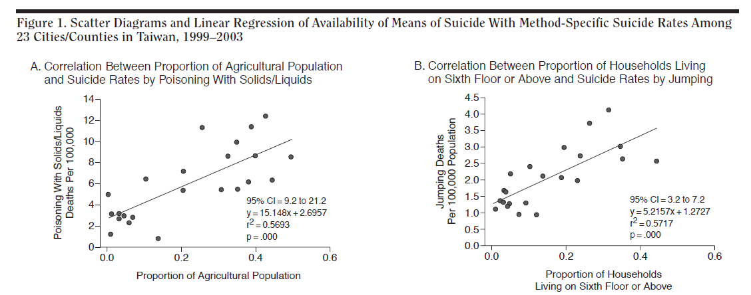
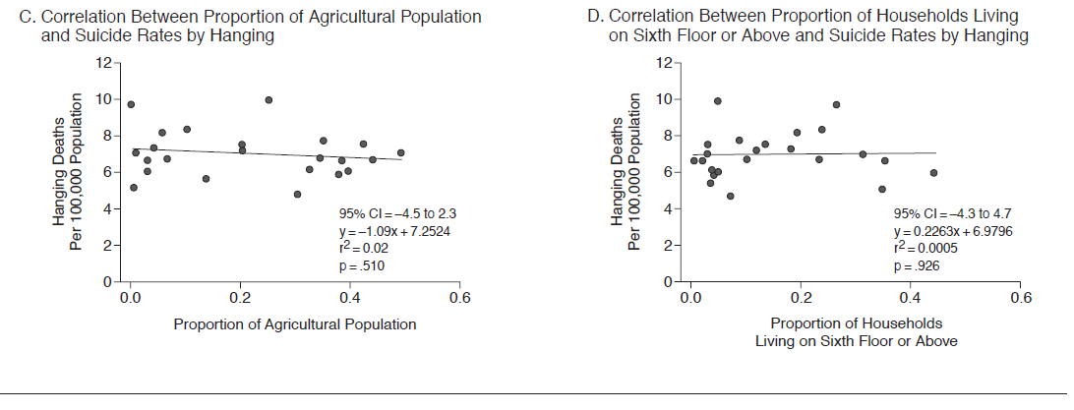

Slide 14
Interpretations
Based on city/county level:
A city/county with higher density of high rise tends to have higher rate of death by suicidal jump. ✓
Based on individual level:
People lived in a city/county with higher density of high rise are at higher risk of death by suicidal jump. ???

